Slide 1

Space activities at
Charles University
1348 – founded by Charles IV as the first university north of Alps
now – 17 faculties teach more than 50 000 students,
space activities are concentrated at Faculty of Mathematics and Physics and Faculty of Natural Sciences
1967 - space activities starts in frame of the INTERCOSMOS initiative
1970 – launch of Intercosmos 3 satellite with PG-1 apparatus
2006 – first project (Bepi Colombo) in frame of the ESA PECS initiative granted to MFF
2018 – successful launch of the Bepi Colombo mission
Notes:
1

Slide 2

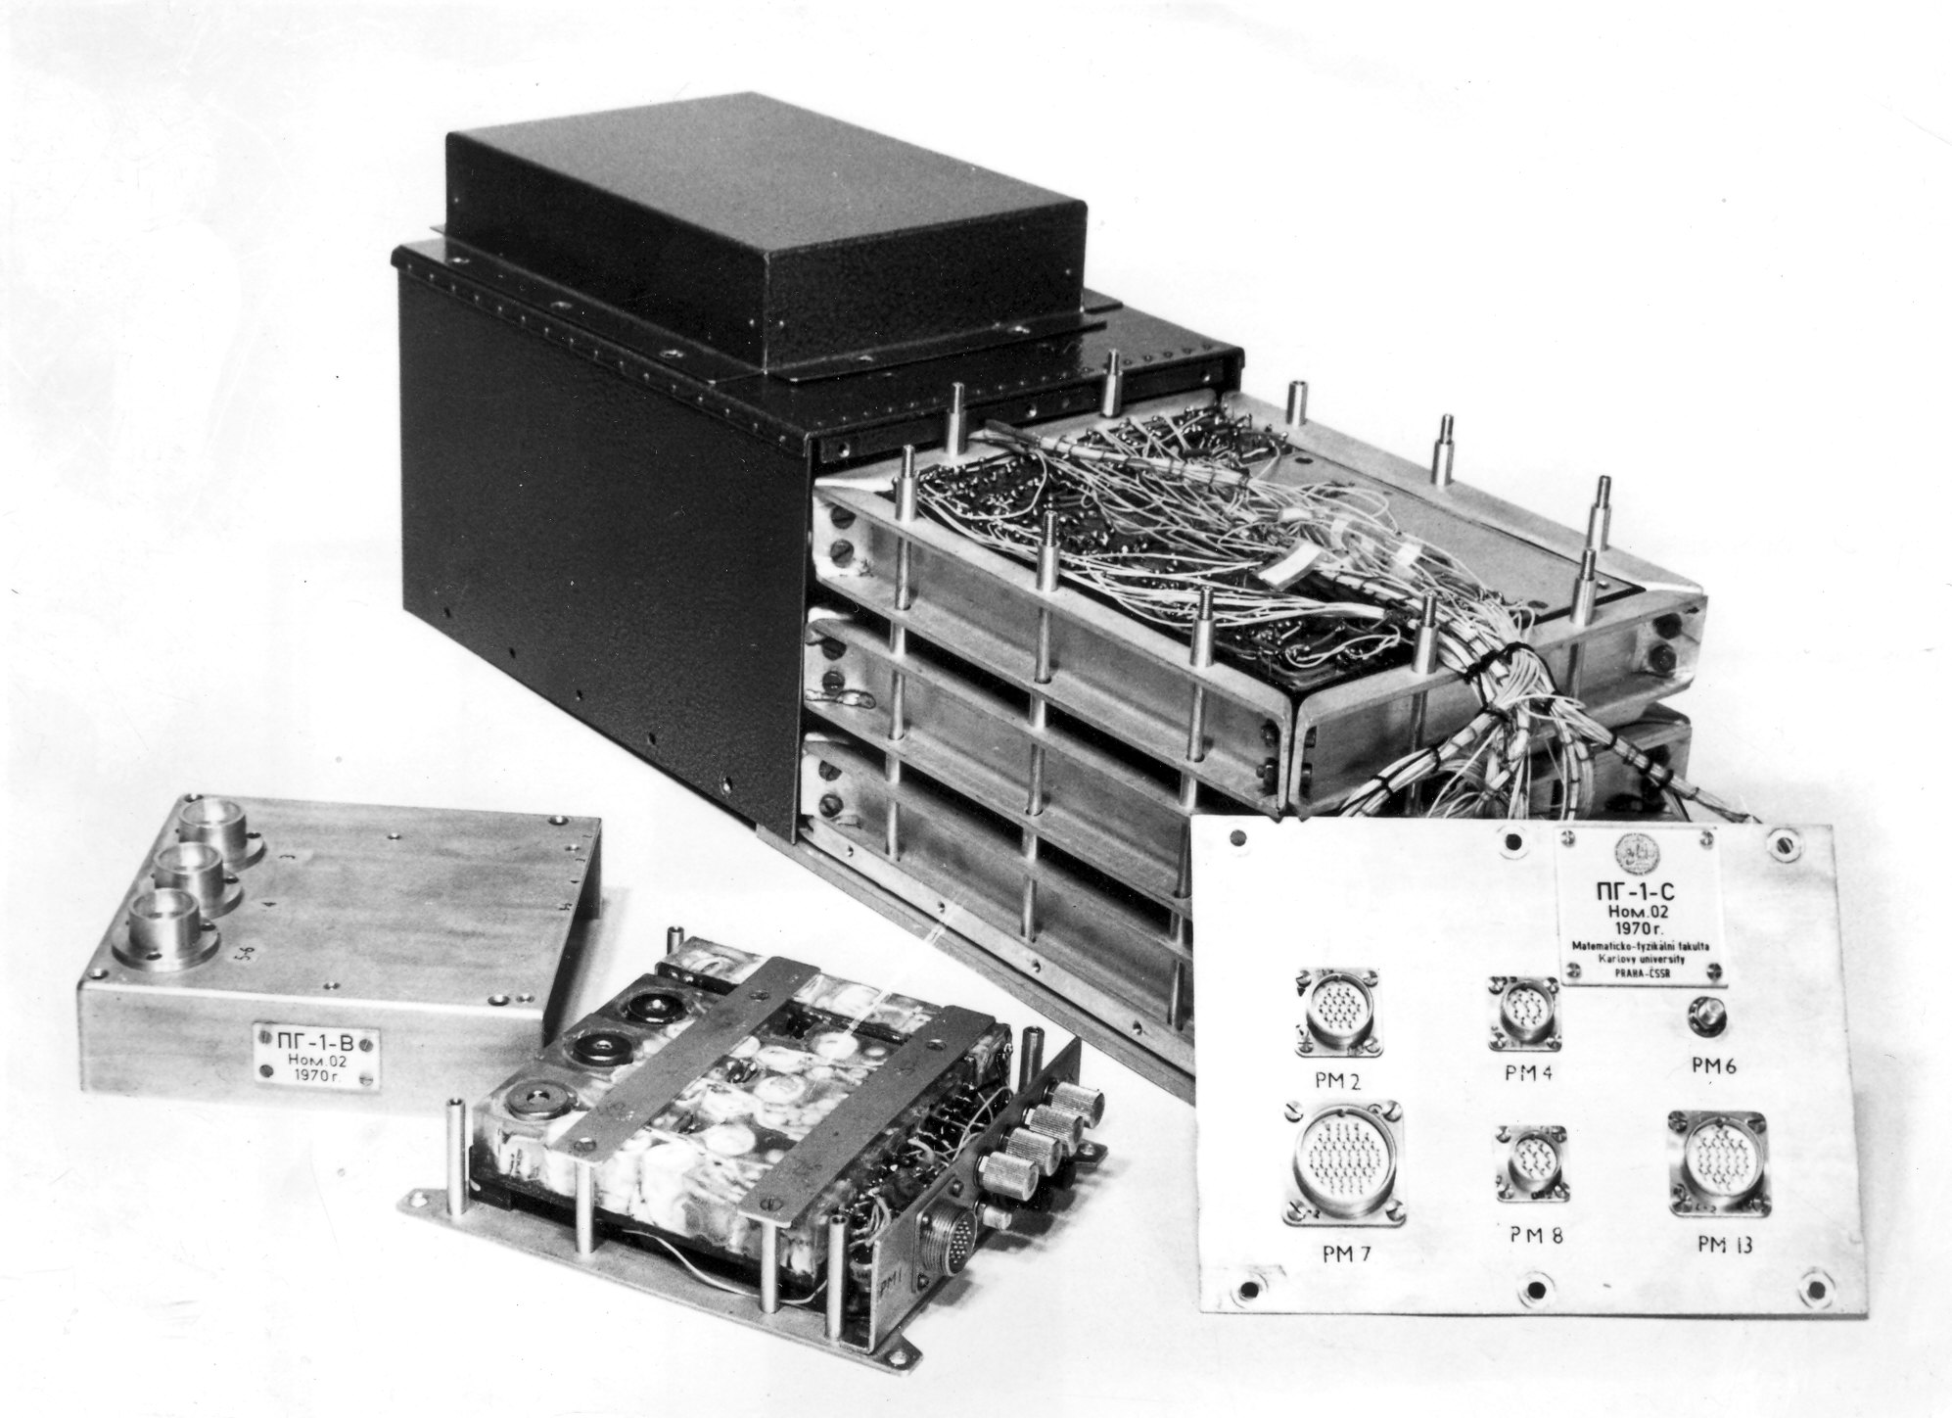
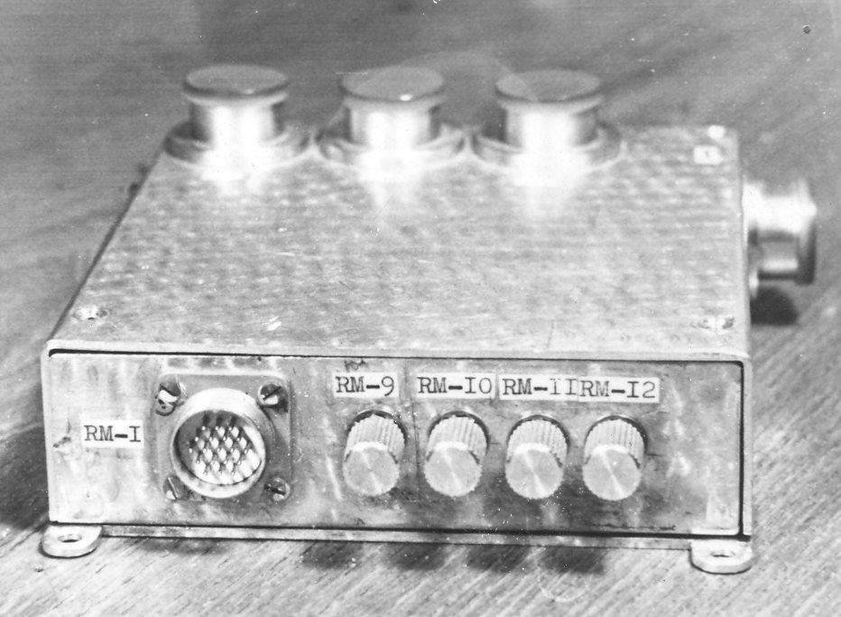
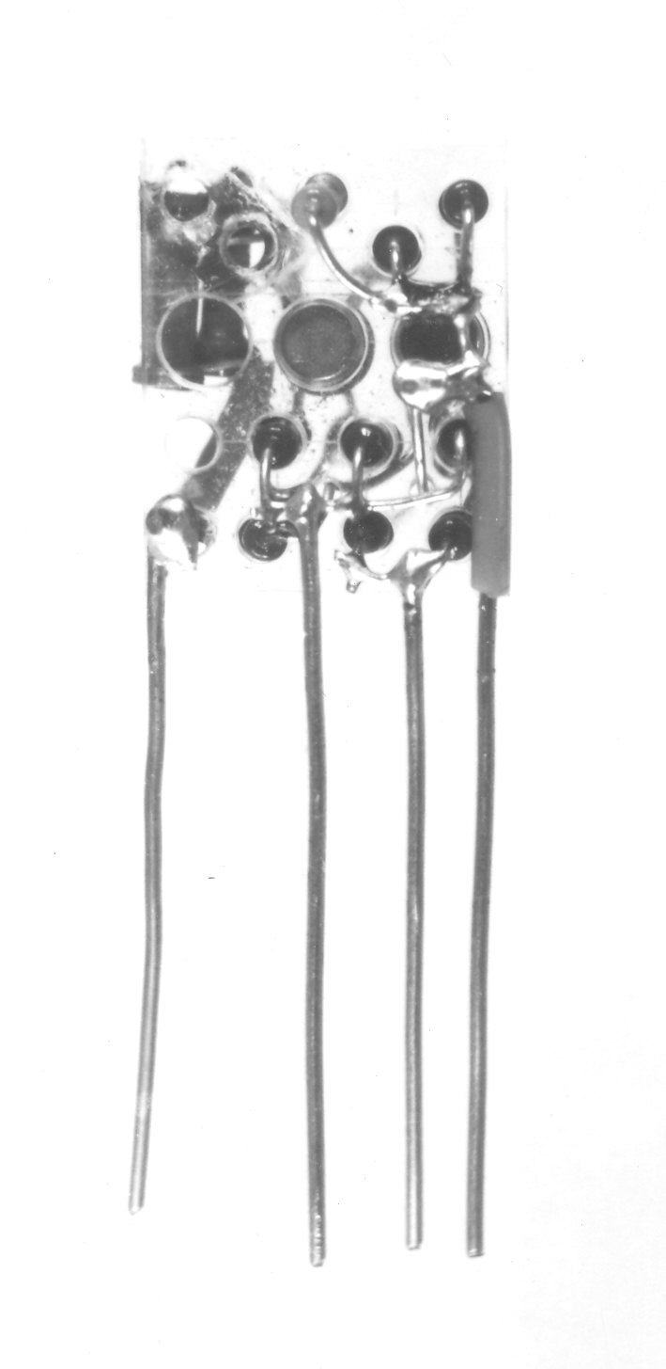
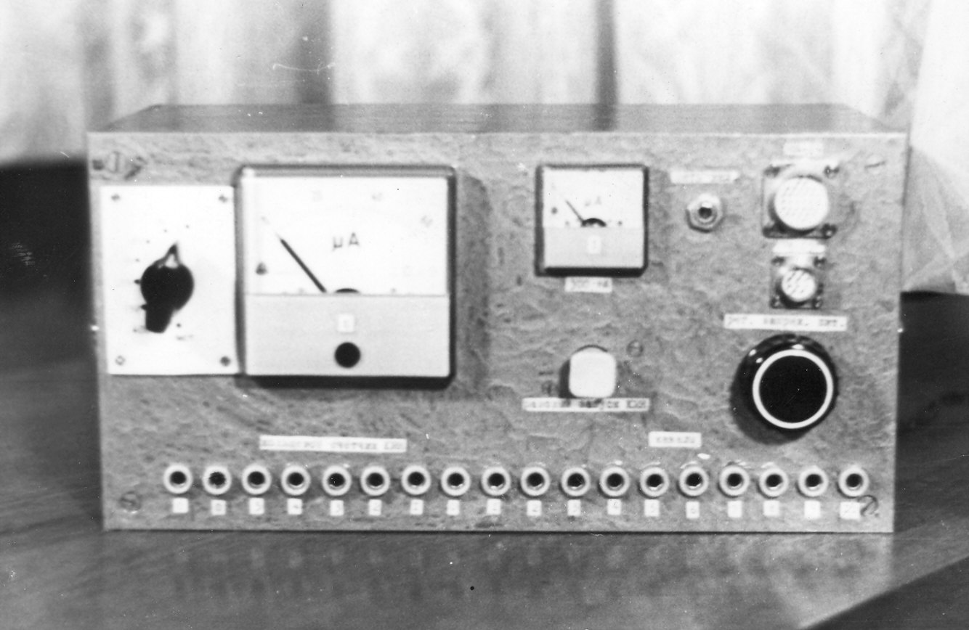
First experiment in space
1970 - PG-1 for investigation of radiation belts, Interkosmos 3 satellite
Semiconductor detectors
Electronics
Detail of design
Follow-up missions
Interkosmos 5, 1971; PG1A
Interkosmos 13, 1973, PG1B, EMA
Interkosmos 17, 1975, ESA
Russian national program
Prognoz 7, 1978, PEAS
Prognoz 8, 1980, Monitor
GSE
Notes:
1

Slide 3
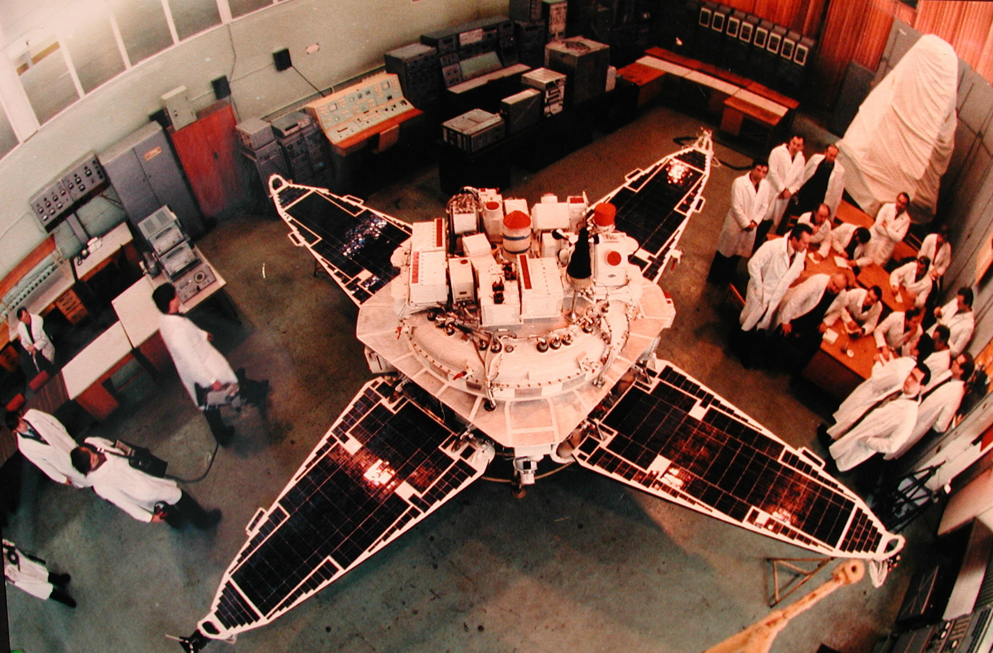
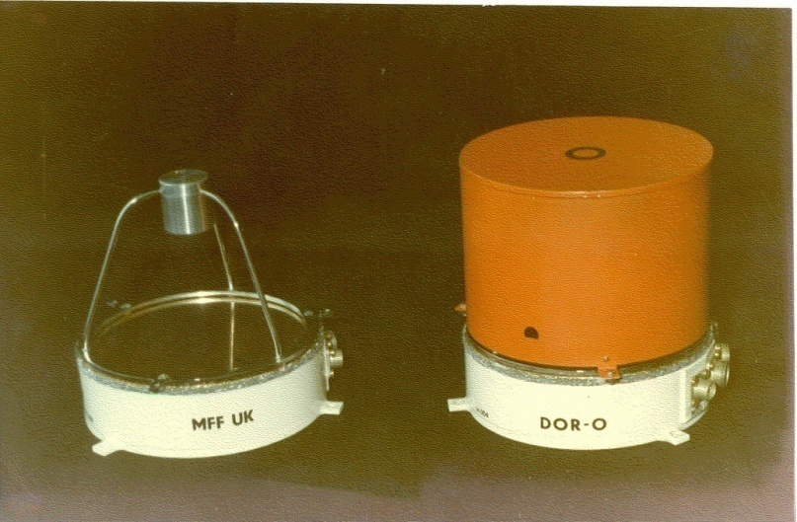
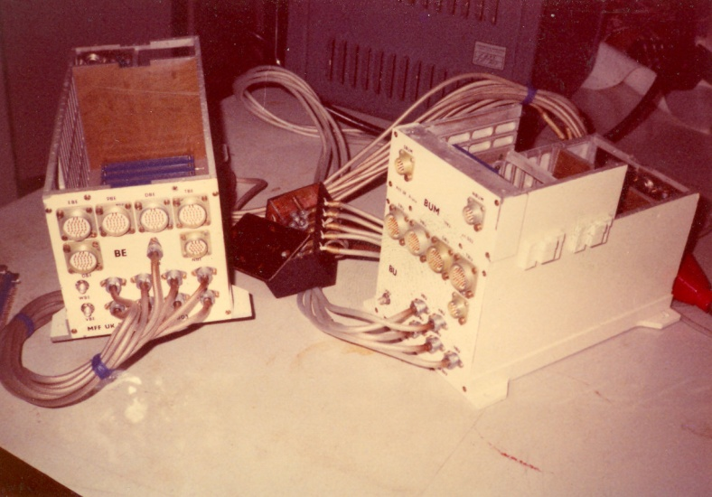
INTERSHOCK project - 1985
Largest space project, MFF UK developed a great majority of the scientific payload
Investigation of the bow shock formation
BIFRAM – Solar wind complex
AKME – Mid-energy ions
DOR – High-energy electrons
BROD – Central processor unit
TP 3 – High-energy ions
Notes:
1

Slide 4
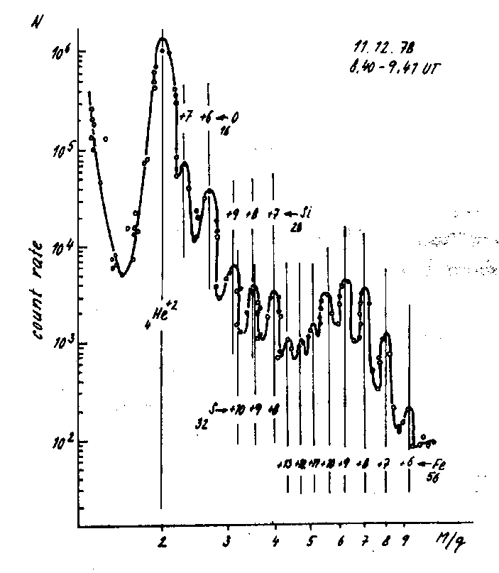
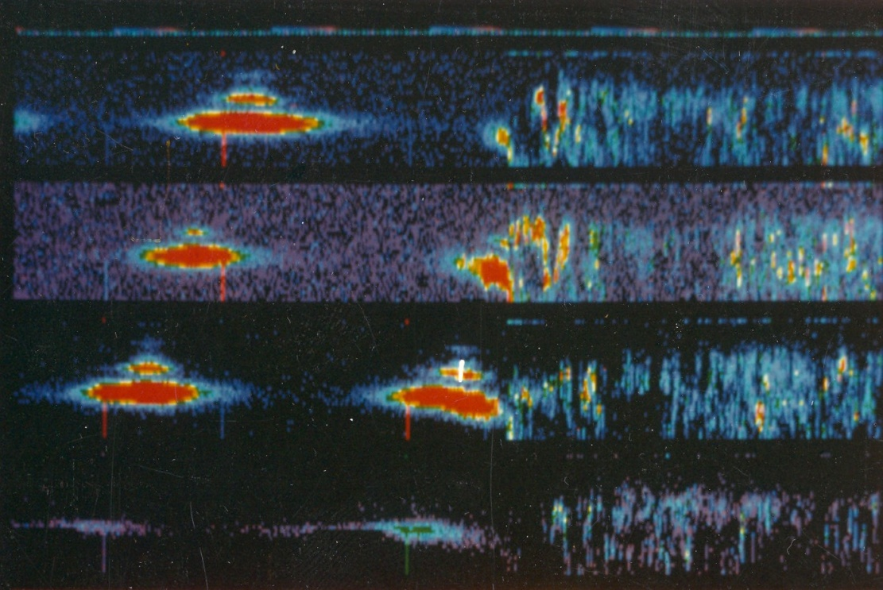
INTERSHOCK project - 1985
Evolution of the ion distribution across the bow shock with 0.6 s time resolution. Better resolution achieved in 2016 by MMS mission
Precise determination of the cross-shock potential - alphas used as test particles
The mass composition of the solar wind
Notes:
1

Slide 5
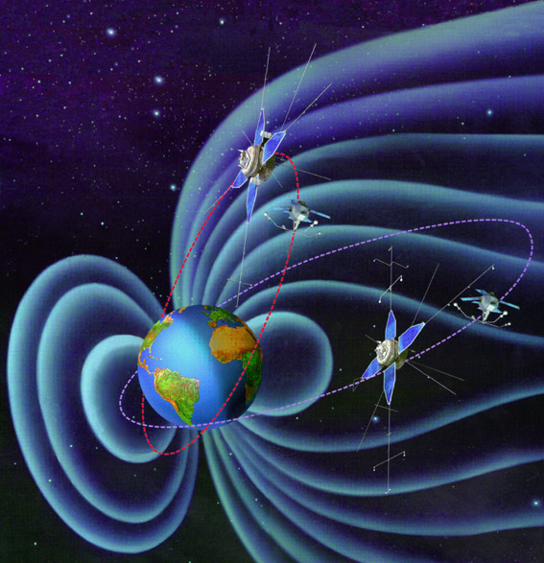
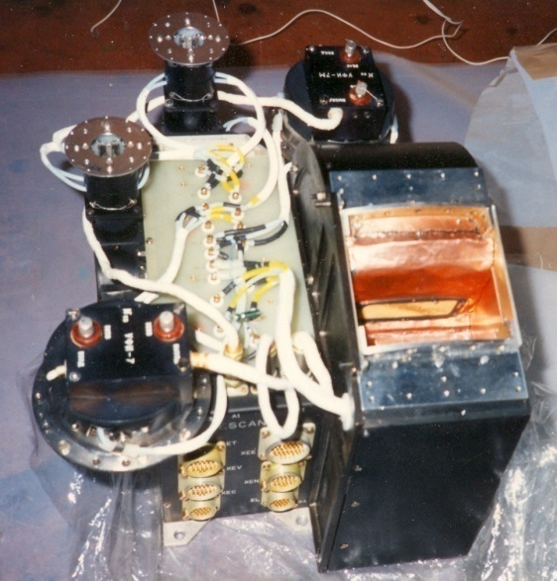
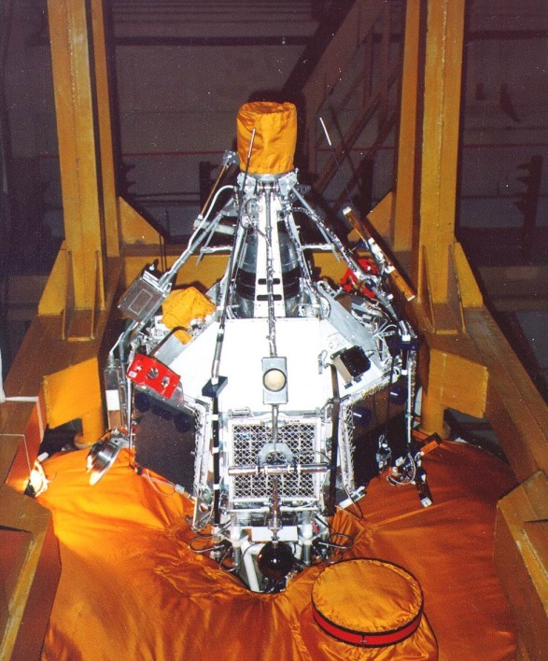
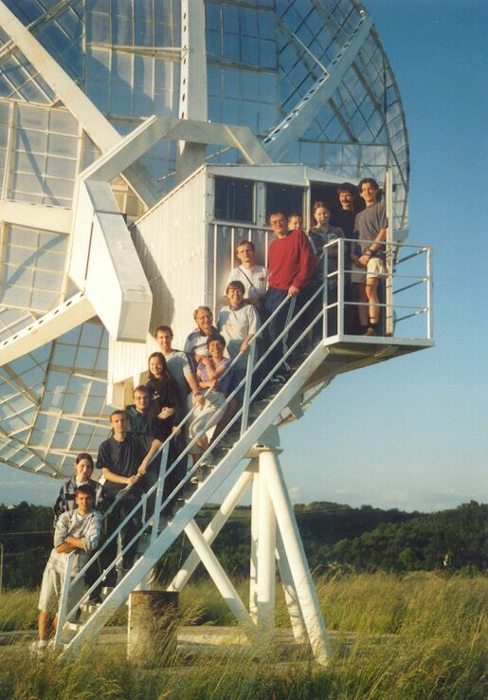
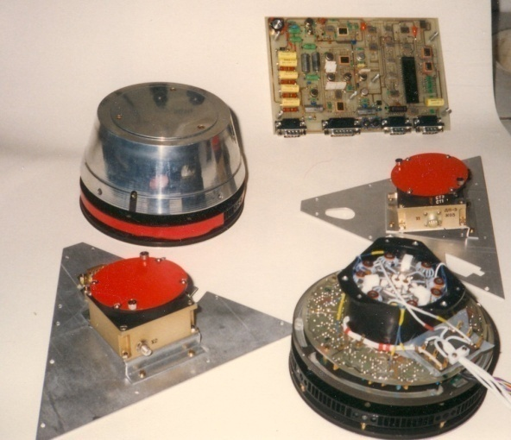
INTERBALL project - 1995-96
First coordinate measurements of 4 spacecraft
Investigation of the Solar wind – magnetosphere coupling
Interball-1/Magion-4
August 03, 1995;
apogee – 200 000 km
period – 92 hours
Interball-2/Magion-5
August 29, 1996;
apogee – 20 000 km
period – 6 hours
Notes:
1

Slide 6
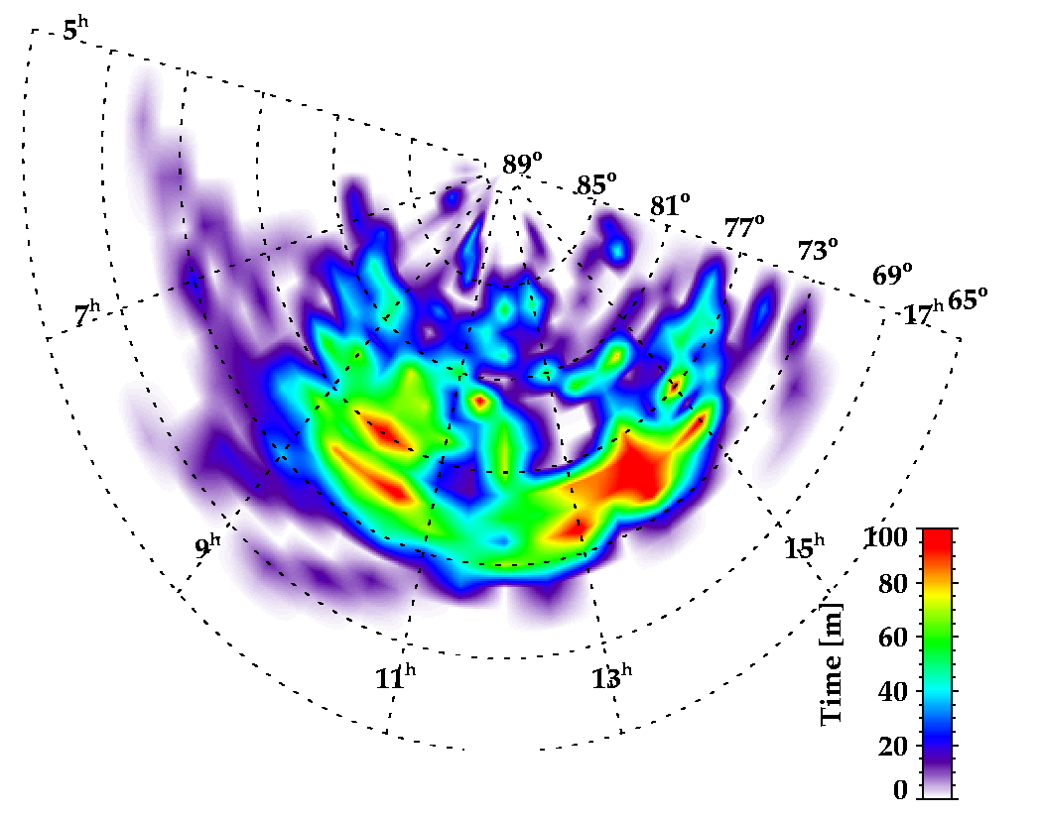
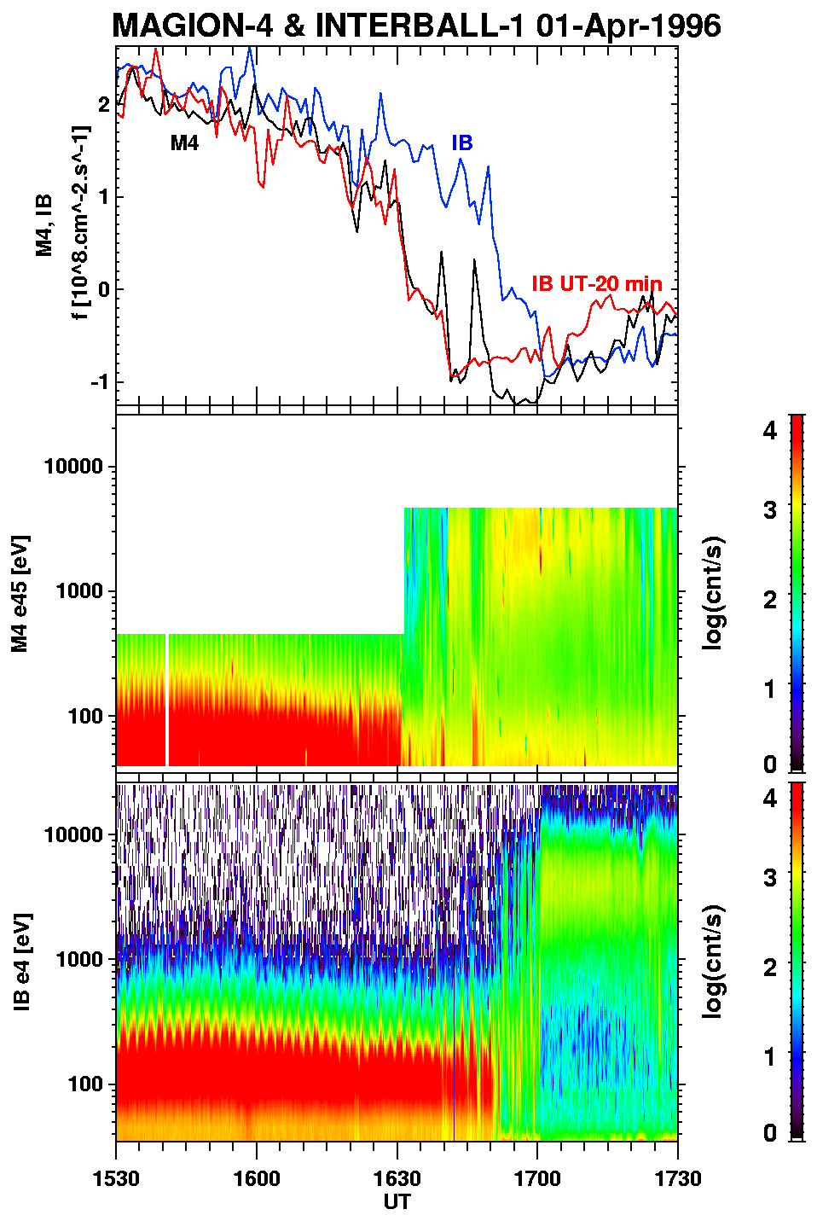
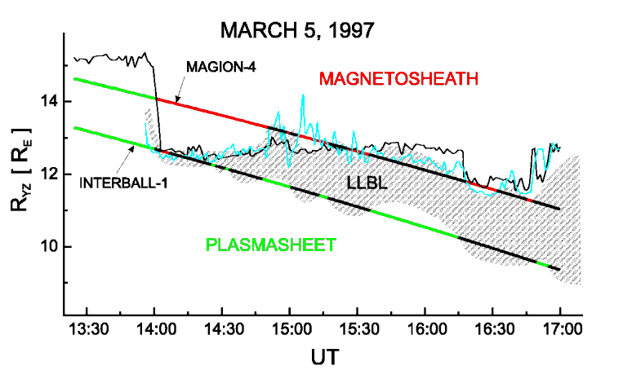
INTERBALL – LLBL structure
Two-point observation of the LLBL, possibility of determination of the spatial structure
Study of the structure of the high-altitude cusp
Měrka et al. (2002)
Šafránková et al. (2002, 2007)
Notes:
1

Slide 7
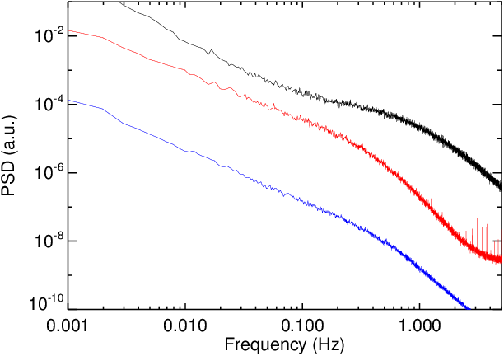
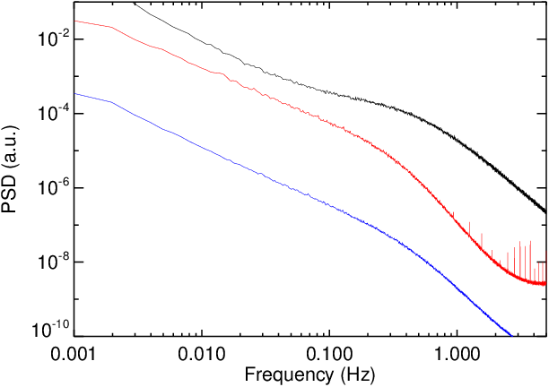
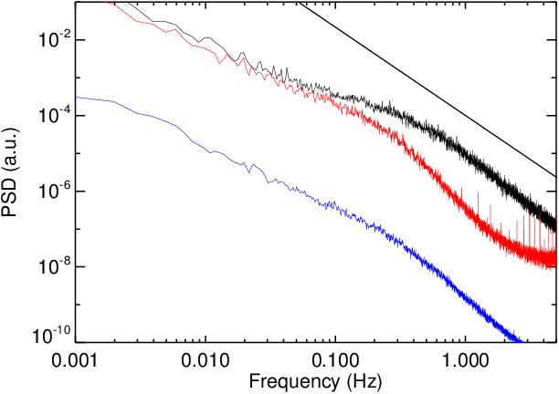
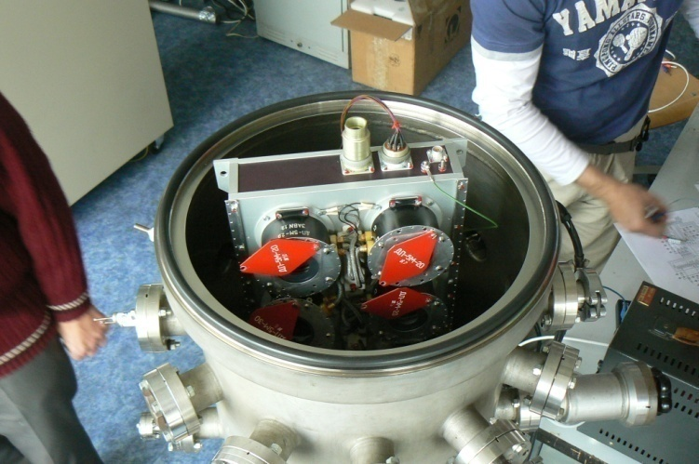
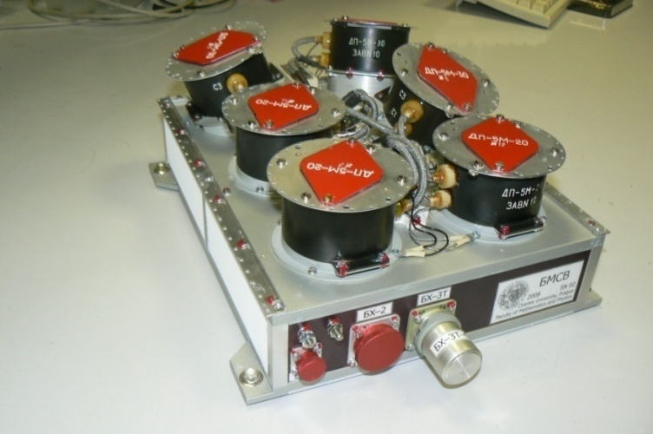
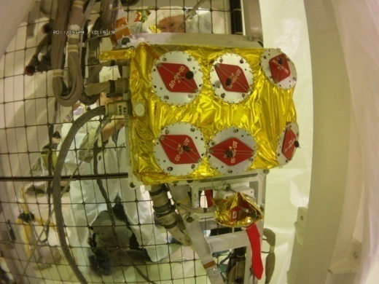
2011: BMSW onboard Spektr-R
Bright Monitor of the Solar Wind
Measurements of the solar wind velocity, density and temperature with time resolution of 30 ms
First observation of the ion turbulence at kinetic scale
- 7/3
- 7/3
- 7/3
- 5/3
-5/3
-5/3
- 3,8
N
V
B
- 4
- 4,2
N
V
B
N
V
B
Low beta
- 3,5
Middle beta
- 3,5
High beta
- 3,5
Notes:
1

Slide 8
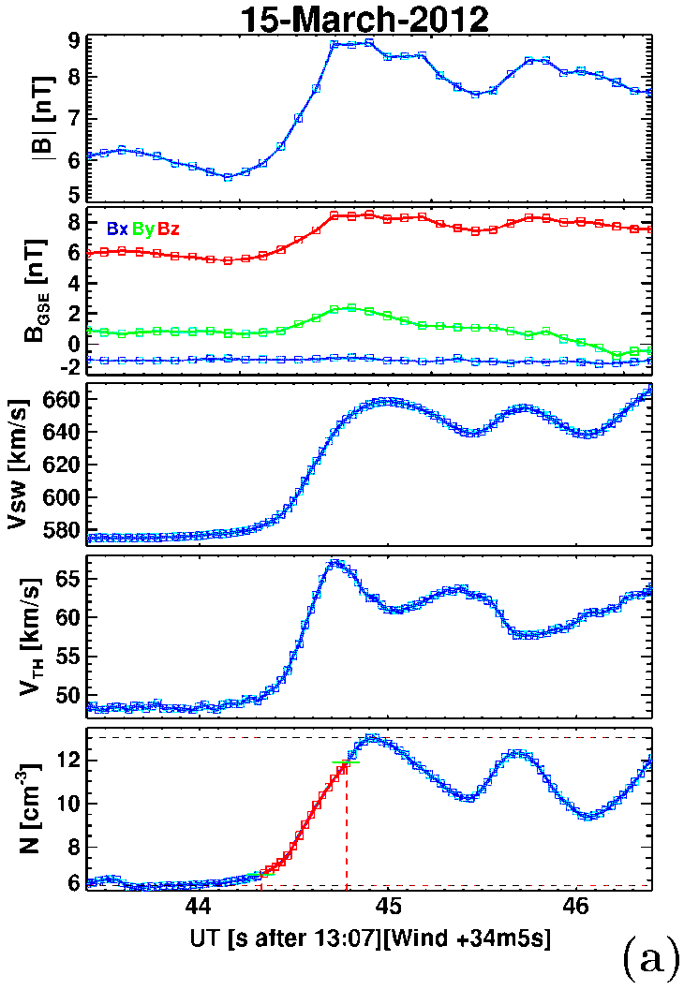
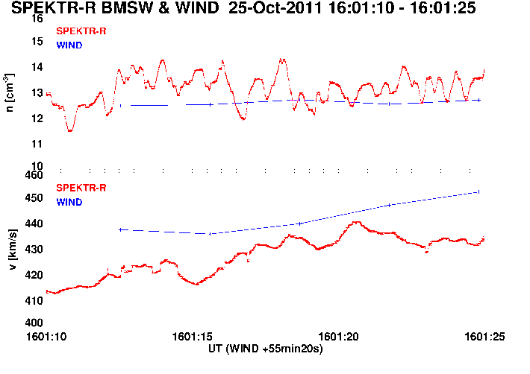
2011: BMSW onboard Spektr-R
Investigation of the interplanetary shocks
Ion ramp structure
Waves associated with the shock
A comparison of the fastest measurements of solar wind parameters prior to (blue) and after Spektr-R launch (red)
Nemecek et al. (2013), Goncharov et al. (2014, 2016)
Notes:
1

Slide 9
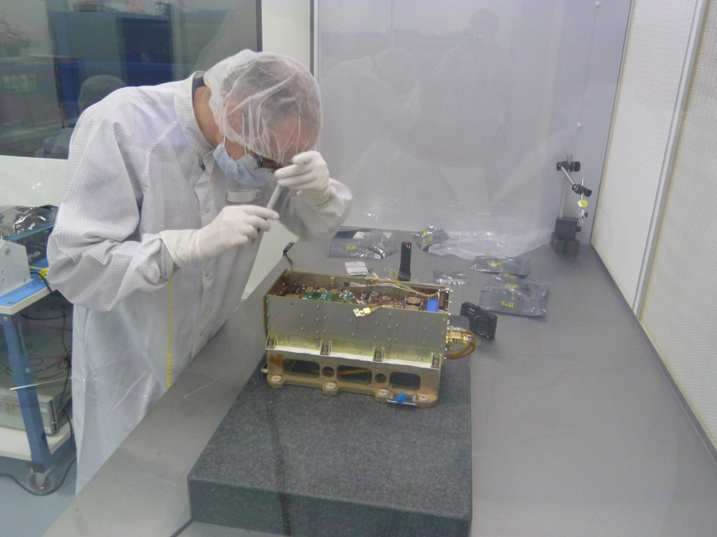
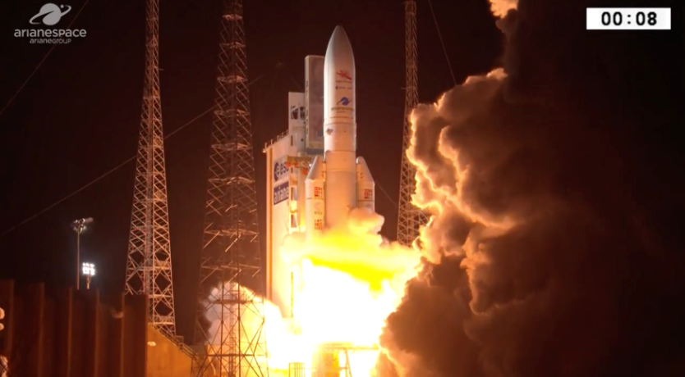
Future ESA missions
Ion spectrometer for Bepi Colombo mission towards Mercury
Contribution to ground segment
Spacecraft launched successfully, first data expected in five years
Ion spectrometer for Solar Orbiter mission
Development of the front-end electronics
Financed partly via Czech PRODEX
Notes:
1

Slide 10
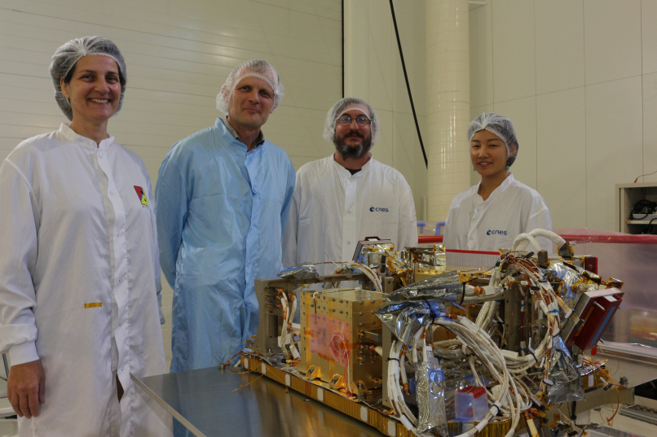
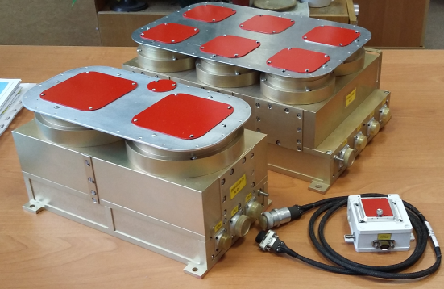
Future non-ESA missions
Detector of run away electrons in sprites for the French TARANIS mission
Fast processor unit and onboard software
Fully financed by Charles University
Expected launch 2019
Fast solar wind monitor BMSW-LG for Russian Lunar orbiter (Luna Resurs)
Full design, Faraday cups provided by Space Research Institute
Financed partly via Czech PRODEX
Expected launch 2022
BMSW-LG STM
Notes:
1

Slide 11
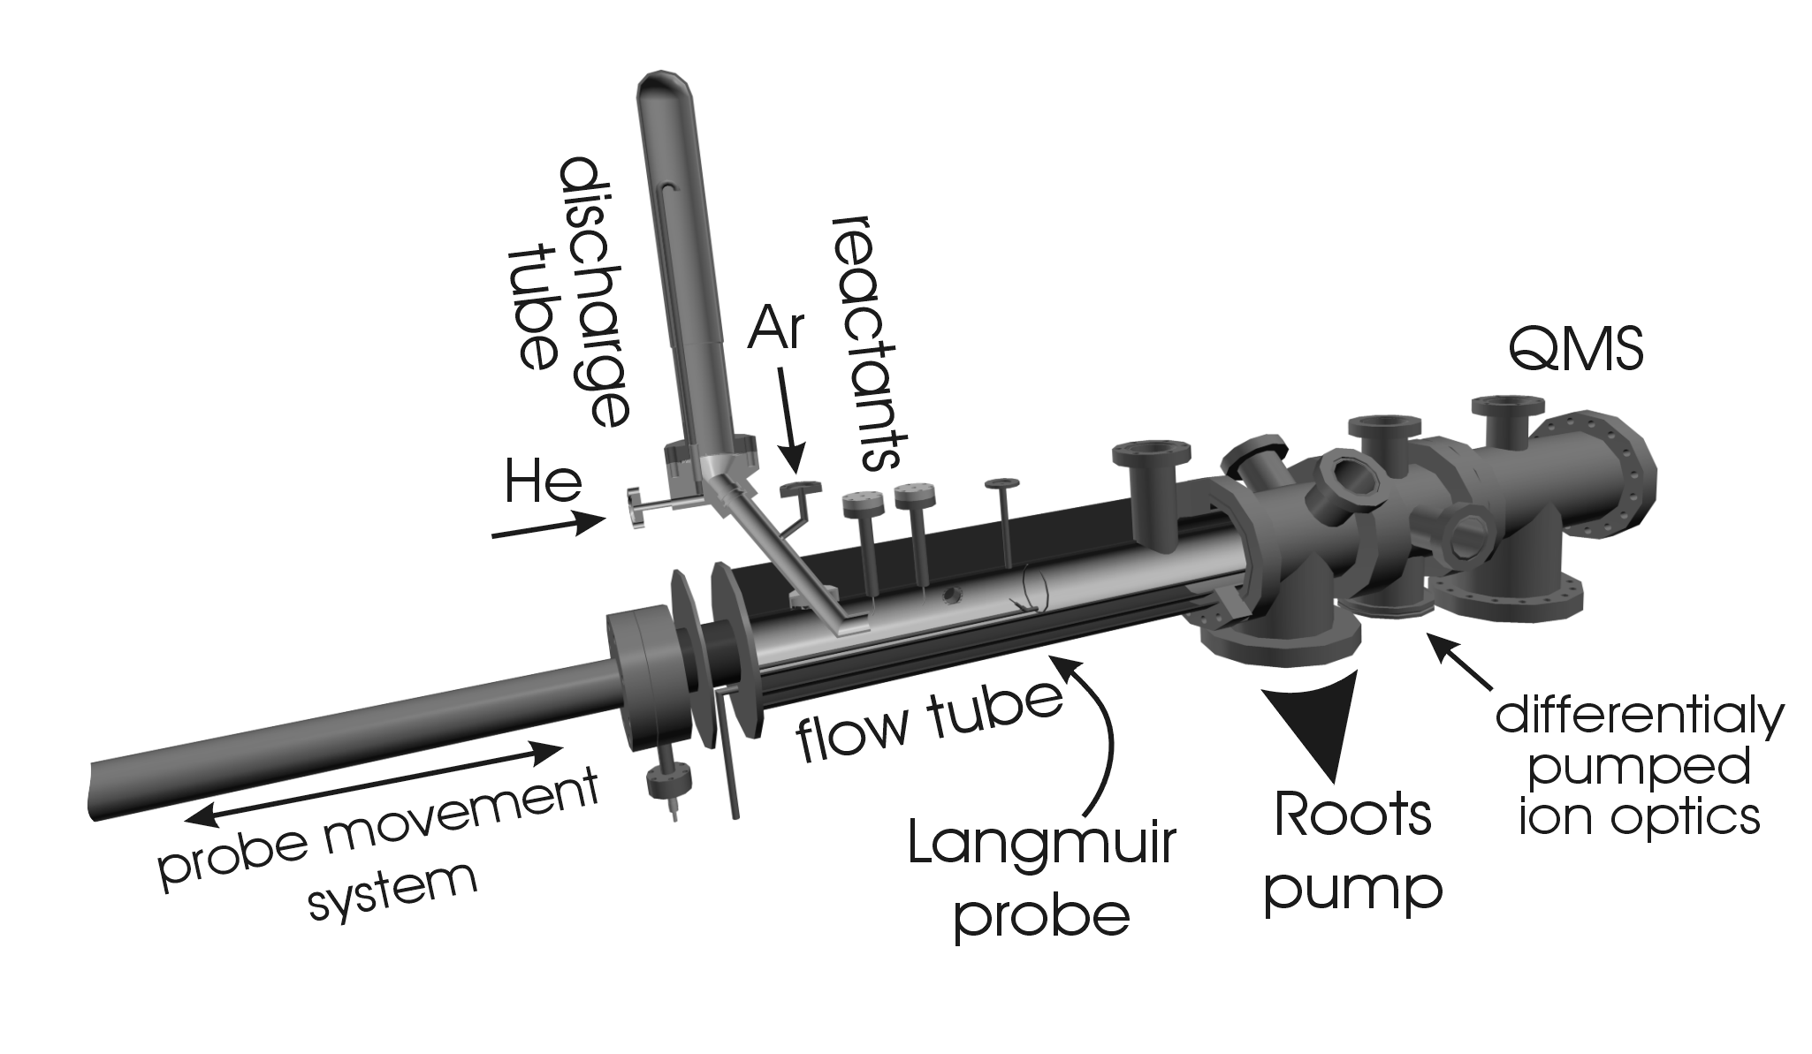
Space related investigations
plasma
reactant
source
buffer gas
pump
x
reaction zone
+
n_{e}
t = x/v
Flowing Afterglow Langmuir Probe – FALP
Notes:
1

Slide 12
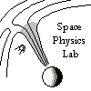
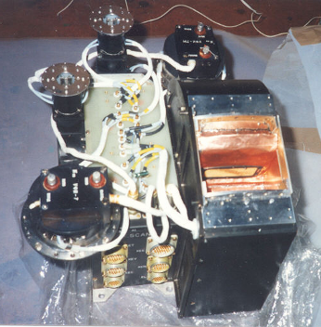
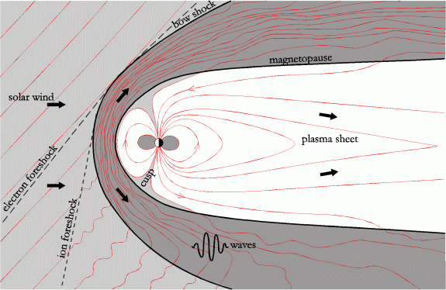
Space research
Preparation of space experiments
Study of Sun-Earth relations
First two-point determination of the magnetopause structure
Notes:
1

