Slide 1
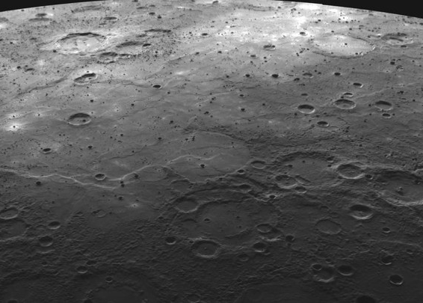
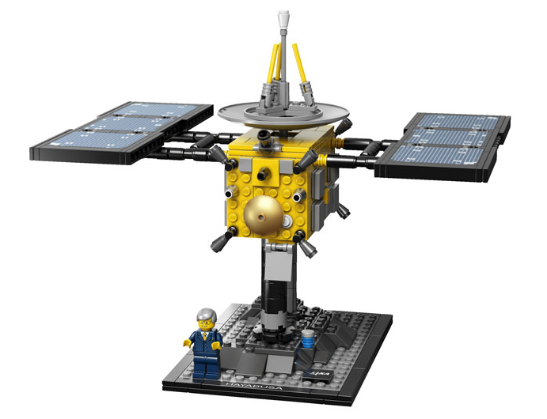

Science and exploration are the WHY and WHAT - let’s talk about the HOW: an engineering perspective
Tina Büchner da Costa, ArianeGroup
MSc Aerospace Engineering
MSc Business psychology

Slide 2


Where science meets engineering
SCIENTISTS:
a science goal
SUBJECT
Example: Explore planet Mercury
SCIENTISTS:
a rationale
WHY?
Poorly explored so far
Understand history and formation of all inner planets
SCIENTISTS/
ENGINEERS
a scope
WHAT?
WHAT exactly?
Input for ENGINEERING:
Mission requirements
HOW?
ENGINEERS:
Technical requirements
ENGINEERS:
Design process for spacecraft/instruments/
launcher/ground segment

Slide 3
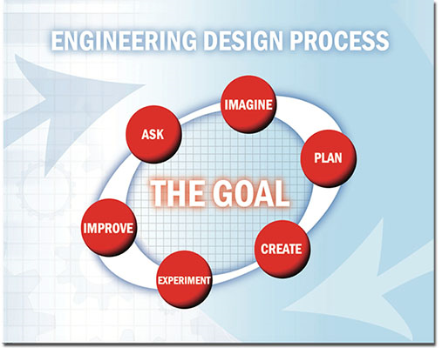
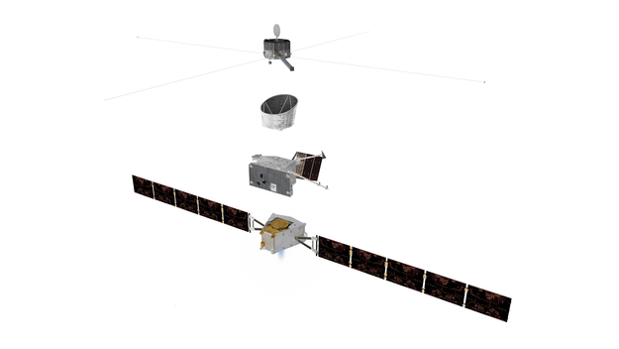
The ‚WHAT‘: Bepi Colombo spacecraft
Mercury Magnetospheric Orbiter
Sunshield and Interface Structure
Mercury Planetary Orbiter
Mercury Transfer Module
Courtesy: NASA
Courtesy: ESA
This is also a result of the ‚HOW‘
Notes:
Functional analysis; trade-offs

Slide 4
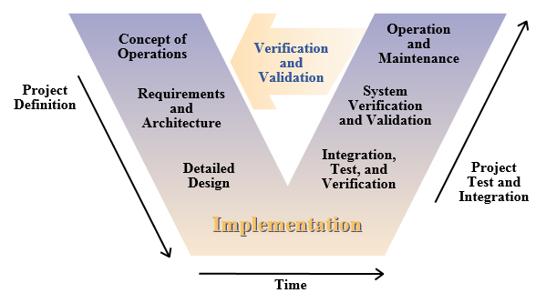
The ‚HOW‘: The design cylce (V-cycle) – process of design and verification/test
Test/Verifikation
Subsystem
Notes:
Candidate concepts, architecture.. Detailed design of substems until freeze of design (CDR), then verification from lower component/assembly level on to subsystem and system test and verification

Slide 5
The ‚WHO‘: Engineering disciplines
SYSTEM ENGINEERING
Mission Analysis
Data Handling/
Communications
GNC (guidance, navigation and control)
Mechanisms/Pyrotechnics
Mechanical
Thermal
Ground Operations
Propulsion
Assembly, Integration and
Verification
Electrical/Power
Design/Configuration
In case of a satellite: Launcher interface

Slide 6
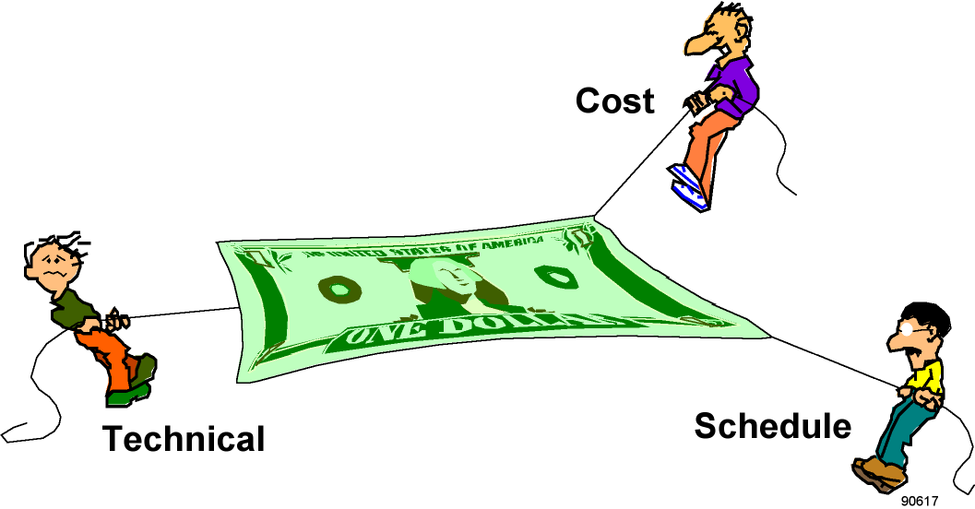

System Engineering
Overall fulfilment of mission requirements
Fulfil technical, cost and schedule requirements
Overall mass budget
Interface management
Test and verification logic
Technical conflicts –
mediation of requirements
Opportunities and risks
System engineer
Good system engineers are hard to find and the major ingredient to successful missions!

Slide 7
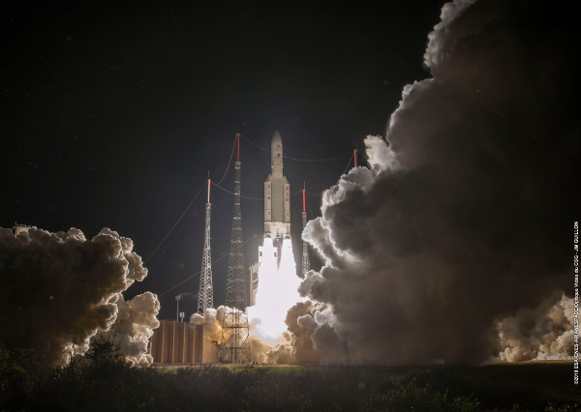
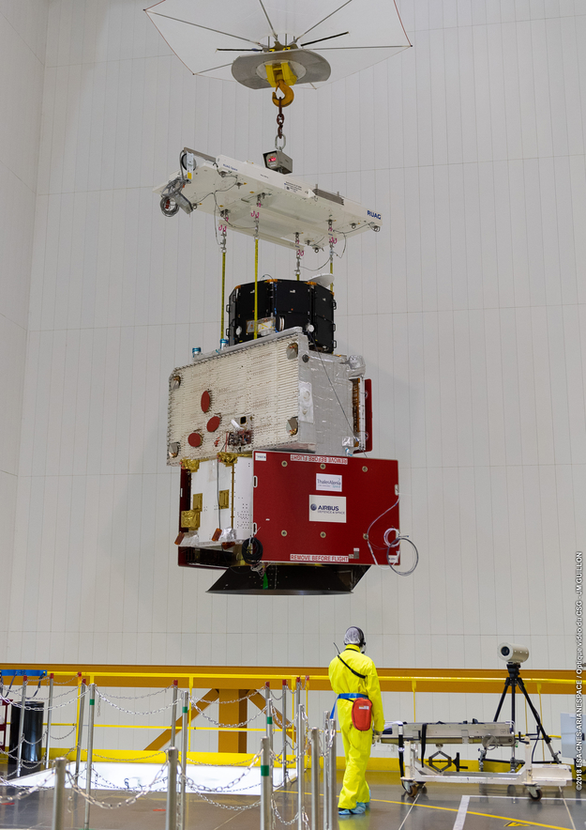
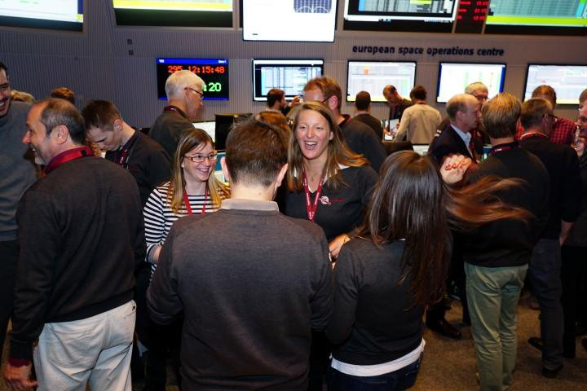
Finally..
Credits: ESA/CNES/Arianespace/Optique vidéo du CSG

Slide 8
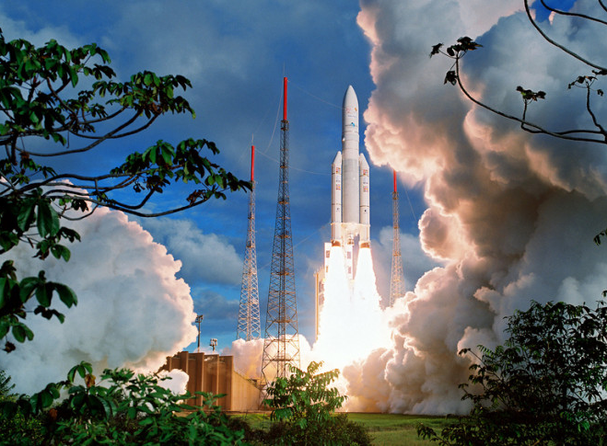
As long as there will be science goals, there is a need of brilliant engineers to make things happen!

