Slide 1
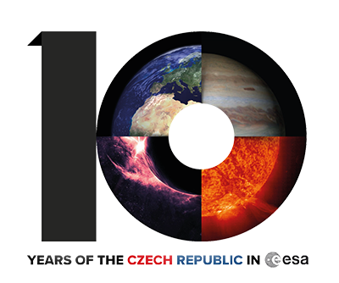
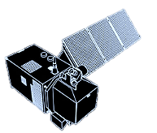
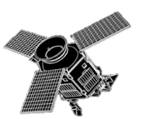
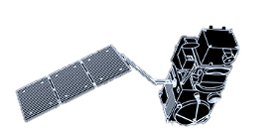
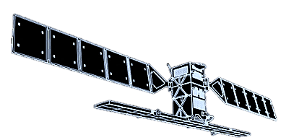
Copernicus Sentinels
Missions, Applications and Data Access
14 November 2018
Tereza Šmejkalová | RUS Copernicus – Serco Italia
Q&A
RUS
Copernicus
Space
Segment
What is
Copernicus?

Slide 2
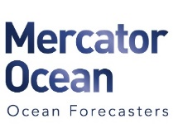
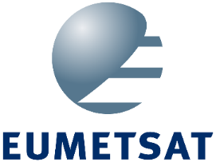
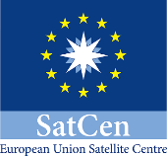
Copernicus Programme
What is
Copernicus?
Europe’s eyes on Earth – flagship programme of the European Union
Conceived in 1998 as Global Monitoring for Environment and Security (GMES)
Monitors the Earth, its environments and ecosystems & prepares for emergency situations (security risks, natural or man-made disasters)
Tool for economic development and a driver for digital economy
Notes:
Copernicus is the European Union's Earth Observation Programme, looking at our planet and its environment. It offers information services based on satellite Earth Observation and in situ (non-space) data.
The idea for a global and continuous European earth observation system was developed under the name of Global Monitoring for Environment and Security (GMES) which was later re-branded into Copernicus.
The Programme is coordinated and managed by the European Commission. It is implemented in partnership with the Member States, the European Space Agency (ESA), the European Organisation for the Exploitation of Meteorological Satellites (EUMETSAT), the European Centre for Medium-Range Weather Forecasts (ECMWF), EU Agencies and Mercator Océan.
The main aim is to provide information to help service providers, public authorities and other international organisations improve the quality of life. Based on satellite and in-situ observations the Copernicus services deliver near-real-time data on a global level which can also be used for local and regional needs, in order to enable sustainable management of our environment.
All data provided under full, free and open policy.

Slide 3
Copernicus Components
What is
Copernicus?
Satellite Data
Value Added Services and Applications
Users
In situ
Data
Data Sources
Service Information
Notes:
Copernicus builds upon three components:
the space component (observation satellites and associated ground segment with missions observing land, atmospheric and oceanographic parameters)
in-situ measurements (ground-based and airborne data gathering networks providing information on oceans, continental surface and atmosphere),
These data sources serve then feed into the third component, the six Copernicus Services – which are developed and managed by Copernicus and offered to its users and public in general. I will cover in detail later. All three components are directly available to users but also serve as an input to further value added services and applications.

Slide 4
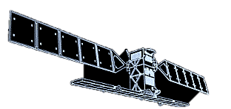
Copernicus in numbers
What is
Copernicus?
> 183.500
Of registered users
6 Operational services
> 150 TB
Of satellite data downloaded every day
7 Satellites in operation
> 9.0 PB
Of satellite data published since the start of operation
0.0 Direct cost of the data for users
Notes:
11 mil. Published products since the start of operation in October 2014

Slide 5
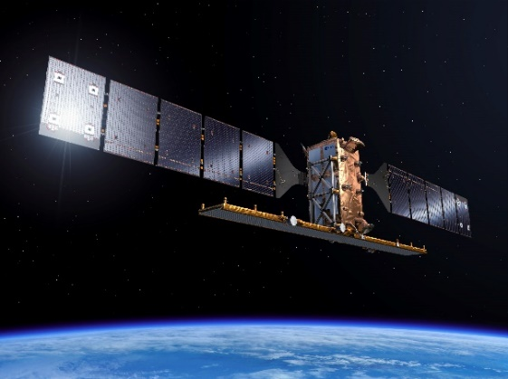
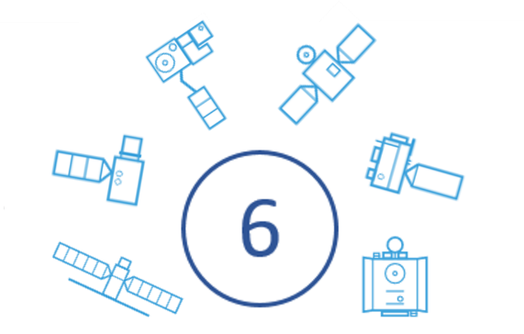
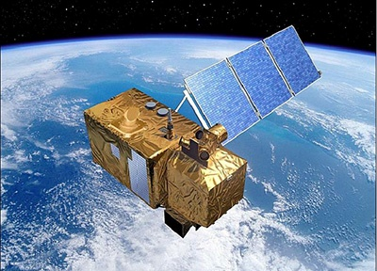
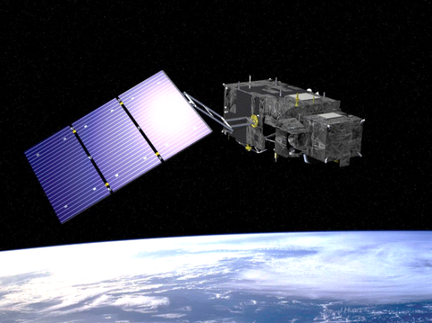
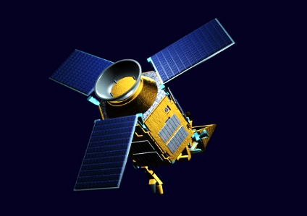
Space Segment
Space Segment
~ 30
Families of satellites
dedicated to Copernicus “The Sentinels”
Contributing missions
from National, European or International organisations
The Sentinel Satellites are developed for the specific needs of the Copernicus programme.
They provide a unique set of observations
Currently 7 satellites in operation – 3 constellations of twin satellites and one single satellite
Source: ESA
Notes:
The Copernicus Space Component comprises two types of satellite missions, six families Sentinel missions developed by ESA and dedicated to the Copernicus programme and around 30 missions from other space agencies, called Contributing Missions. A unified ground segment, through which the data are streamed and made freely available for Copernicus services, completes the Space Component.
ESA is establishing a mechanism to integrate and harmonise access to all the relevant data from the multitude of different satellite missions. This is being carried out in close cooperation with national space agencies, EUMETSAT and, where relevant, with owners of non-European missions contributing to the Copernicus objectives.
I will further introduce only the Sentinel satellites as they provide unique set of observations developed for the specific needs of the Copernicus programme.

Slide 6
Space Segment
Space Segment
Sentinel-1A/B: Radar Mission
3 April 2014/ 25 April 2016
Sentinel-2A/B: High Resolution Optical Mission
23 June 2015/ 7 March 2017
Sentinel-3A/B: Medium Resolution Imaging and Altimetry Mission
16 Feb. 2016/ 25 April 2018
Sentinel-4A/B: Geostationary Atmospheric Chemistry Mission
2023/2027
Sentinel-5P: Low Earth Orbit Atmospheric Chemistry Mission
13 October 2017
Sentinel-5A/B: Low Earth Orbit Atmospheric Chemistry Mission
2021/2027
Sentinel-6A/B: Altimetry Mission
2020/2025
Notes:
Currently there are 7 satellites in operation (marked in red). They are three constellations of twin satellites and one single satellite. The management and operation of the missions id divided between ESA and EUMETSAT with ESA being responsible for the operation of the Sentinel-1 and Sentinel-2 satellites as well as delivering the Sentinel-3 Land mission and Sentinel-5P mission.
EUMETSAT is responsible for operating the Sentinel-3 satellites and delivering the marine mission and will also operate and deliver products from the Sentinel-4, and -5 instruments, and the Sentinel-6 satellites in the future.
The Sentinels carry a range of technologies, such as radar and multi-spectral imaging instruments for land, ocean and atmospheric monitoring:
Sentinel-1 provides all-weather, day and night radar imagery for land and ocean services
Sentinel-2 provides high-resolution optical imagery for land services
Sentinel-3 provides high-accuracy optical, radar and altimetry data for marine and land services
Sentinel-4 and Sentinel-5 will provide data for atmospheric composition monitoring from geostationary orbit and polar orbit, respectively
Sentinel-5 Precursor will bridge the gap between Envisat and Sentinel-5
Sentinel-6 will provide radar altimetry data to measure global sea-surface height, primarily for operational oceanography and for climate studies
Sentinel-4 and -5 will be instruments carried on the next generation of meteorological satellites: Meteosat Third Generation (MTG) and MetOp Second Generation.

Slide 7
Space Segment
Space Segment
Sentinel-1A/B: Radar Mission
3 April 2014/ 25 April 2016
Sentinel-2A/B: High Resolution Optical Mission
23 June 2015/ 7 March 2017
Sentinel-3A/B: Medium Resolution Imaging and Altimetry Mission
16 Feb. 2016/ 25 April 2018
Sentinel-4A/B: Geostationary Atmospheric Chemistry Mission
2023/2027
Sentinel-5P: Low Earth Orbit Atmospheric Chemistry Mission
13 October 2017
Sentinel-5A/B: Low Earth Orbit Atmospheric Chemistry Mission
2021/2027
Sentinel-6A/B: Altimetry Mission
2020/2025
Notes:
I will now introduce the missions in operation in detail. And we will start with Senitnel-1.

Slide 8
Sentinel-1: SAR Mission
Source: ESA
Notes:
Here we have short animation showing the satellite in operation acquiring the interferometric wide swath which is the main acquisition mode over land. It acquires data with a 250 km swath at 5 m by 20 m spatial resolution. IW mode captures three sub-swaths using Terrain Observation with Progressive Scans SAR (TOPSAR). With the TOPSAR technique, in addition to steering the beam in range as in ScanSAR, the beam is also electronically steered from backward to forward in the azimuth direction for each burst, resulting in homogeneous image quality throughout the swath.

Slide 9
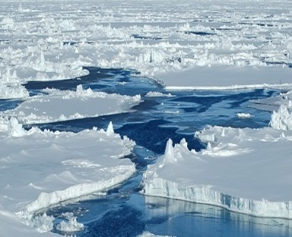
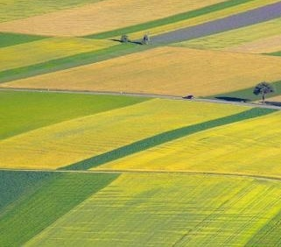
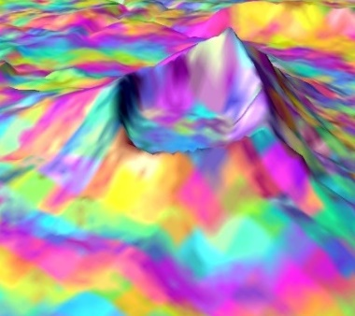
Sentinel-1: Radar Mission
Space Segment
Payload: C-band synthetic aperture radar (SAR) at 5.405 GHz (corresponds to approx. 5.54 cm)
Constellation: Twin satellites - same orbit (180° apart) – 12 day orbit
Orbit: Polar, Sun-synchronous at an altitude of 693 km
Repeat frequency: max. 6 days at equator Revisit time: 3 days at equator, < 1 day at high latitudes
Coverage: Global (provides an all-weather, day-and-night acquisitions)
Source: ESA
Sentinel-1B - Soyuz
25 April 2016
Kourou, Fr. Guiana
Notes:
As I said before Sentinel-1 is the radar mission consisting of two identical satellites in the same orbit phased approx. 180 degrees of each other. Senitnel-1A was the first Sentinel mission ever to be launched on the 3 April 2014, Senitnel-1B then followed on 25 April 2016. They carry C-band synthetic aperture radar at 5.405 GHz which corresponds to wavelength of approx. 5.54 cm. And they are in polar, sun Synchronous 12 day orbit with altitude of 693 km. This results in 6 day repeat frequency at equator for the constellation and 12 days for single satellite. The revisit time is approximately 3 days at equator and <1 day at high latitudes. By repeat frequency we mean coverage insured from the same, repetitive relative orbit which ensures identical geometry necessary for example for interferometric applications.
sea ice monitoring, iceberg detection, ship detection , oil slick detection, marine winds, deforestation, biomass estimation, forest type classification, burned area mapping, land use, crop conditions, soil properties, soil degradation, land subsidence and structural damage, land use, crop conditions, soil properties, soil degradation, land subsidence and structural damage, earthquake analysis , flood monitoring, landslides, volcano monitoring

Slide 10
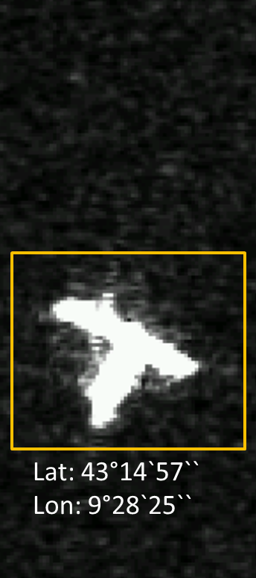
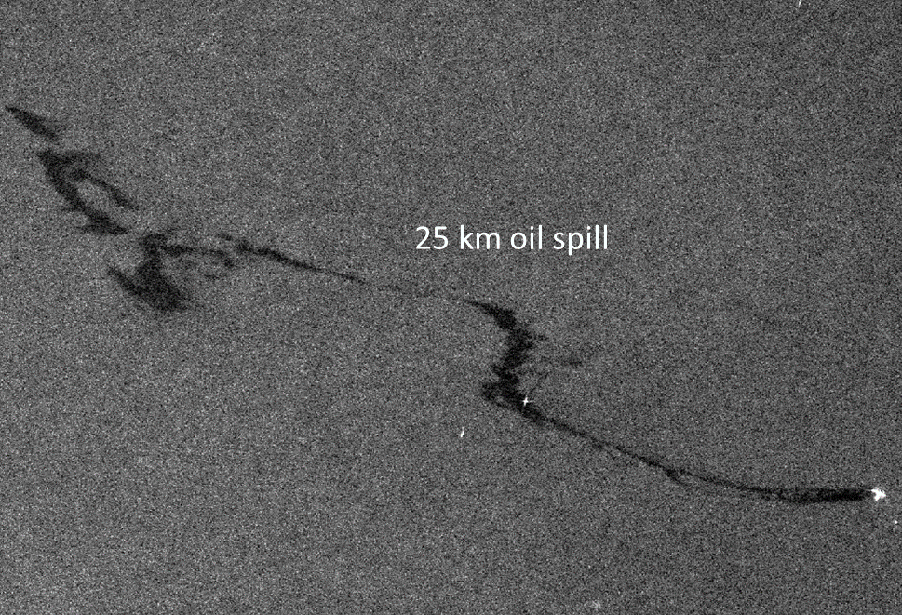
Ship collision of coast of Corsica (Sunday, 7 Sept. 2018)
Credits: RUS Copernicus (contains modified Copernicus data)
Source: ESA

Slide 11
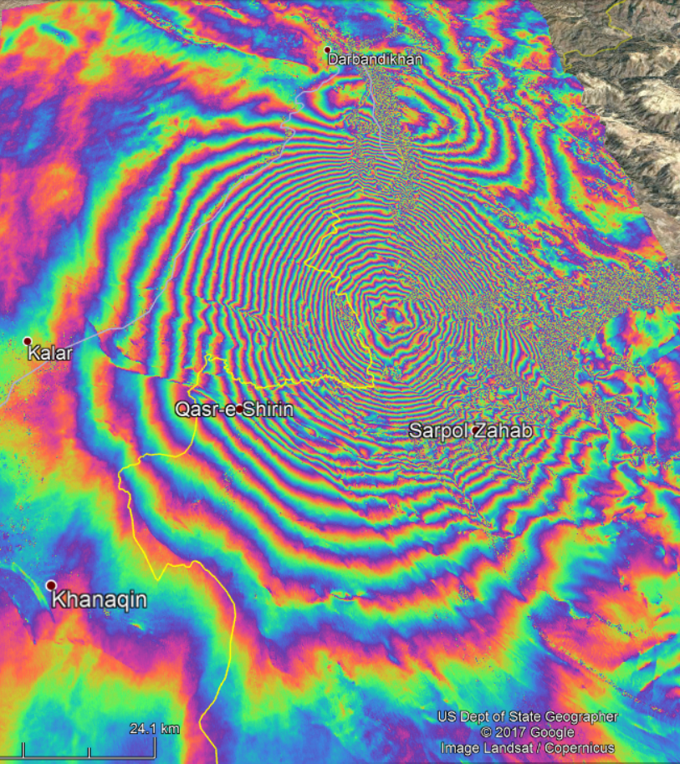
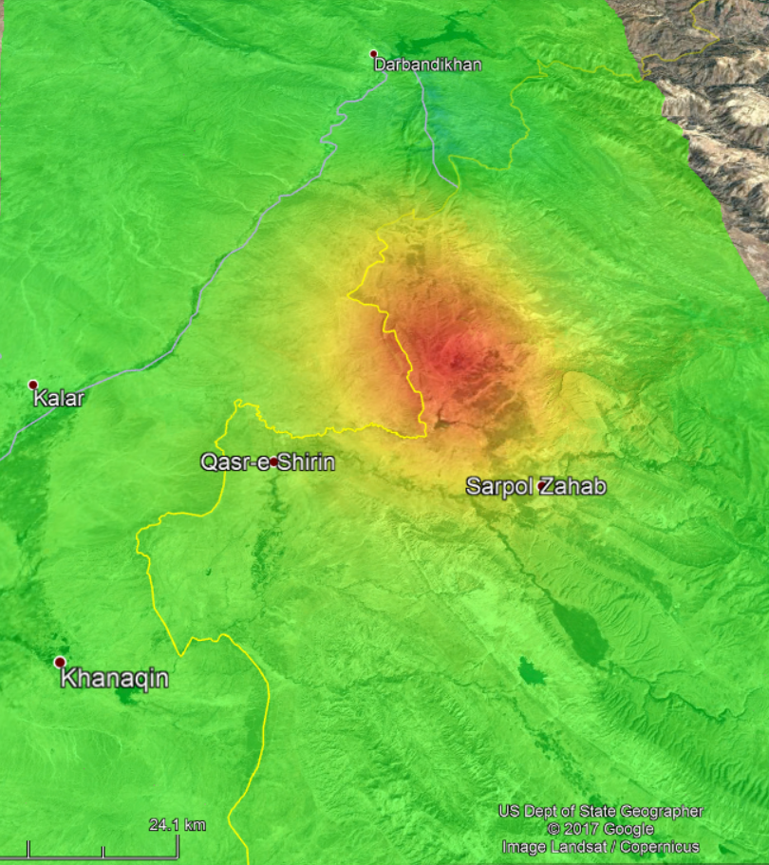
7.3 Magnitude Earthquake on the Iraq/Iran border on 12 November 2017
Sentinel-1 Interferogram (left) and Ground displacement (right)
Credits: RUS Copernicus (contains modified Copernicus data)

Slide 12
Space Segment
Space Segment
Sentinel-1A/B: Radar Mission
3 April 2014/ 25 April 2016
Sentinel-2A/B: High Resolution Optical Mission
23 June 2015/ 7 March 2017
Sentinel-3A/B: Medium Resolution Imaging and Altimetry Mission
16 Feb. 2016/ 25 April 2018
Sentinel-4A/B: Geostationary Atmospheric Chemistry Mission
2023/2027
Sentinel-5P: Low Earth Orbit Atmospheric Chemistry Mission
13 October 2017
Sentinel-5A/B: Low Earth Orbit Atmospheric Chemistry Mission
2021/2027
Sentinel-6A/B: Altimetry Mission
2020/2025
Notes:
Next we will continue to the Sentinel-2 optical mission.

Slide 13
Sentinel-2: HR Optical Mission
Source: ESA
Notes:
Here is a quick animation of the satellite acquiring data over Europe.

Slide 14
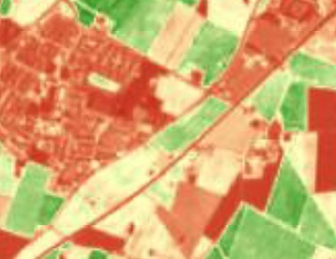
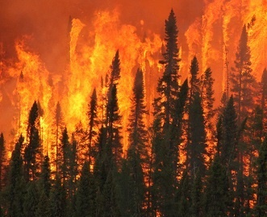
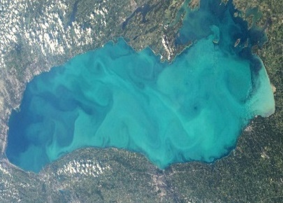
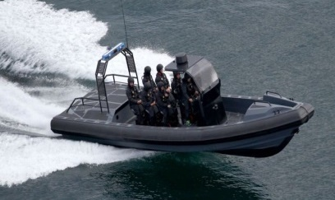
Sentinel-2: HR Optical Mission
Space Segment
Payload: Multispectral instrument with 13 spectral bands (VIS–NIR–SWIR)
Constellation: Twin polar-orbiting satellites in the same orbit (180° apart)
Orbit: Polar, Sun-synchronous at altitude of 786 km
Repeat frequency: 5 days at equator
Revisit time: < 1 day at high latitudes
Coverage: Systematic coverage of land and coastal areas (84°N and 84°S)
Source: ESA
Sentinel-2A - Vega
23 June 2015
Kourou, Fr. Guiana
Notes:
The mission is dedicated to the full and systematic coverage of land surface (including major islands) with the objective to provide cloud-free products typically every 15 to 30 days over Europe and Africa. It carries a multispectral instrument with 13 bands from Visible to short wave infrared part of the spectrum.
Similarly as for Sentinel-1 it consists of twin satellite in the same polar orbit with 180 degree separation. This configuration allows to reach a 5-day repeat frequency. In comparison, Landsat-7 provides a 16-day repeat frequency time, while SPOT provides a 26-day repeat, and neither of them provides systematic coverage of the overall land surface. The revisit time decreases to less than one day at high latitudes.
Senitnel-2A was launched on the 23 June 2015, Senitnel-2B followed on March 7 2017.
Agriculture, Land cover mapping, Change detection, Forest and vegetation monitoring, Natural disasters, Man-made emergency, Floods , Forest fire , Humanitarian crises , Water quality parameters, Surface chlorophyll concentration, Algal blooms , Turbidity , Border surveillance, Maritime surveillance , Support EU external action

Slide 15
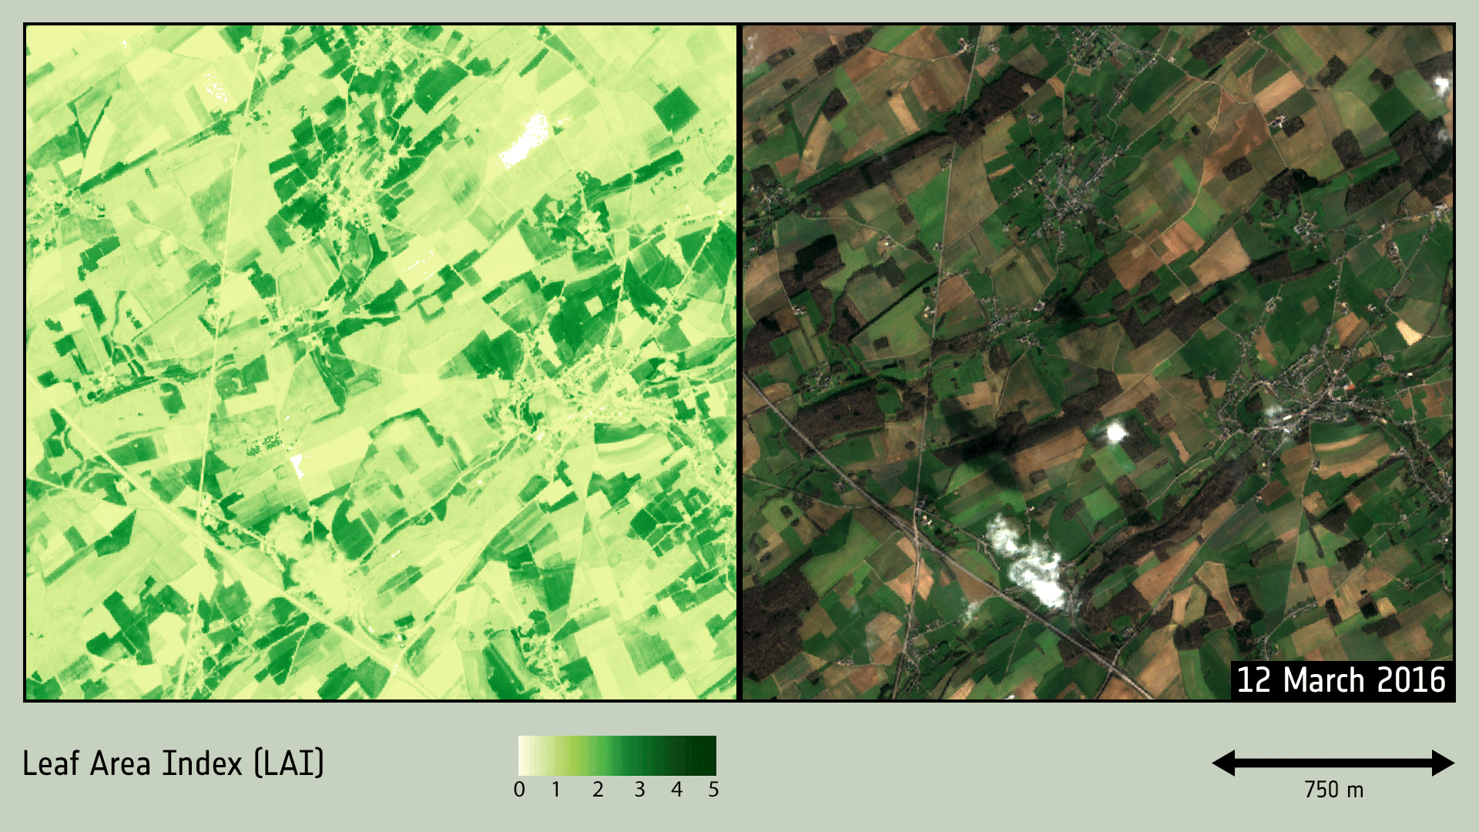
Credits: ESA (contains modified Copernicus data)
Notes:
Data from the Copernicus Sentinel-2 mission can be used to measure the ‘leaf area index’ of vegetation (left). This information can, in turn, be used to monitor crop growth and agricultural practices like harvesting. The animation shows the development of crop fields in Belgium between March and October 2016. This kind of information is now being used to simplify and modernise the EU’s Common Agricultural Policy.

Slide 16
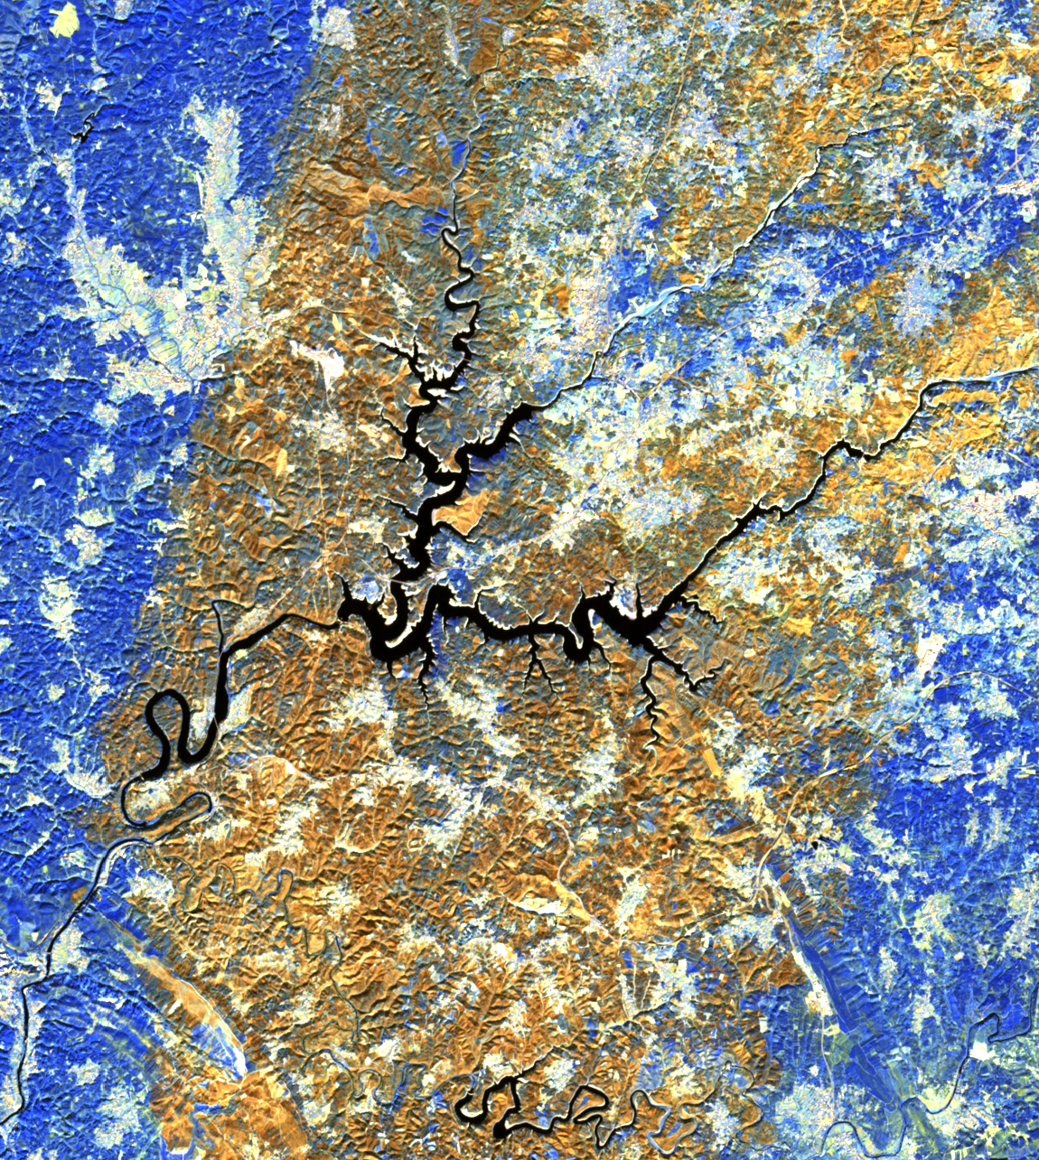
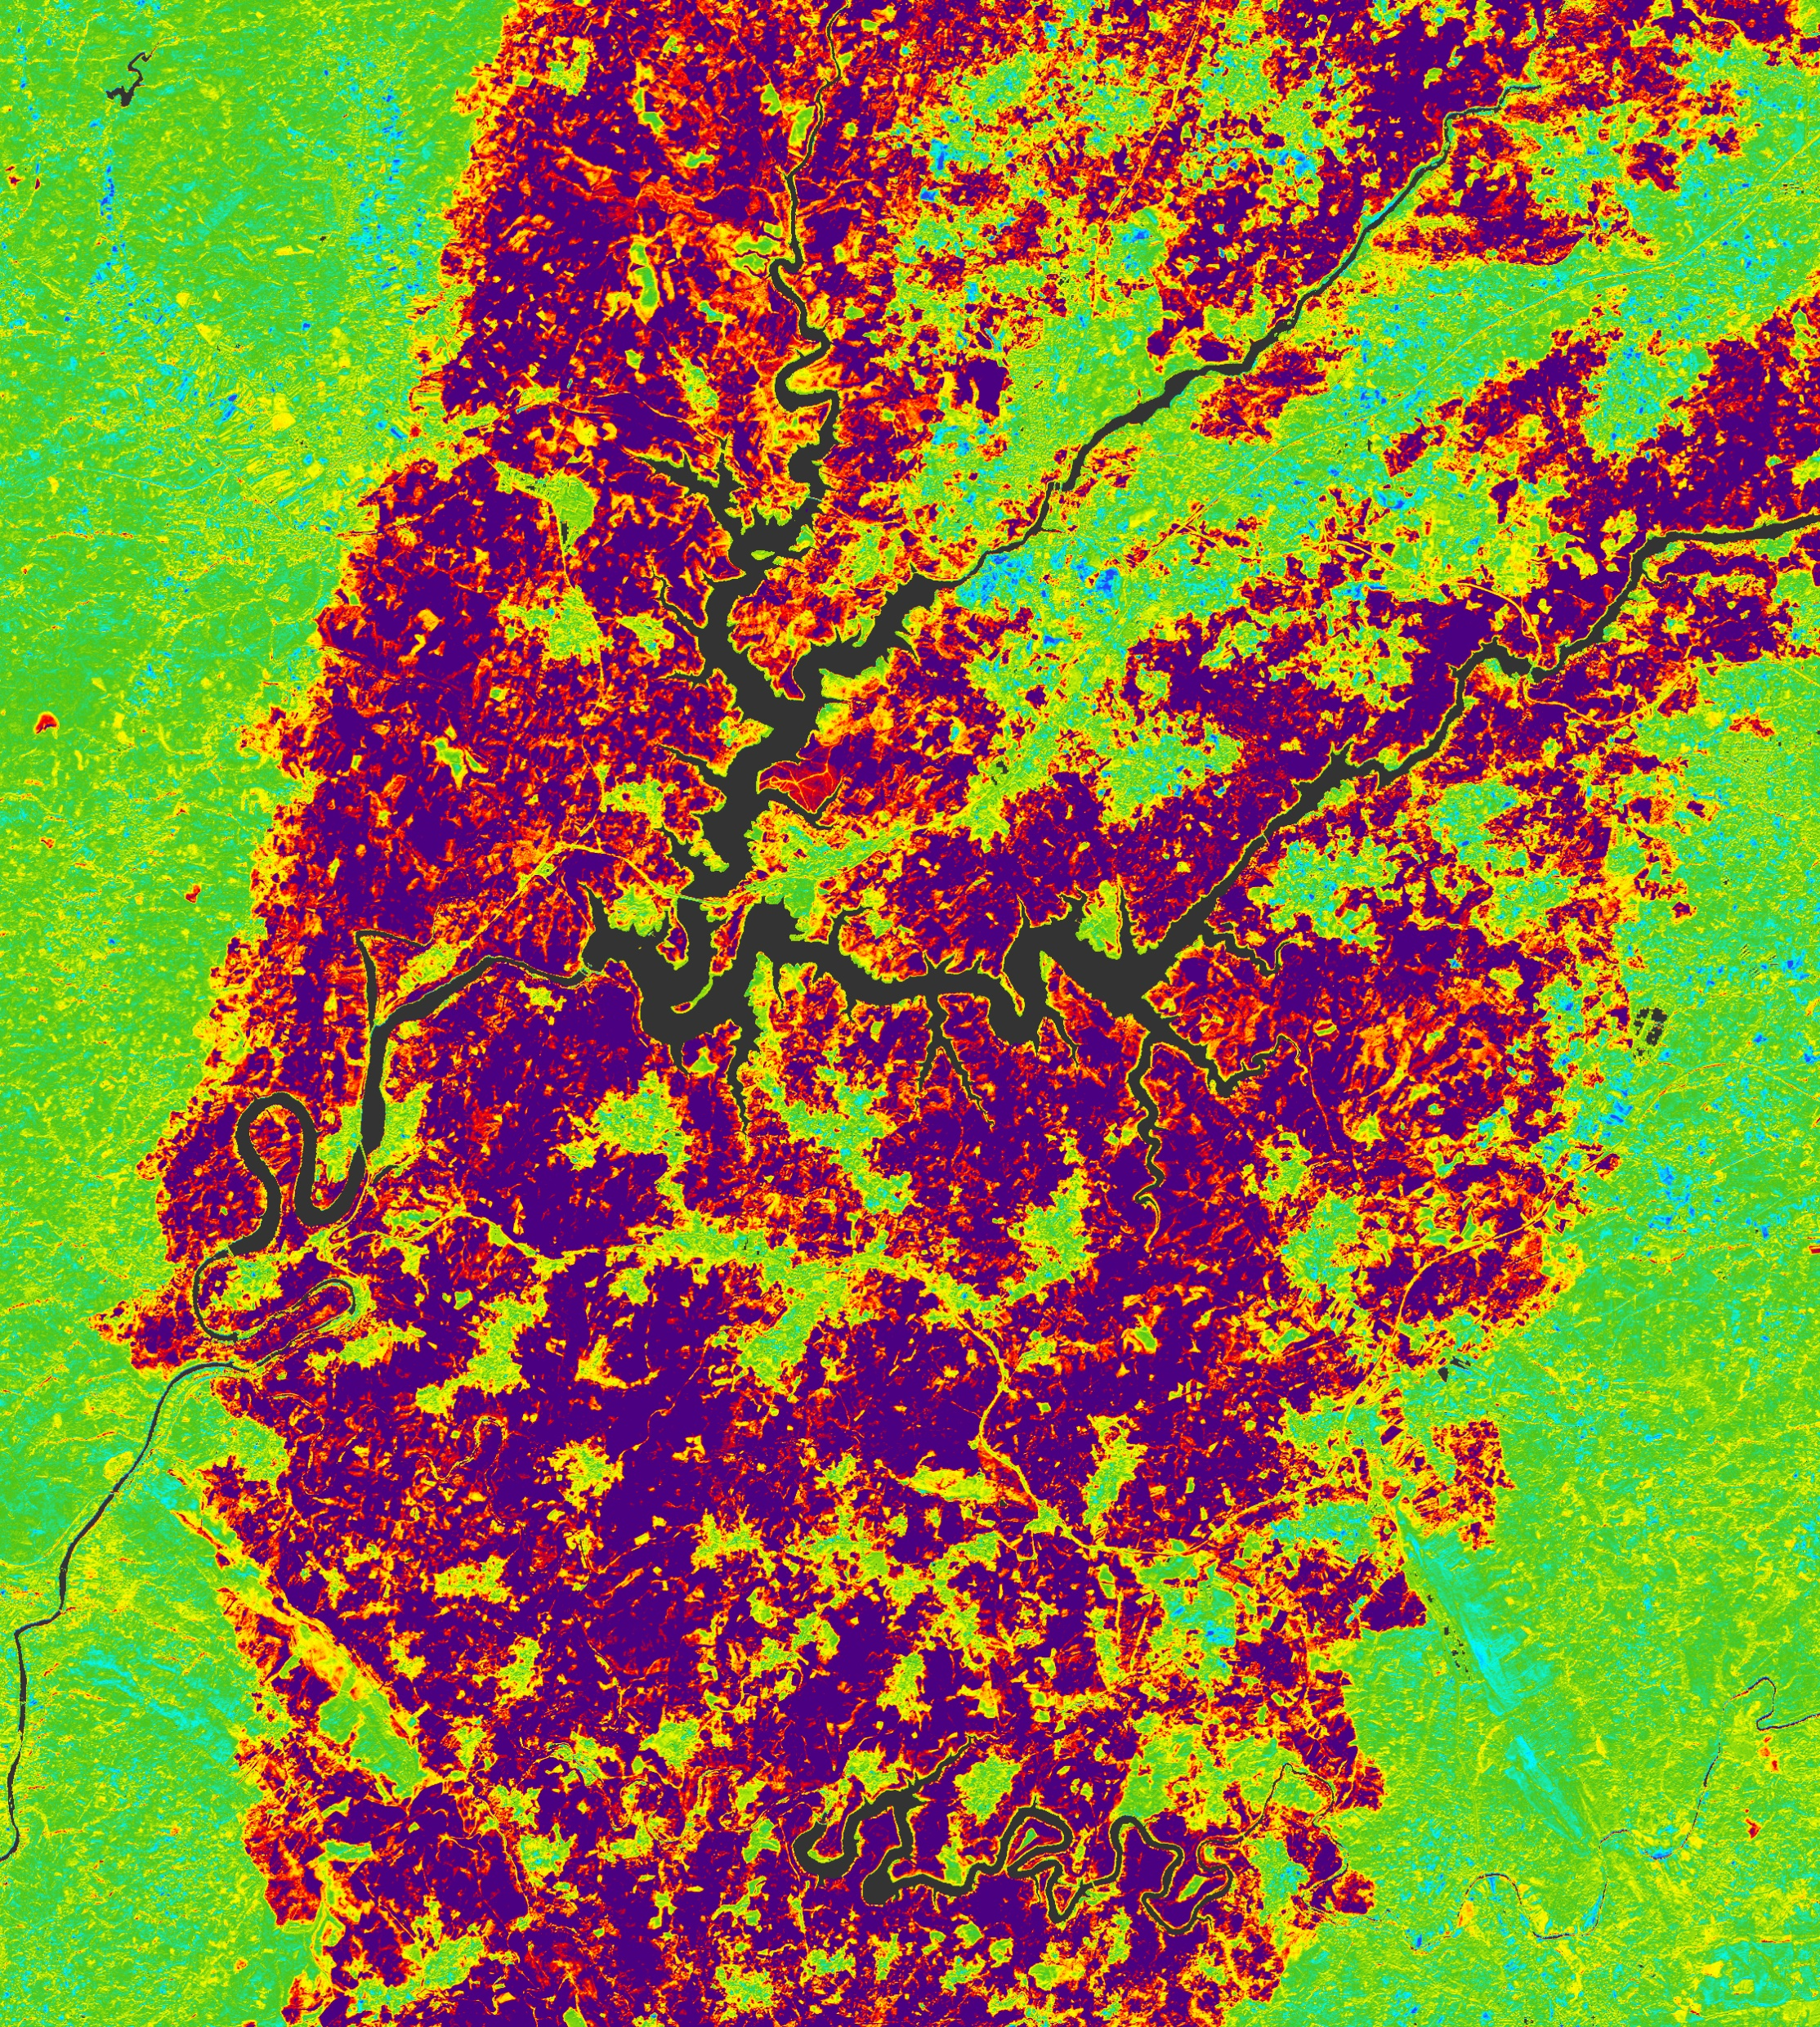
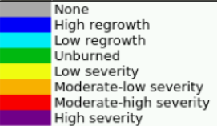
Forest fire and burned area monitoring – Portugal, June 2017
Sentinel-2 false colour composite (left) and Burn severity map (right)
Credits: RUS Copernicus (contains modified Copernicus data)

Slide 17
Space Segment
Space Segment
Sentinel-1A/B: Radar Mission
3 April 2014/ 25 April 2016
Sentinel-2A/B: High Resolution Optical Mission
23 June 2015/ 7 March 2017
Sentinel-3A/B: Medium Resolution Imaging and Altimetry Mission
16 Feb. 2016/ 25 April 2018
Sentinel-4A/B: Geostationary Atmospheric Chemistry Mission
2023/2027
Sentinel-5P: Low Earth Orbit Atmospheric Chemistry Mission
13 October 2017
Sentinel-5A/B: Low Earth Orbit Atmospheric Chemistry Mission
2021/2027
Sentinel-6A/B: Altimetry Mission
2020/2025
Notes:
Now lets have look at Sentinel-3

Slide 18
Sentinel-3: OLCI
Source: ESA
Notes:
Here is a quick animation of the satellite acquiring data.

Slide 19
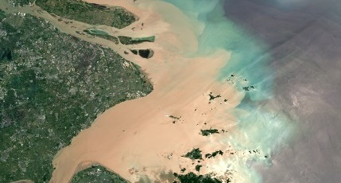
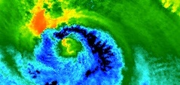
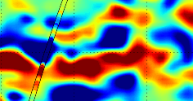
Sentinel-3: MR Imaging and Altimetry Mission
Space Segment
Payload: 5 instruments
Ocean and Land Colour Instrument (OLCI)
Sea and Land Surface Temperature Radiometer (SLSTR)
Altimetry package Synthetic Aperture Radar Altimeter (SRAL), MicroWave Radiometer (MWR) and Precise Orbit Determination (POD)
Constellation: Twin satellites - same orbit (180° apart)
Orbit: Polar, Sun-synchronous at altitude of 815 km
Coverage: Global (day-and-night acquisitions)
Source: ESA
Sentinel-3B - Rockot
25 April 2018
Plesetsk
Notes:
Senitnel-3 provides enhanced continuation to Envisat. It carries a suite of cutting-edge instruments to systematically observe Earth’s oceans, land, ice and atmosphere to monitor and understand large-scale global dynamics and provides essential information in near-real time for ocean and weather forecasting. Same as the others the mission consists of two identical satellites in the same orbit at altitude 815 km. It provides repeat frequency of less than 1 day for OLCI and SLSTR sensor and 27 days for the topography package.
The timeframe for delivery of products is dependent on the specific application:
Near Real-Time (NRT) products are delivered to the users less than 3 hours after acquisition of the data by the sensor
Non-Time Critical (NTC) products are delivered not later than 1 month (commitment) after acquisition or from long-term archives. Typically, the product should be available within 24 or 48 hours (but this is not guaranteed).
Ocean and Land Colour Instrument (OLCI) - Push-broom imaging spectrometer that measures solar radiation reflected by the Earth
21 spectral bands (400 –1020 nm)

Slide 20
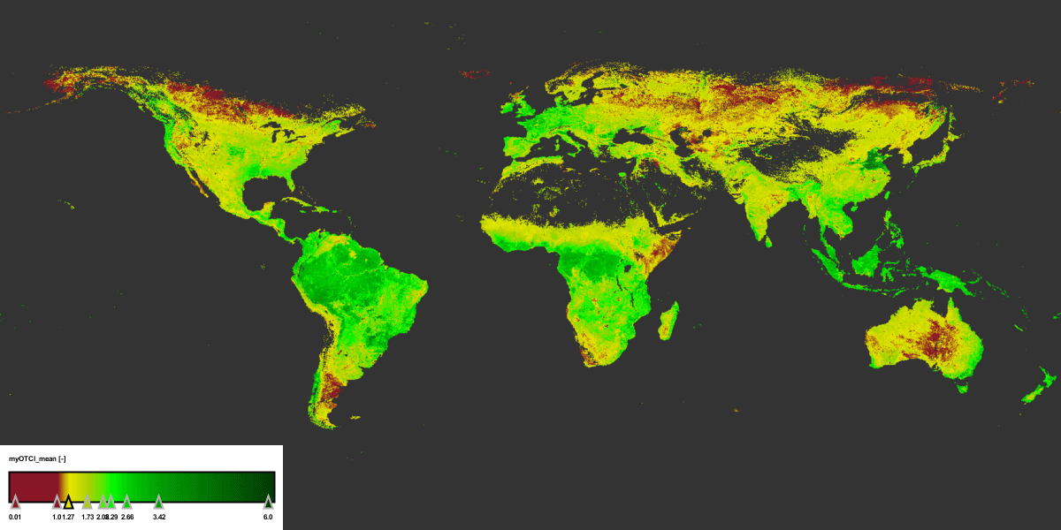
Global chlorophyll change - between 1 April and 27 May 2017
Sentinel-3 OLCI
Credits: University of Southampton–J. Dash/Brockman Consult (S3-MPC) (contains modified Copernicus data)
Notes:
The Copernicus Sentinel-3A’s ocean and land colour instrument can ‘see’ chlorophyll in vegetation. The animation shows how chlorophyll, which is essential in photosynthesis, around the world changed between 1 April and 27 May 2017. While tropical rainforests can be seen to maintain a high degree of chlorophyll, the animation clearly shows the progress of spring greening in the northern hemisphere. This is particularly evident in the eastern part of the USA. It also captures the progress of agricultural planting for summer crops across China where planting normally takes place between March and May. Here various stages of growth are captured. The chlorophyll index ranges from 1 to 6.5.

Slide 21
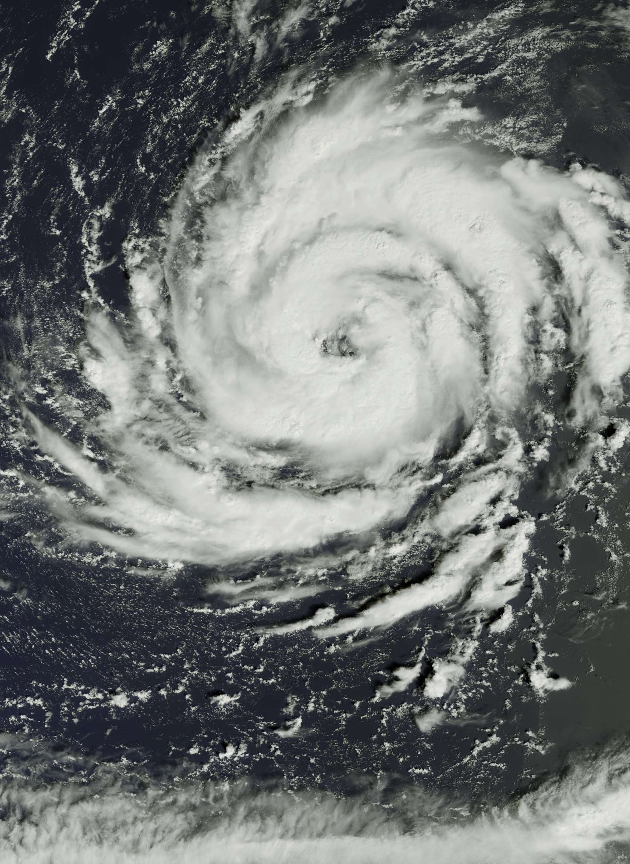
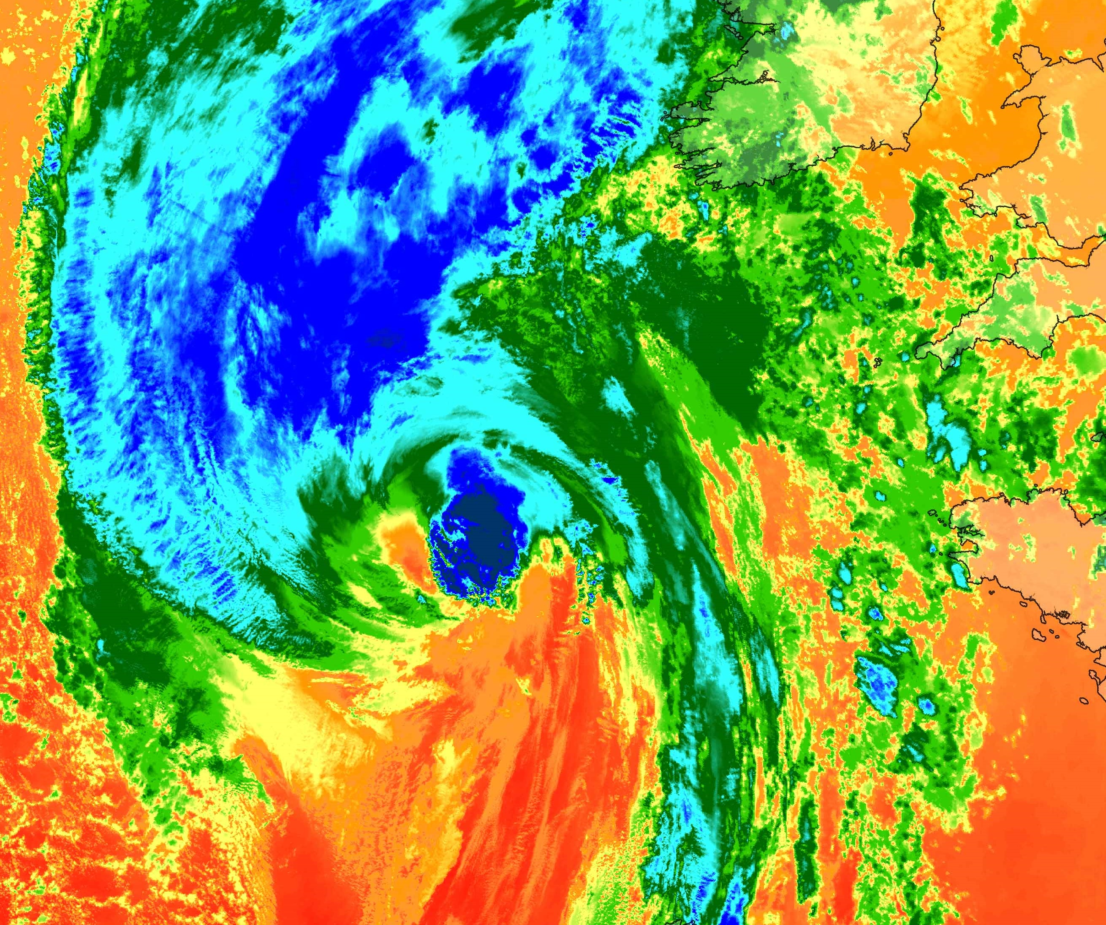
Hurricane Ophelia – 15 October 2017
Sentinel-3 OLCI (left) and SLSTR Top of cloud brightness temperature (right)
Credits: ESA (contains modified Copernicus data)

Slide 22
Space Segment
Space Segment
Sentinel-1A/B: Radar Mission
3 April 2014/ 25 April 2016
Sentinel-2A/B: High Resolution Optical Mission
23 June 2015/ 7 March 2017
Sentinel-3A/B: Medium Resolution Imaging and Altimetry Mission
16 Feb. 2016/ 25 April 2018
Sentinel-4A/B: Geostationary Atmospheric Chemistry Mission
2023/2027
Sentinel-5P: Low Earth Orbit Atmospheric Chemistry Mission
13 October 2017
Sentinel-5A/B: Low Earth Orbit Atmospheric Chemistry Mission
2021/2027
Sentinel-6A/B: Altimetry Mission
2020/2025
Notes:
Last satellite in operation is the Sentinel-5-P

Slide 23
Sentinel-5P: Atmospheric Chemistry Mission
Source: ESA

Slide 24
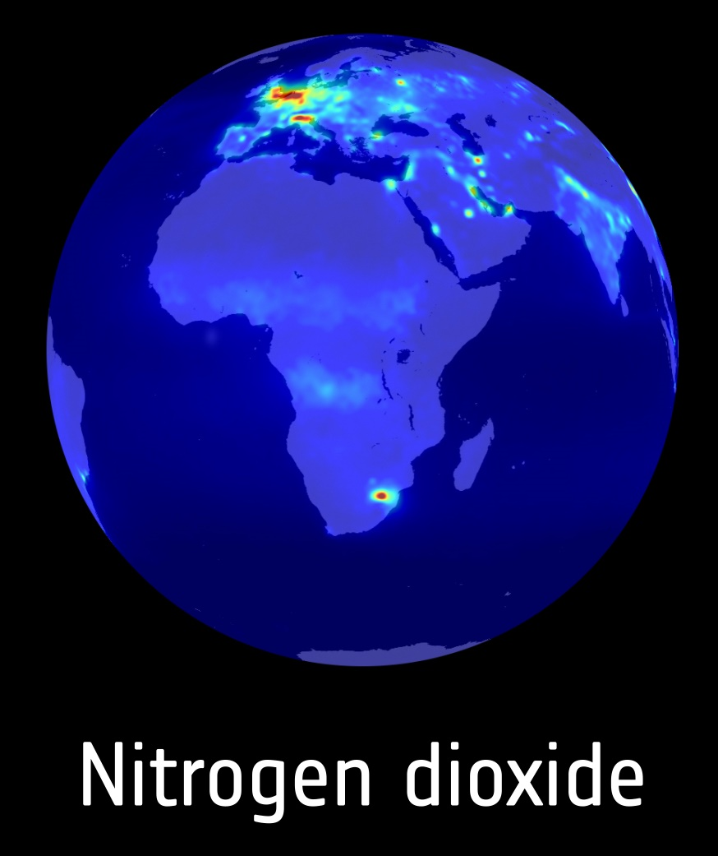
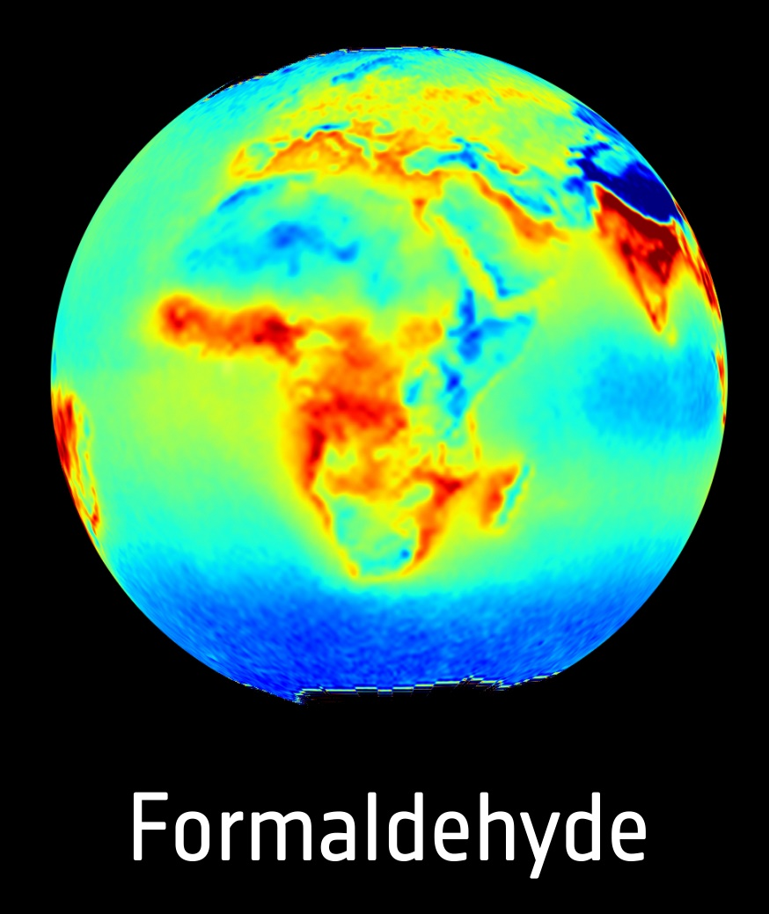
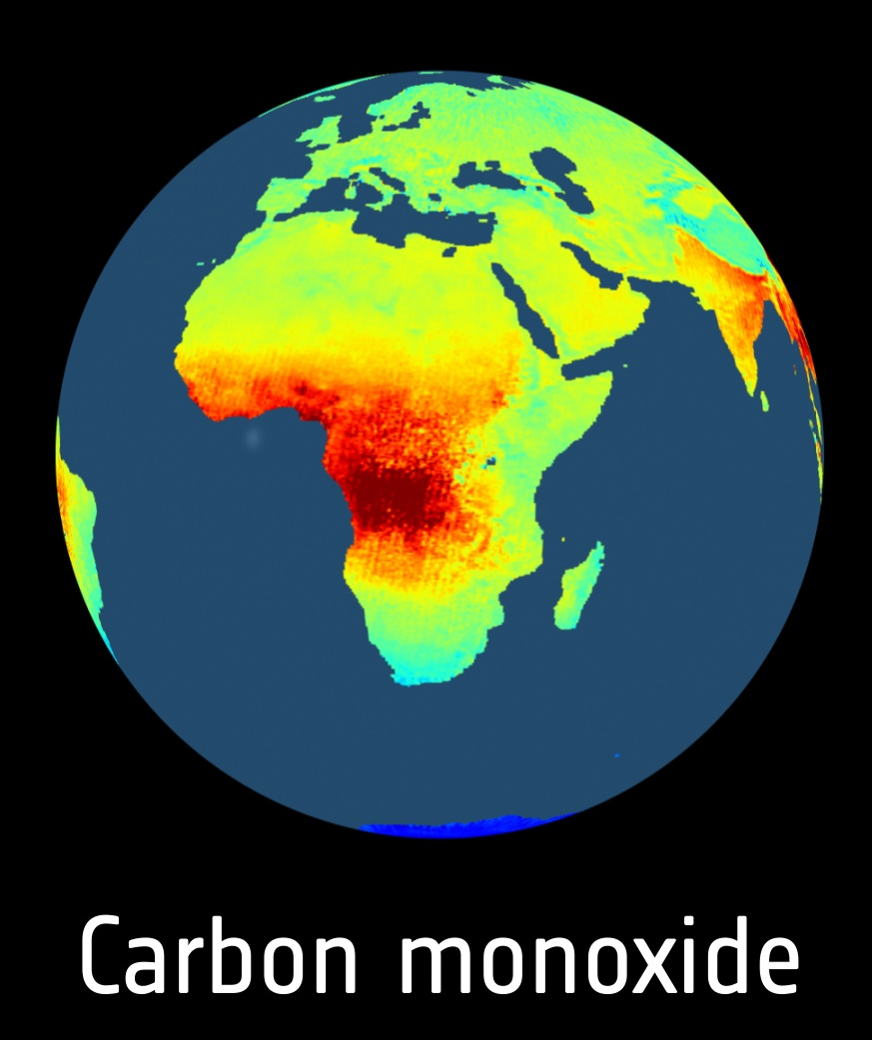
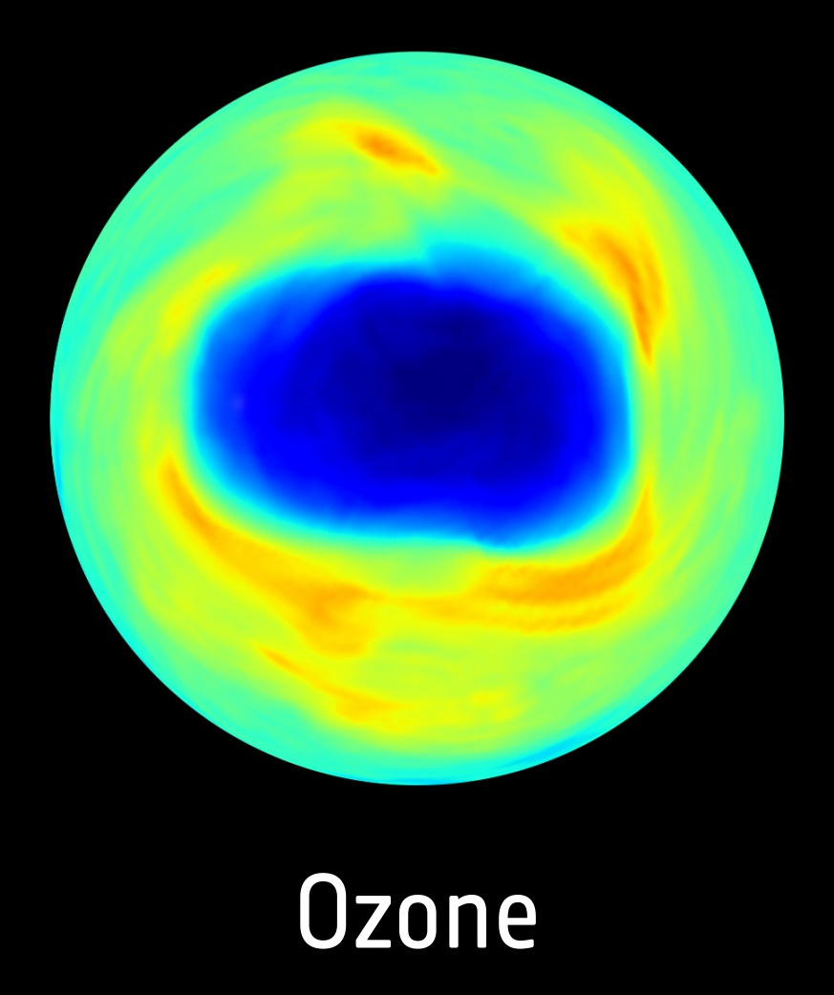
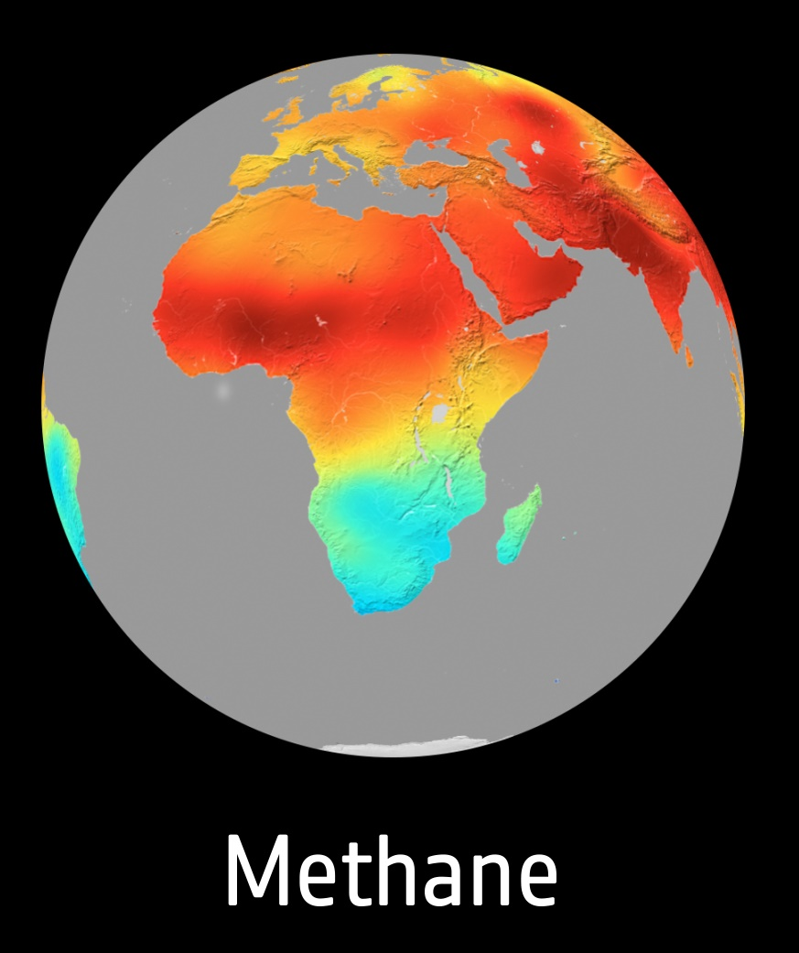
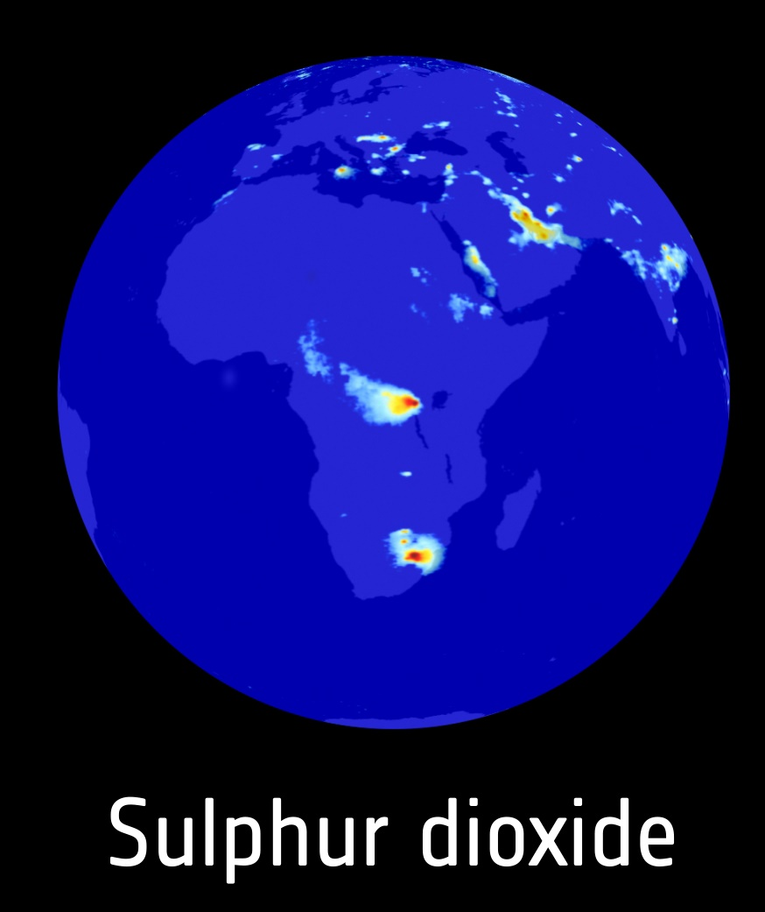
Sentinel-5P: Atmospheric Chemistry Mission
Space Segment
Payload: Tropospheric Monitoring Instrument (TROPOMI) – passive grating imaging spectrometer
Orbit: Polar, Sun-synchronous at altitude of 824 km and in flight formation with Suomi-NPP (US NOAA)
Revisit time: Daily global coverage (13:30 local solar time)
Source: ESA
Sentinel-5P - Rockot
13 October 2017
Plesetsk
Notes:
The sentinel-5P satellite was launched on 13 October 2017 and it carries a single unique instrument, the Tropospheric Monitoring Instrument or TROPOMI. It is a space-borne, nadir-viewing, imaging spectrometer covering wavelength bands between the ultraviolet and the shortwave infrared. It uses passive remote sensing techniques to measure the Top Of Atmosphere (TOA), the solar radiation reflected by and radiated from the earth.
The instrument operates in a push-broom configuration, with a swath width of ~2600 km and ensures daily global coverage at 13:30 local solar time.

Slide 25
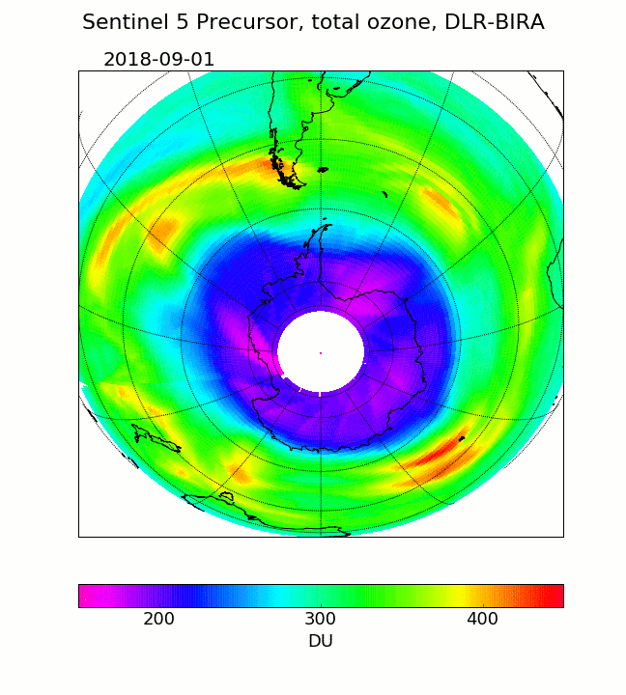
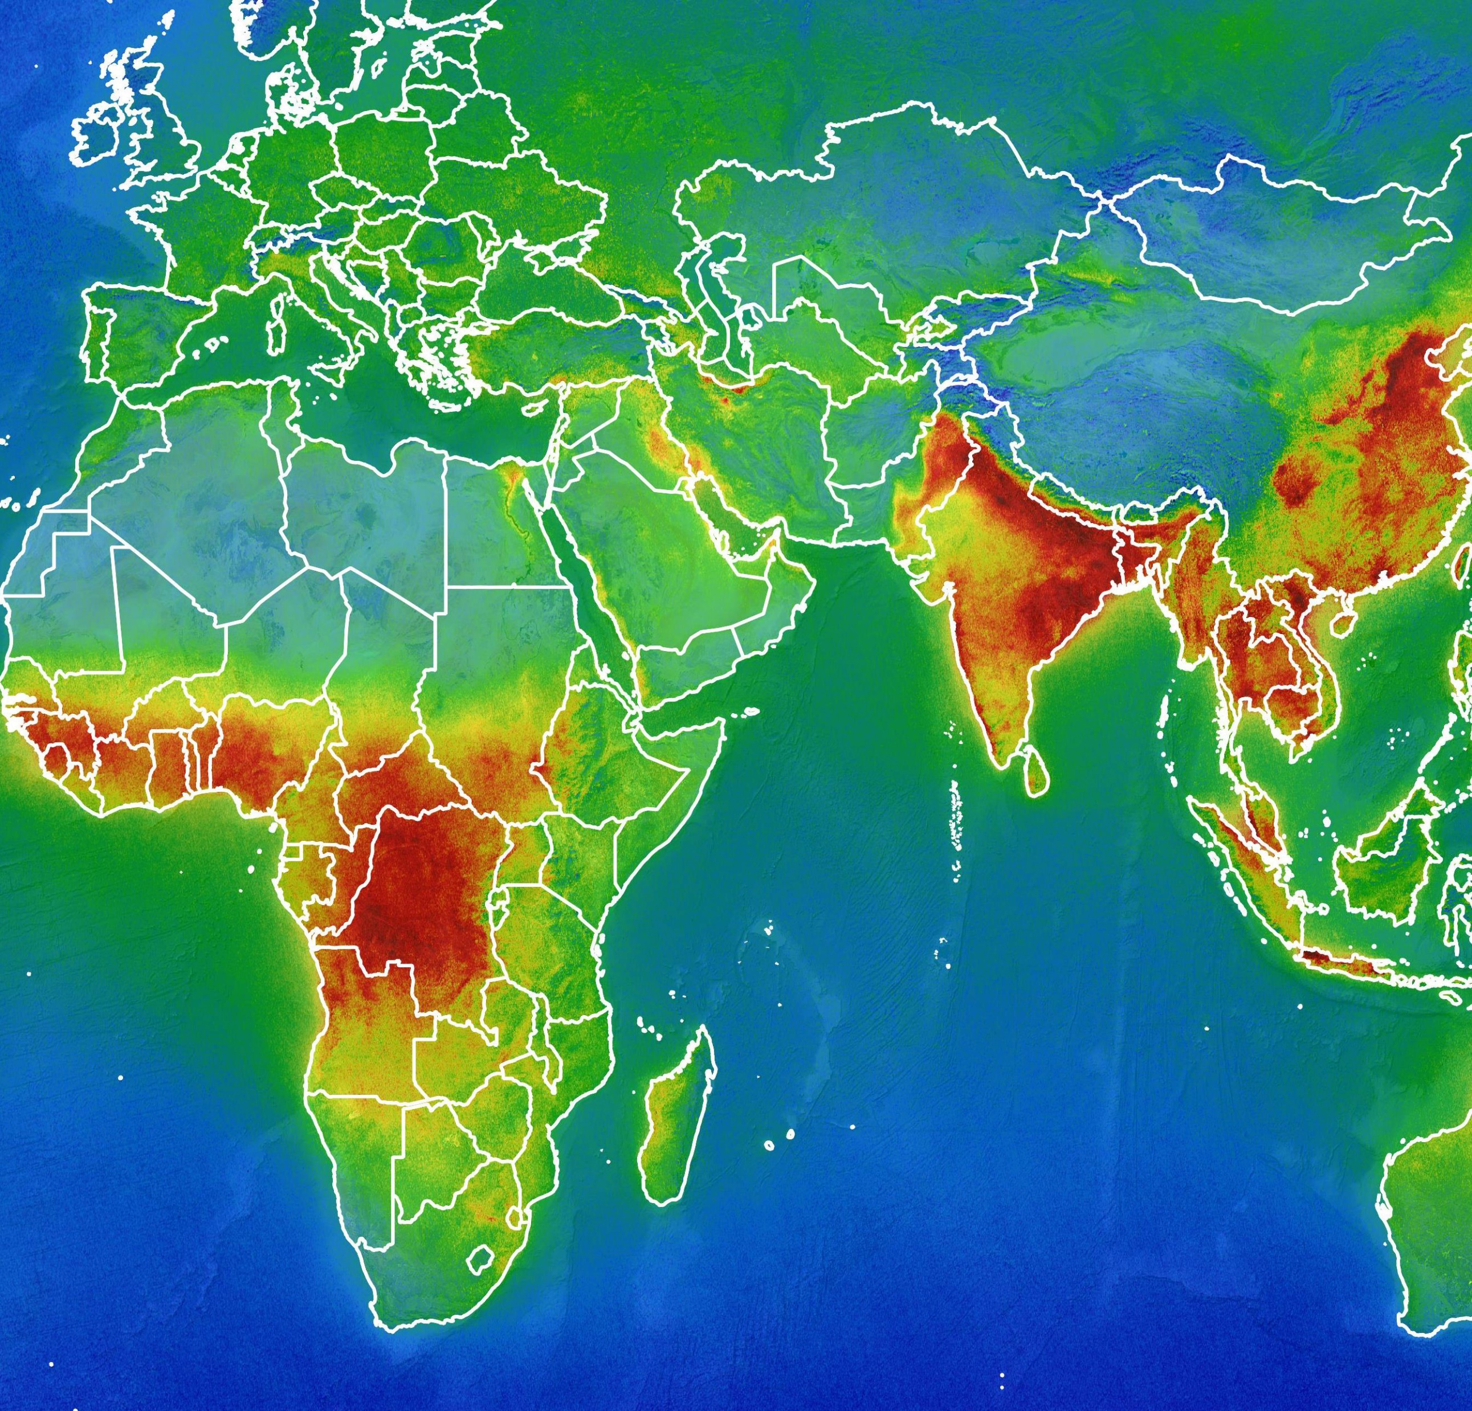
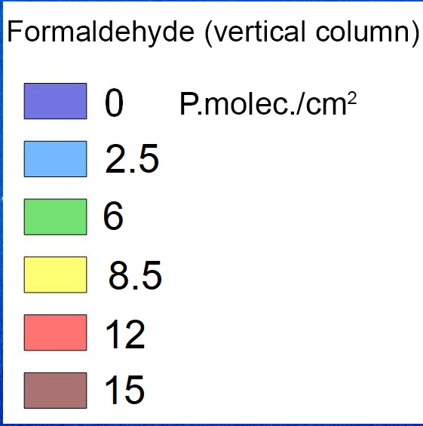
Credits: BIRA–IASB/DLR (contains modified Copernicus data)
Ozone hole over Antarctica
Sentinel-5P - September and October 2018
Formaldehyde vertical column concentrations
Sentinel-5P - January and August 2018
Notes:
Using measurements from the Copernicus Sentinel-5P satellite, the animation shows changes in the ozone hole over Antarctica between September and October 2018.
Launched in October 2017, Sentinel-5P is the first Copernicus mission dedicated to monitoring our atmosphere. The satellite carries the state-of-the-art Tropomi instrument to map a multitude of trace gases that affect the air we breathe and our climate. As well as measuring ozone, this new mission also measures gases such as nitrogen dioxide, formaldehyde, sulphur dioxide, methane, carbon monoxide, and aerosols.
Measurements gathered by the Copernicus Sentinel-5P mission between January and August 2018 have been averaged to reveal formaldehyde in the atmosphere. This map is based on ‘vertical column’ concentrations. This air pollutant is released into the atmosphere from forest fires and wood processing, for example. It is an important intermediate gas in the oxidation of methane and other hydrocarbons. While it is short-lived in the atmosphere, it reacts chemically to become a major source of carbon monoxide – another harmful pollutant.

Slide 26
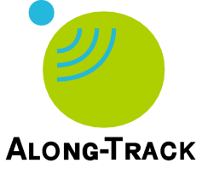
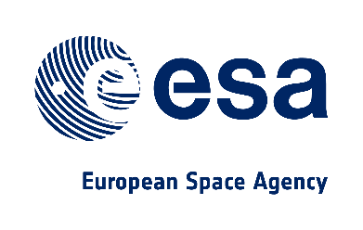
RUS Copernicus
RUS Copernicus
Research and User Support for Sentinel core products
Free access to ICT resources and training for Sentinel data exploitation
Open to everyone for research, R&D and learning purposes
Funded by European Commission and managed by ESA

Slide 27
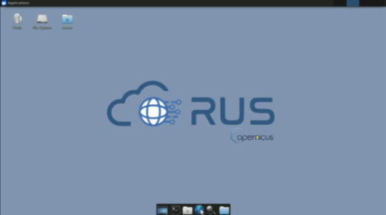
RUS Copernicus
RUS Copernicus
Specialized remote sensing helpdesk
Available via chat or e-mail
Customized preinstalled virtual machines (VMs)
 | Level A | Level B | Level C
Processors | 1-4 cores | 1-10 cores | Up to 40 cores
Disk Space | < 1 TB | < 10 TB | < 50 TB
Duration | 3 months | 6 months | 6 months
Funded by European Commission and managed by ESA

Slide 28
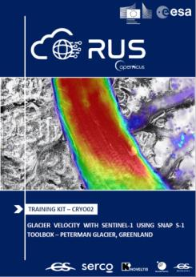
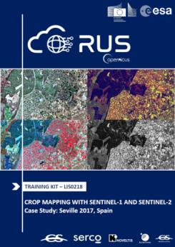
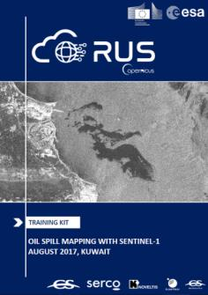
RUS Copernicus -
Training
RUS Copernicus
Sentinel data processing and application (Land, Ocean etc.)
Webinars
One webinar every month
Up to 500 participants
1 hour + live Q&A session
Face-To-Face
Theoretical and hands-on part
20 – 45 participants
Using RUS VMs
E-learning
RUS Training
Funded by European Commission and managed by ESA

Slide 29
RUS Copernicus - Access
RUS Copernicus
@RUS-Copernicus
https://rus-copernicus.eu/
RUS-Copernicus
RUS-Copernicus
https://rus-training.eu/
RUS Copernicus Training
Funded by European Commission and managed by ESA

Slide 30
THANK YOU FOR YOUR ATTENTION!
QUESTIONS?
Q&A

