Slide 1
Regional recovery of the disturbing gravitational potential from GOCE observables
Martin Pitoňák¹, Michal Šprlák² and Pavel Novák¹
¹New Technologies for Information Society,
Faculty of Applied Sciences,
University of West Bohemia,
Plzeň, Czech Republic
²School of Engineering and Built Environment, University of Newcastle, Callaghan, NSW 2308, Australia
10 YEARS OF THE CZECH REPUBLIC IN ESA, November 12 - 15, 2018, Prague

Slide 2
Content:
Colaboration with ESA
Motivation,
Theoretical background,
Numerical experiment,
Results,
Conclusion and discussion
Pitoňák et al.
Regional recovery of the disturbing gravitational potential from GOCE observables
1/20

Slide 3
Colaboration with ESA (1/4 ):
ESTEC Project 4000103566/11/NL/FvO/ef
„Towards a Better Understanding of the Earth’s Interior and Geophysical Exploration Research – GOCE-GDC“
GOCE+ GeoExplore funded by ESA through the Support To Science Element–STS
Pitoňák et al.
Regional recovery of the disturbing gravitational potential from GOCE observables
2/20

Slide 4
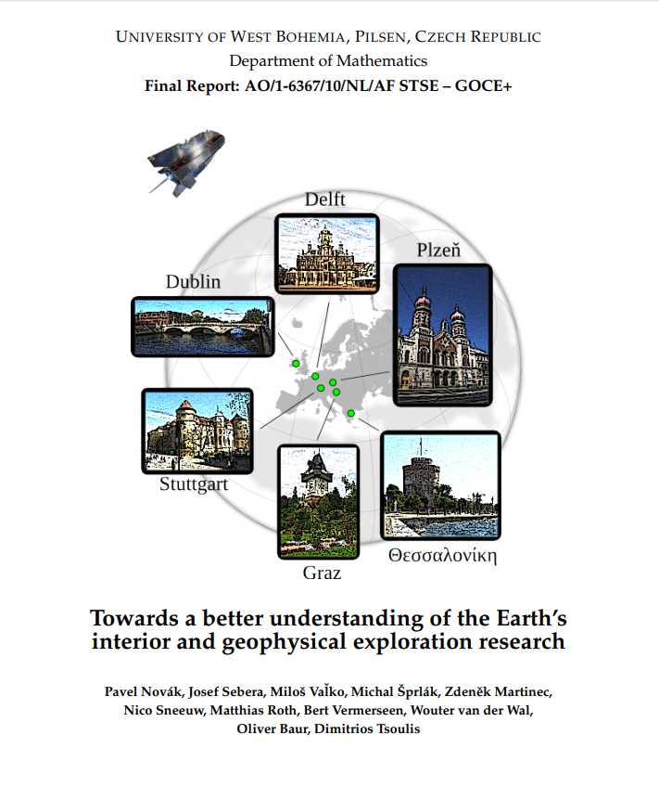
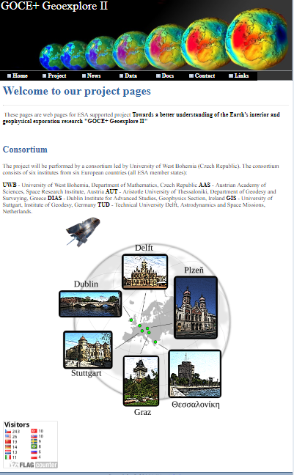
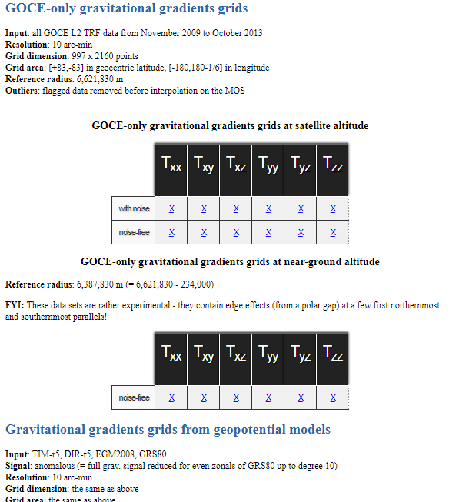
Colaboration with ESA (2/4):
More information and details
on the website
http://goce.kma.zcu.cz/
Pitoňák et al.
Regional recovery of the disturbing gravitational potential from GOCE observables
3/20

Slide 5
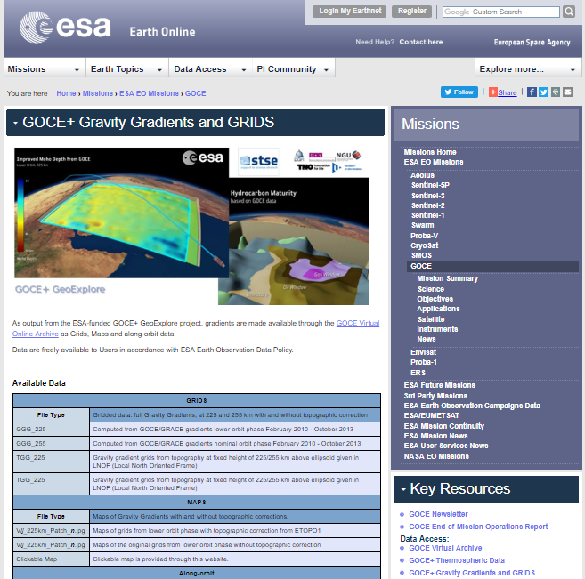
Colaboration with ESA (3/4 ):
Please visit the website:
https://earth.esa.int/web/guest/missions/esa-operational-eo-missions/goce/geoexplore
Pitoňák et al.
Regional recovery of the disturbing gravitational potential from GOCE observables
4/20

Slide 6
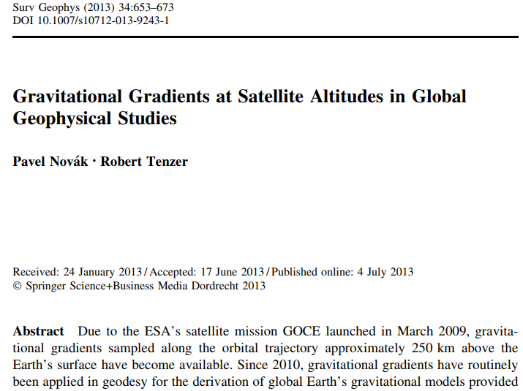
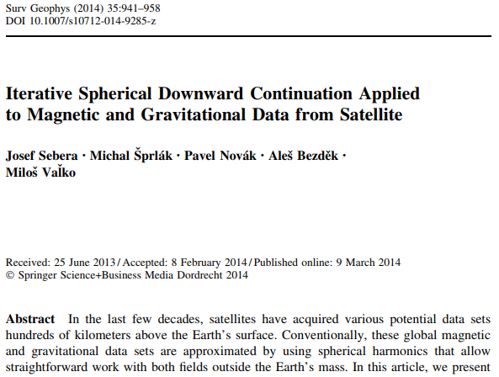
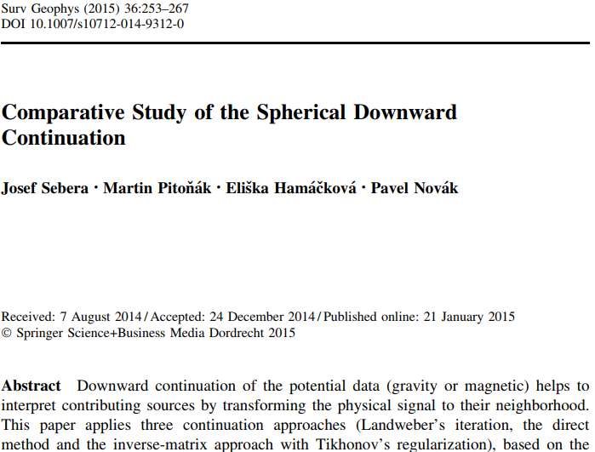
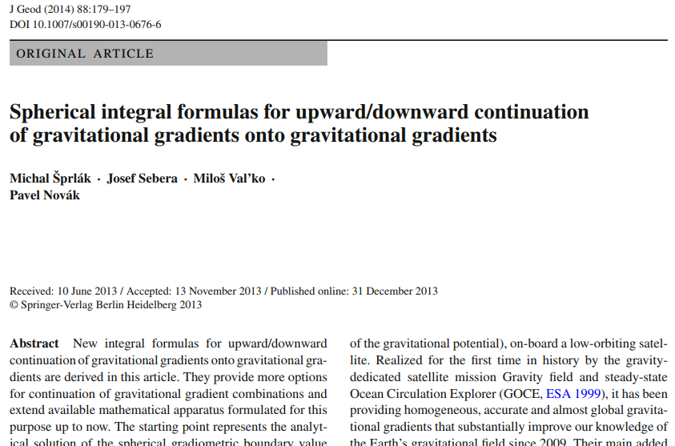
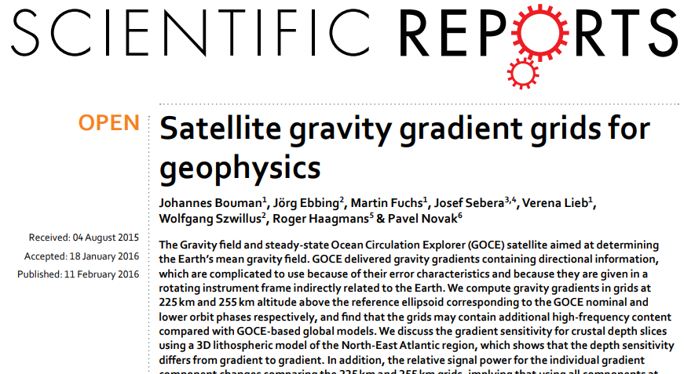
Colaboration with ESA (4/4 ): Projects publications
Pitoňák et al.
Regional recovery of the disturbing gravitational potential from GOCE observables
5/20

Slide 7
Motivation:
The GOCE mission - more than three years of outstanding measurements which resulted into five releases of global gravitational models (GGMs),
Comparison of two strategies for reduction the far zone effect,
How compare results from downward continuation with EGM2008 and quantify the differences?
Can we improve regional gravity field in Europe from EGG data?
How various time-span of the EGG data influence accuracy of the final results?
Pitoňák et al.
Regional recovery of the disturbing gravitational potential from GOCE observables
6/20

Slide 8
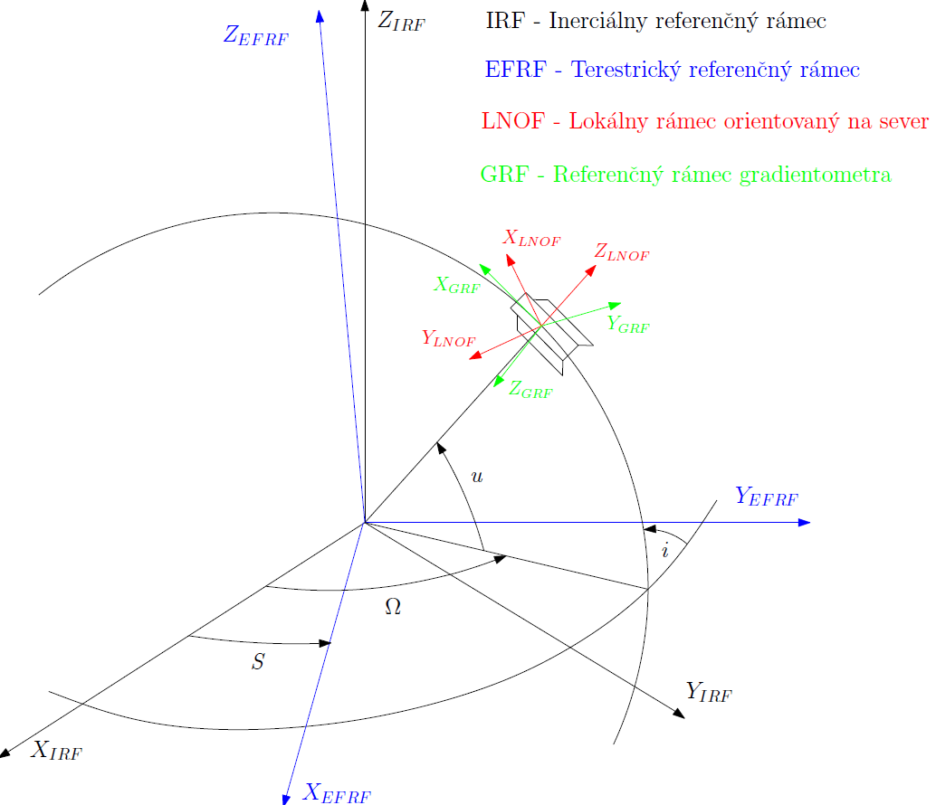
Theoretical background (1/2): Integral transformation
The relationship between the disturbing gravitational gradients and the disturbing gravitational potential can be obtained by differentiating the spherical Abel-Poisson integral formula (Šprlák et al., 2015)
IRF – Inertial Reference Frame
The corresponding integral kernel functions were derived by (ibid.)
EFRF – Earth Fixed Reference Frame
LNOF – Local North Oriented Frame
GRF – Gradiometer Reference Frame
The isotropic kernel functions in the previous equations are (ibid.)
The nomenclature which was used in the previous equations
Pitoňák et al.
Regional recovery of the disturbing gravitational potential from GOCE observables
7/20

Slide 9
Theoretical background (2/2): Regularization
Eq. (1) in the vector-matrix form well-known as the Gauss-Markov model
for the least-squares estimate of x we can write
The system of normal equations (5) represents the discretized Fredholm integral equation of the first kind with the ill-conditioned matrix of normal equations N (its condition number in numerical experiments reached values ≈ 10¹⁶). The Tikhonov regularization (Tikhonov 1963a, b) with the estimate of x in the following form was applied
In our numerical experiments we applied the general cross-validation (GCV) method (Hansen and O’Fleary, 1993) and L-curve criterion (Miller, 1970) to determine regularization parameter. The bias of the solution can formally be computed from (Xu et al., 2006)
Combination of all four well-measured gravitational gradients:
Variance Component estimation (Koch and Kusche, 2002)
The Tikhonov regularization (Eq. 6)
Pitoňák et al.
Regional recovery of the disturbing gravitational potential from GOCE observables
8/20

Slide 10
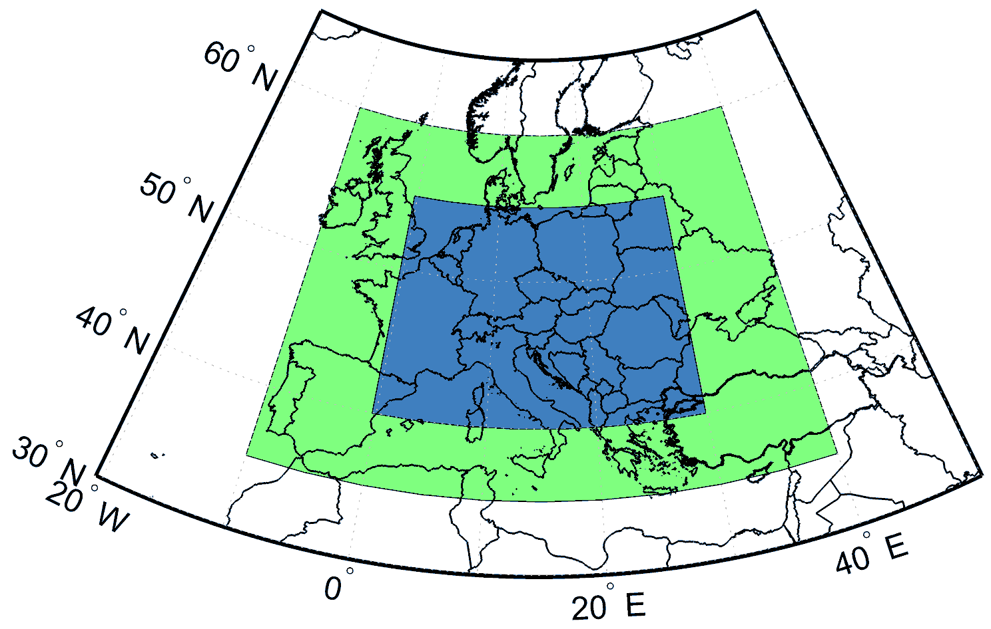
Numerical experiment (1/4): Test area and input data
Input data: GOCE Level 2 EGG_TRF_2 (1 November 2009 to 30 June 2010) ≈ 8 months
(≈354000 values for each gravitational gradient)
Solution area:
Integration radius:
Pitoňák et al.
Regional recovery of the disturbing gravitational potential from GOCE observables
9/20

Slide 11
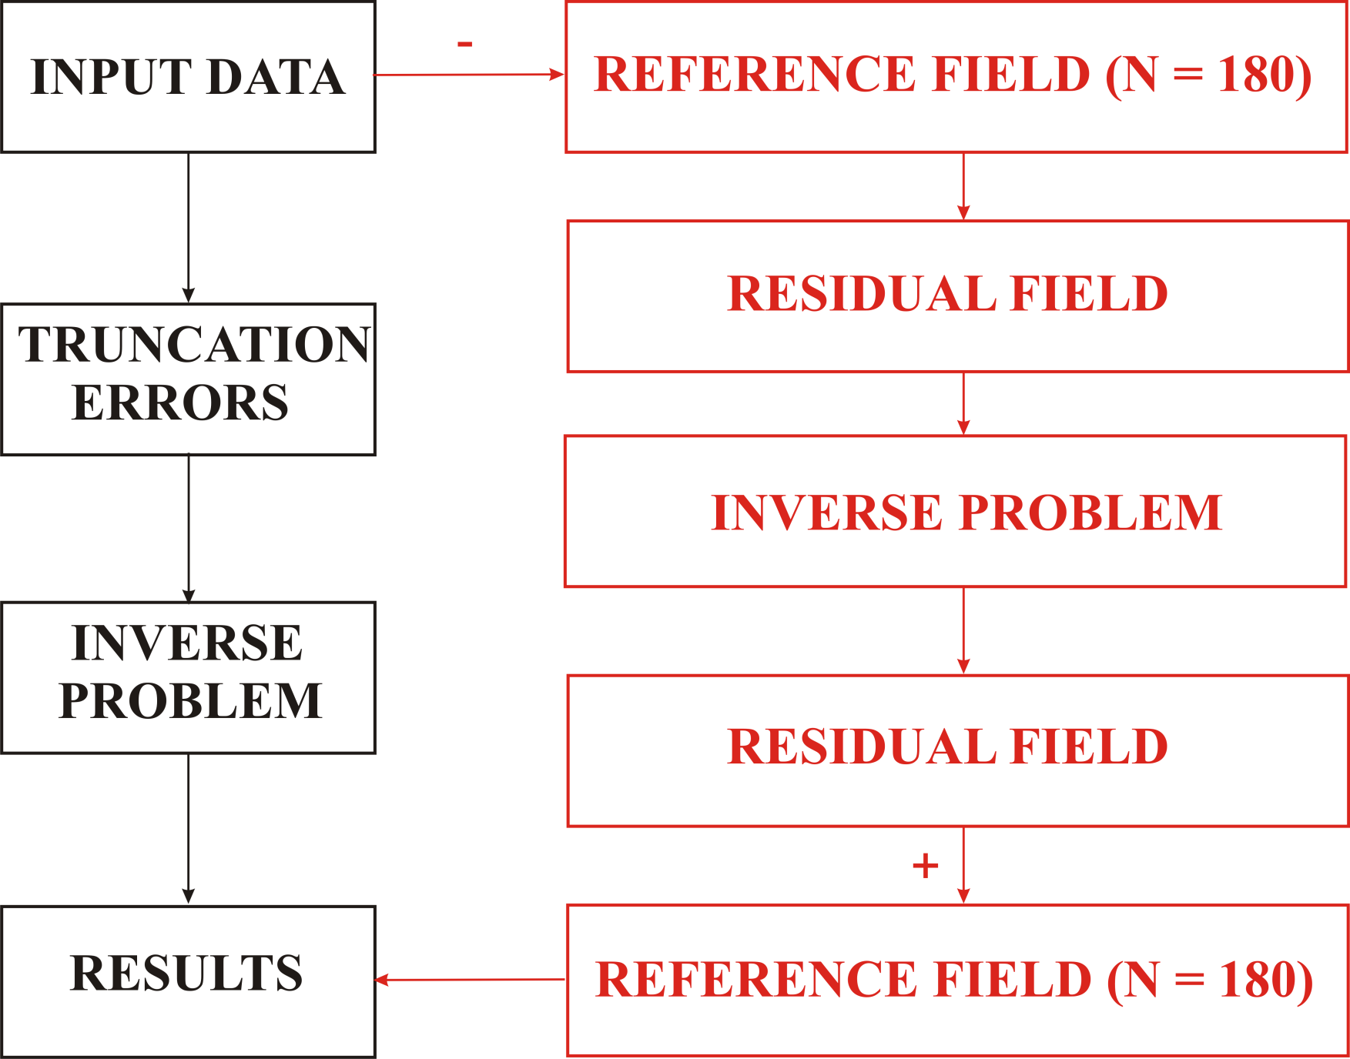
Numerical experiment (2/4): Computation scheme
Strategy I
Strategy II
Pitoňák et al.
Regional recovery of the disturbing gravitational potential from GOCE observables
10/20

Slide 12
Numerical experiment (3/4):
Strategy I:
- the truncation error formulas computed according to (Šprlák et al., 2015) up to the degree 150 from the GRACE-based global gravitational model GGM05S (Tapley et al., 2013).
Strategy II:
Low frequencies of the gravitational field should be removed to reduce the effect of the omitted distant
zone data.
The long-wavelength effect was generated from the TIM-r4 model (Pail et al., 2011) up to the degree 180
version a: 30 days (November 2009) of the input data,
version b: 72 days (1 November 2009 – 11 January 2010) of the input data,
version c: 212 days (1 November 2009 – 30 June 2013) of the input data.
Pitoňák et al.
Regional recovery of the disturbing gravitational potential from GOCE observables
11/20

Slide 13
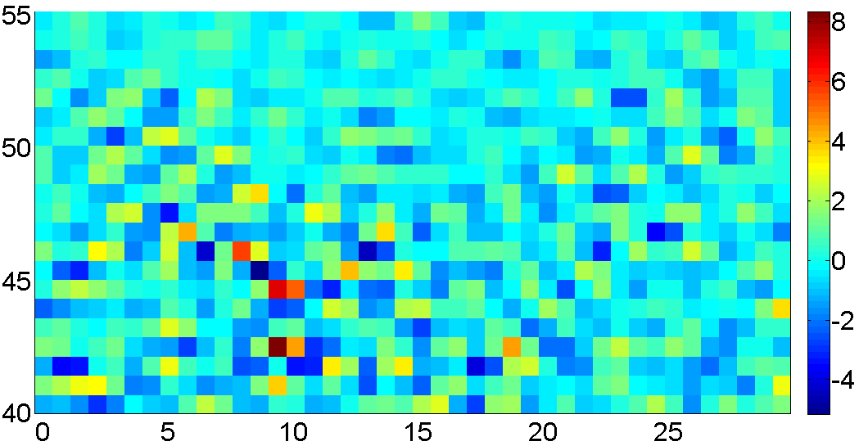
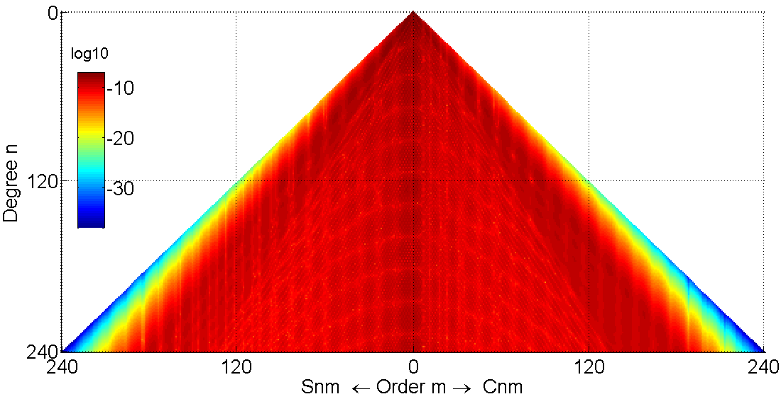
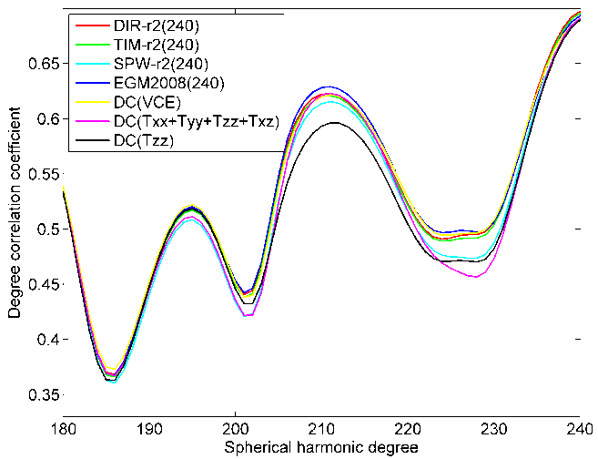
Numerical experiment (4/4): Test of the results
Spherical harmonic synthesis
Spherical harmonic analysis
Degree correlation with Rock-Water-Ice topographic-isostatic gravitational model (Grombein et al., 2014)
Pitoňák et al.
Regional recovery of the disturbing gravitational potential from GOCE observables
12/20

Slide 14
Results (Strategy I):
Differences between the values of the disturbing gravitational potential obtained from T_{xx}, T_{yy}, T_{zz} and T_{xz}, as well as from their combination using joint inversion and the VCE method (truncation error reduction) from the 212 day data coverage, and from EGM2008 up to the degree 240 (unit 1 m² s⁻²)
 | T_{xx} | T_{yy} | T_{zz} | T_{xz} | Joint inversion | VCE
RMS | 22.346 | 24.941 | 8.514 | 74.641 | 2.971 | 3.201
Min | -123.893 | -103.249 | -57.330 | -527.766 | -18.380 | -17.737
Max | 4.170 | 35.139 | 1.149 | -169.314 | 5.568 | 5.000
mean | -33.352 | -20.995 | -10.294 | -356.775 | -1.806 | -4.859
Differences between values of the disturbing gravitational potential from the selected models and EGM2008 up to the degree 240 (unit 1 m² s⁻²)
 | TIM-r2 | DIR-r2 | SPW-r2
RMS | 1.110 | 1.262 | 1.485
min | -4.959 | -3.967 | -8.203
max | 2.968 | 3.789 | 6.432
mean | 0.002 | -0.014 | 0.034
Pitoňák et al.
Regional recovery of the disturbing gravitational potential from GOCE observables
13/20

Slide 15
Results (Strategy II):
Differences between the values of the disturbing gravitational potential obtained from T_{xx}, T_{yy}, T_{zz} and T_{xz}, as well as from their combination using joint inversion and the VCE method (remove-compute-restore scenario) from the 30, 72 and 212 day data coverage, and from EGM2008 up to the degree 240 (unit 1 m² s⁻²)
30 days
 | T_{xx} | T_{yy} | T_{zz} | T_{xz} | Joint inversion | VCE
RMS | 2.055 | 2.331 | 2.627 | 2.626 | 1.805 | 1.712
Min | -11.430 | -12.102 | -9.054 | -10.000 | -8.963 | -11.573
max | 8.850 | 10.583 | 7.861 | 8.041 | 5.123 | 9.437
mean | 0.044 | -0.018 | 0.015 | -0.050 | 0.019 | 0.014
72 days
rms | 1.916 | 2.176 | 2.041 | 2.152 | 1.584 | 1.497
min | -11.882 | -12.572 | -8.947 | -9.062 | -8.340 | -10.567
max | 8.444 | 10.651 | 8.136 | 7.666 | 6.529 | 8.215
mean | 0.030 | 0.027 | 0.034 | -0.052 | 0.023 | 0.015
212 days
rms | 1.789 | 2.015 | 1.515 | 1.719 | 1.326 | 1.231
min | -10.073 | -12.317 | -9.341 | -8.739 | -8.326 | -7.522
max | 7.930 | 10.769 | 5.053 | 5.946 | 5.166 | 5.036
mean | 0.025 | 0.021 | 0.021 | -0.030 | 0.019 | 0.014
Pitoňák et al.
Regional recovery of the disturbing gravitational potential from GOCE observables
14/20

Slide 16
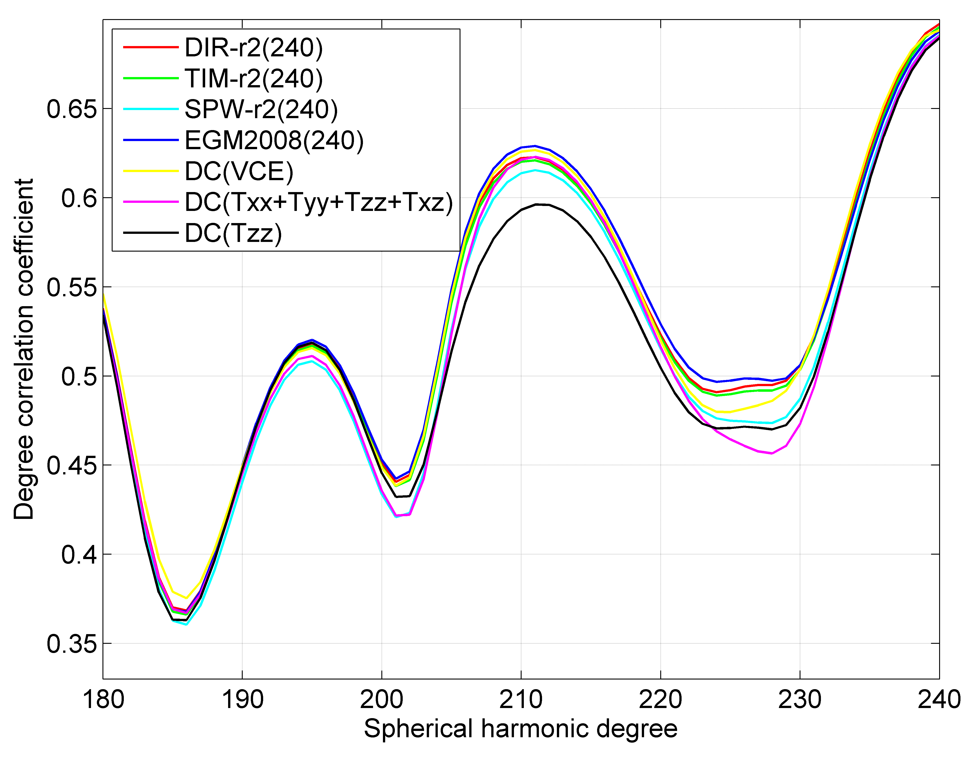
Results (Strategy I):
Degree correlation coefficients between selected GOCE-based global gravitational models, EGM2008, selected regional solutions (GOCE gradient data from November 2009 - June 2010 with truncation error reduction applied) and RWI model.
Pitoňák et al.
Regional recovery of the disturbing gravitational potential from GOCE observables
15/20

Slide 17
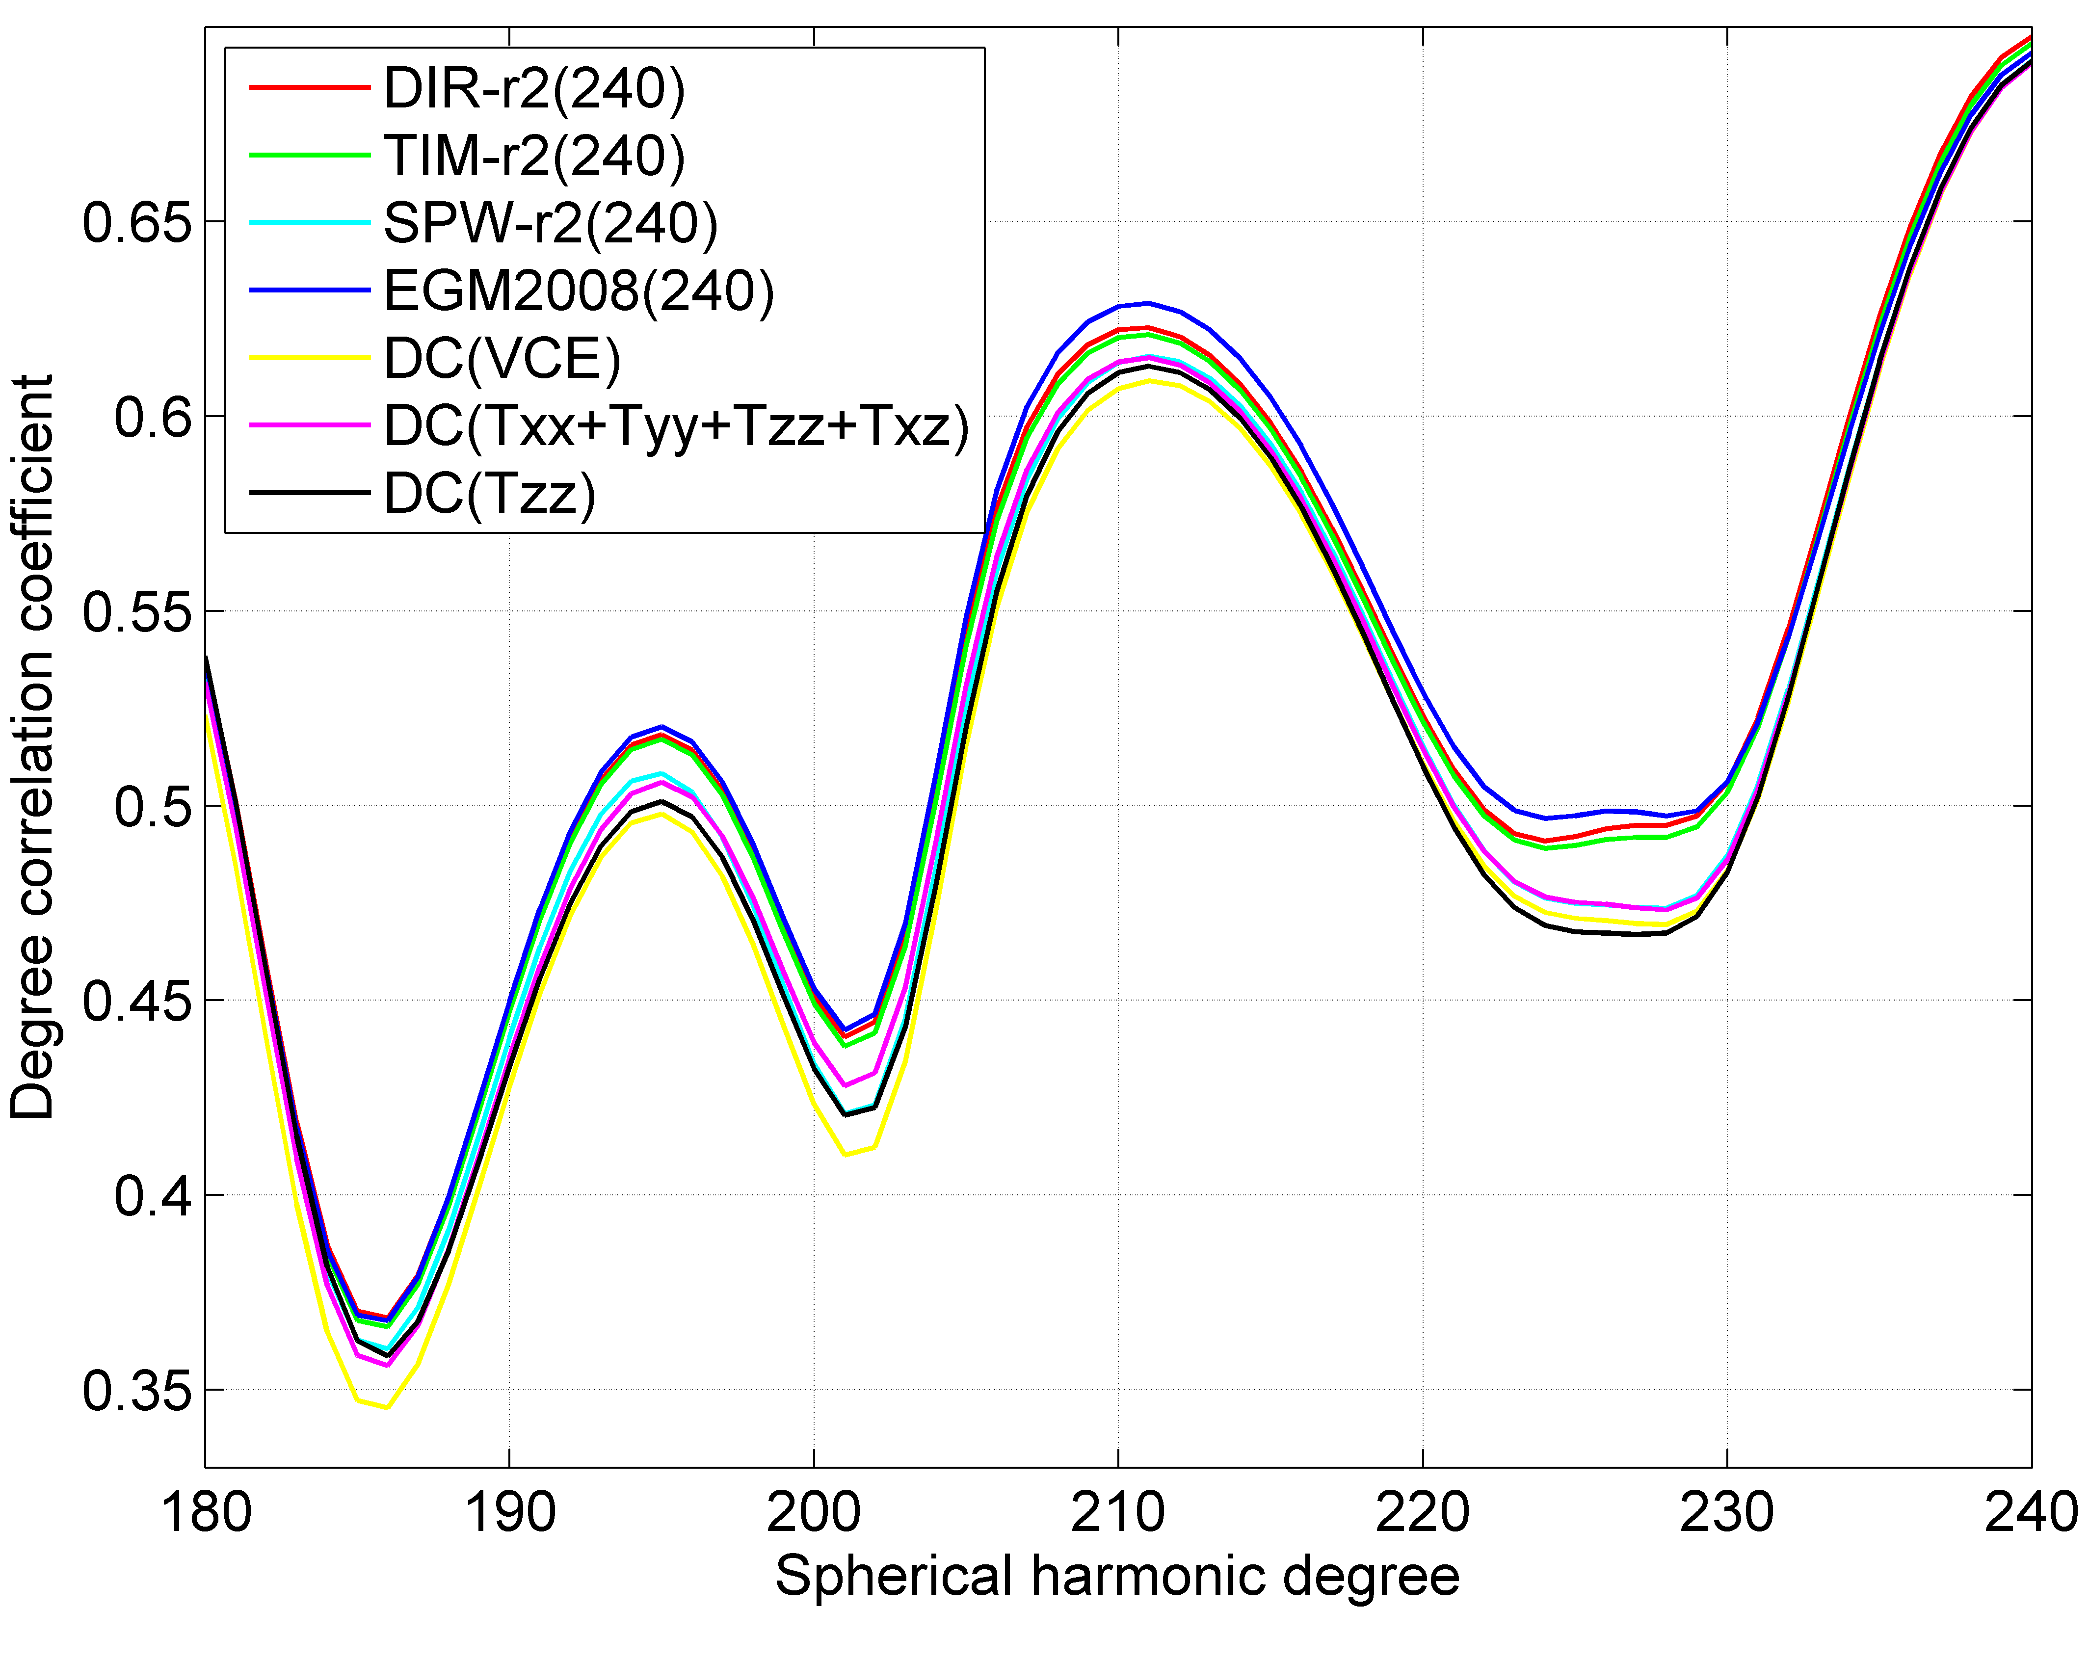
Results (Strategy II version a):
Degree correlation coefficients between selected GOCE-based global gravitational models, EGM2008, selected regional solutions (GOCE data from November 2009 with the remove-compute-restore scenario applied) and RWI model.
Pitoňák et al.
Regional recovery of the disturbing gravitational potential from GOCE observables
16/20

Slide 18
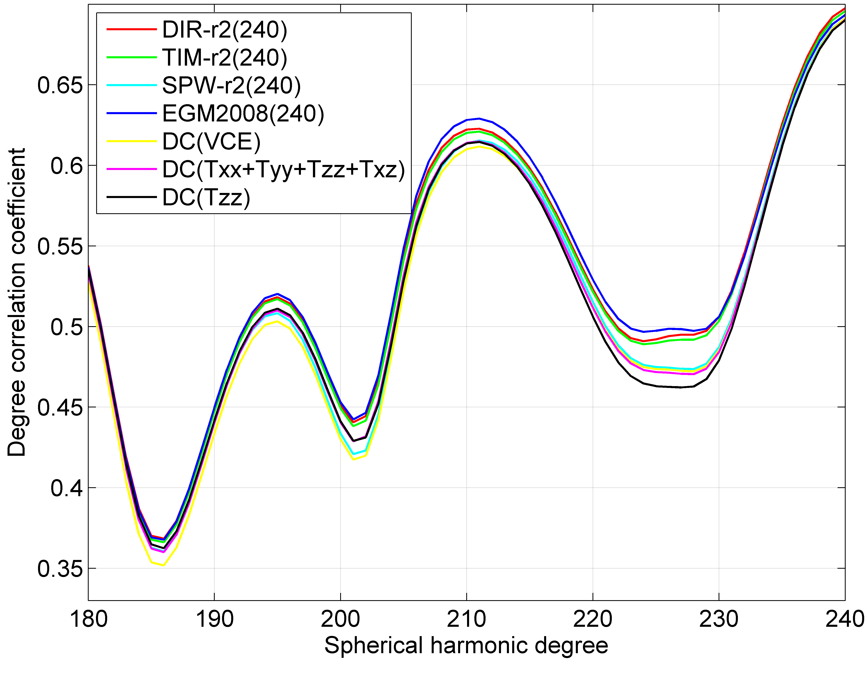
Results (Strategy II version b):
Degree correlation coefficients between selected GOCE-based global gravitational models, EGM2008, selected regional solutions (GOCE data from 1 November 2009 – 11 January 2010 with the remove-compute-restore scenario applied) and RWI model.
Pitoňák et al.
Regional recovery of the disturbing gravitational potential from GOCE observables
17/20

Slide 19
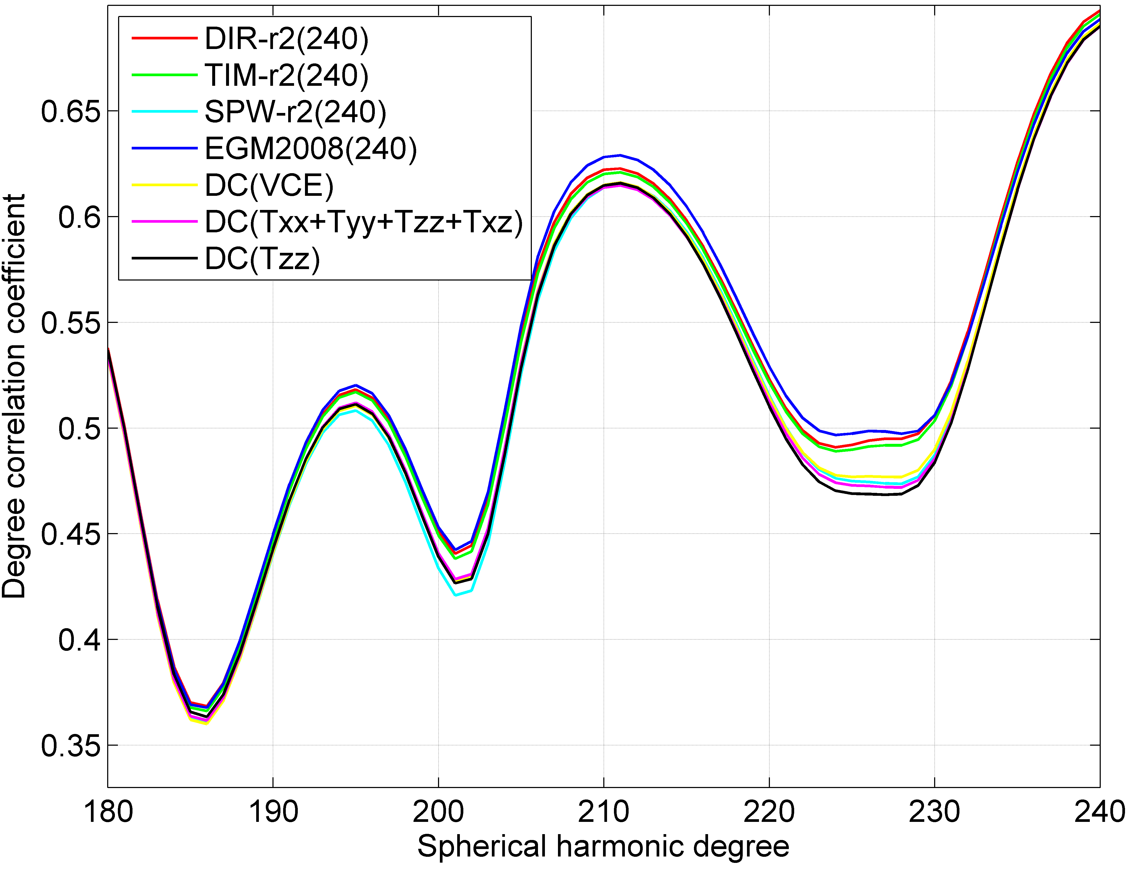
Results (Strategy II version c):
Degree correlation coefficients between selected GOCE-based global gravitational models, EGM2008, selected regional solutions (GOCE data from 1 November 2009 – 30 June 2010 with the remove-compute-restore scenario applied) and RWI model
Pitoňák et al.
Regional recovery of the disturbing gravitational potential from GOCE observables
18/20

Slide 20
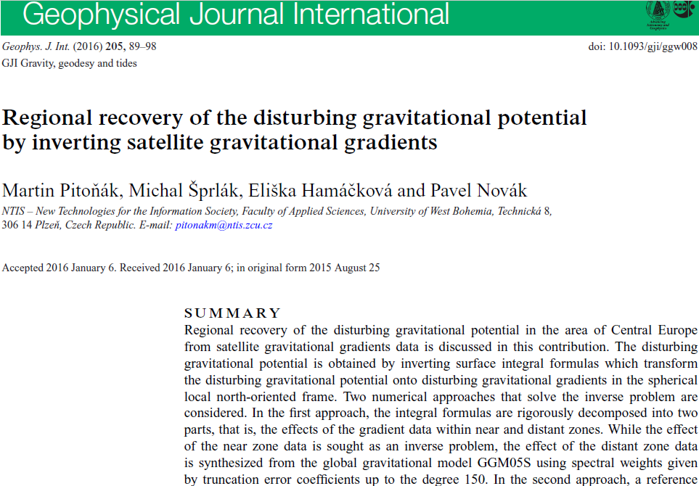
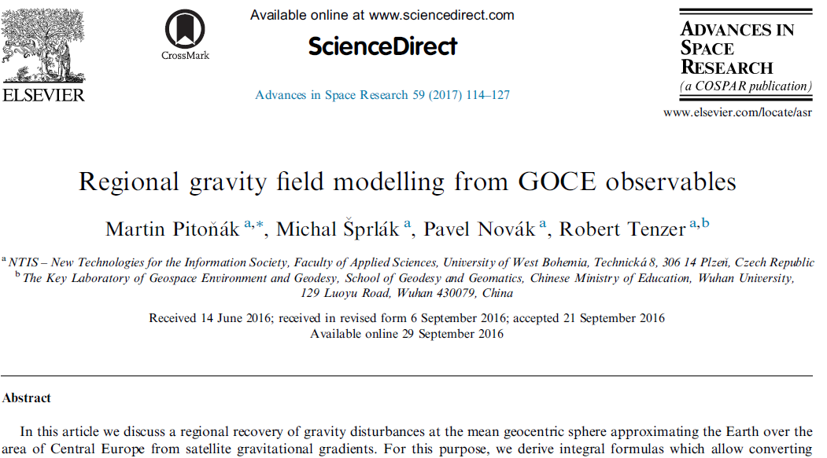
Conclusion and discussion:
A method for comparing results from downward continuation with EGM2008 was suggested,
Our regional models are comparable with the second release of GOCE-based GGMs,
More data improved an accuracy of regional models about 0.5 mGal for combined solutions and more than 1 mGal
for T_{zz} ,
In the future experiment the reprocessed gravitational gradients in the gradiometric reference frame will be applied.
NOTHING TO FEAR FROM REAL GRAVITATIONAL GRADIENTS MEASURED BY GOCE GRADIOMETER
Pitoňák et al.
Regional recovery of the disturbing gravitational potential from GOCE observables
19/20

Slide 21
Thank you for your attention
pitonakm@ntis.zcu.cz
Pitoňák et al.
Regional recovery of the disturbing gravitational potential from GOCE observables
20/20

