Slide 1


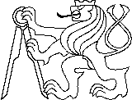
10 years of the Czech Republic in ESA, Nov. 2018
Jaroslav Klokočník ¹,* Jan Kostelecký ^{2, 3}, Aleš Bezděk ^{1,4}
^{*1}Astronomical Institute, Czech Academy of Sciences, CZ 25 165 Ondřejov, Fričova 298, Czech Republic
² Research Institute of Geodesy, Topography and Cartography, CZ 25 066 Zdiby 98, Czech Republic,
³ Department of Geodesy and Mining Surveying, Faculty of Mining and Geology, VSB-TU Ostrava,
CZ-70833 Ostrava, Czech Republic
⁴ Department of Geomatics, Faculty of Civil Engineering, Czech Technical University in Prague,
Thákurova 7, CZ 16 629 Prague 6, Czech Republic
Candidates for subglacial volcanoes, lakes, a lake basin,
and a huge impact structure in East Antarctica
from new gravito-topographic data
including ESA GOCE gradiometry
Notes:
Satellite dynamics (…) and physical geodesy, use of their theory and numerical results s/c….

Slide 2
www.asu.cas.cz/~jklokocn
www.asu.cas.cz/~jklokocn/REVIEW-SG2018
Co-authors and cooperating persons:
Jan Kostelecký
Aleš Bezděk
Jan Kalvoda
Václav Cílek
Ivan Pešek
B. Bucha
Christoph Foerste
Nikolaos S. Pavlis
H.D. Pritchard
Christian Hirt
C.K. Shum
L.V. Eppelbaum
M. Beiki
Rune Floberghagen …

Slide 3
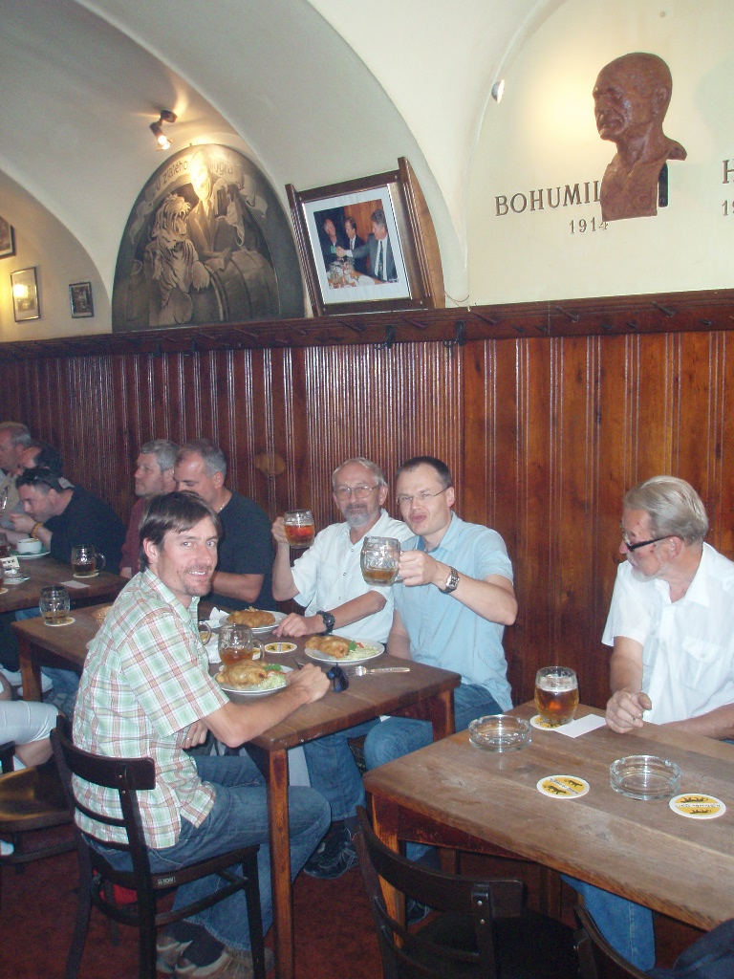
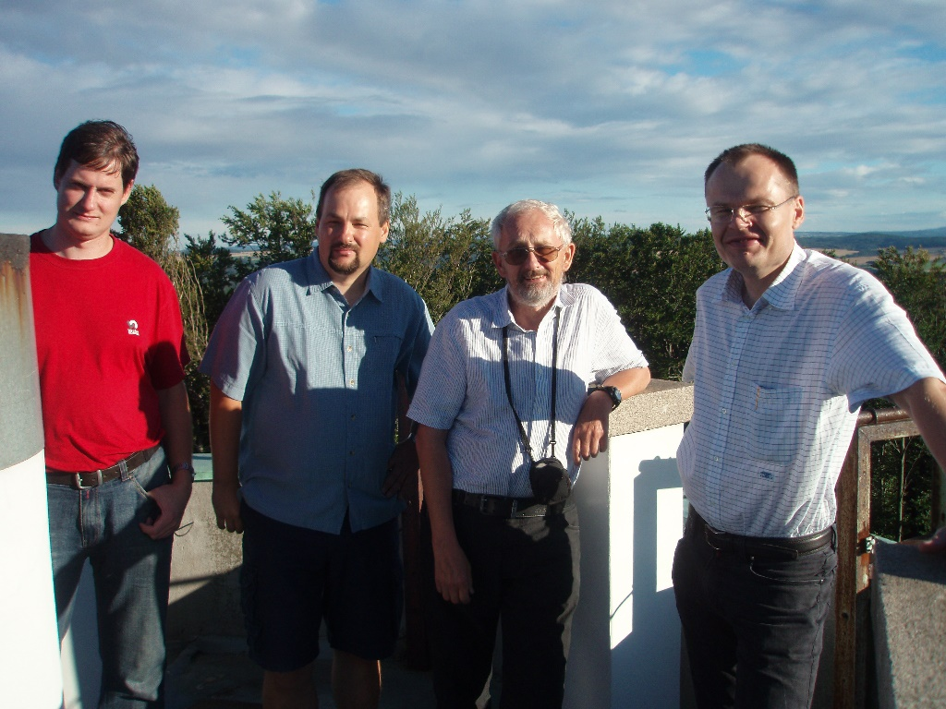
PECS Plan for European Cooperating States
Grant 2008-2013:
“GOCE-specific tasks on fine gravity field structure of the Earth”
Dr. Rune Floberghagen, ESA GOCE project manager,
cooperation since 2006 ESA ESRIN, Frascati
Visit in Ondřejov and Prague in 2008

Slide 4
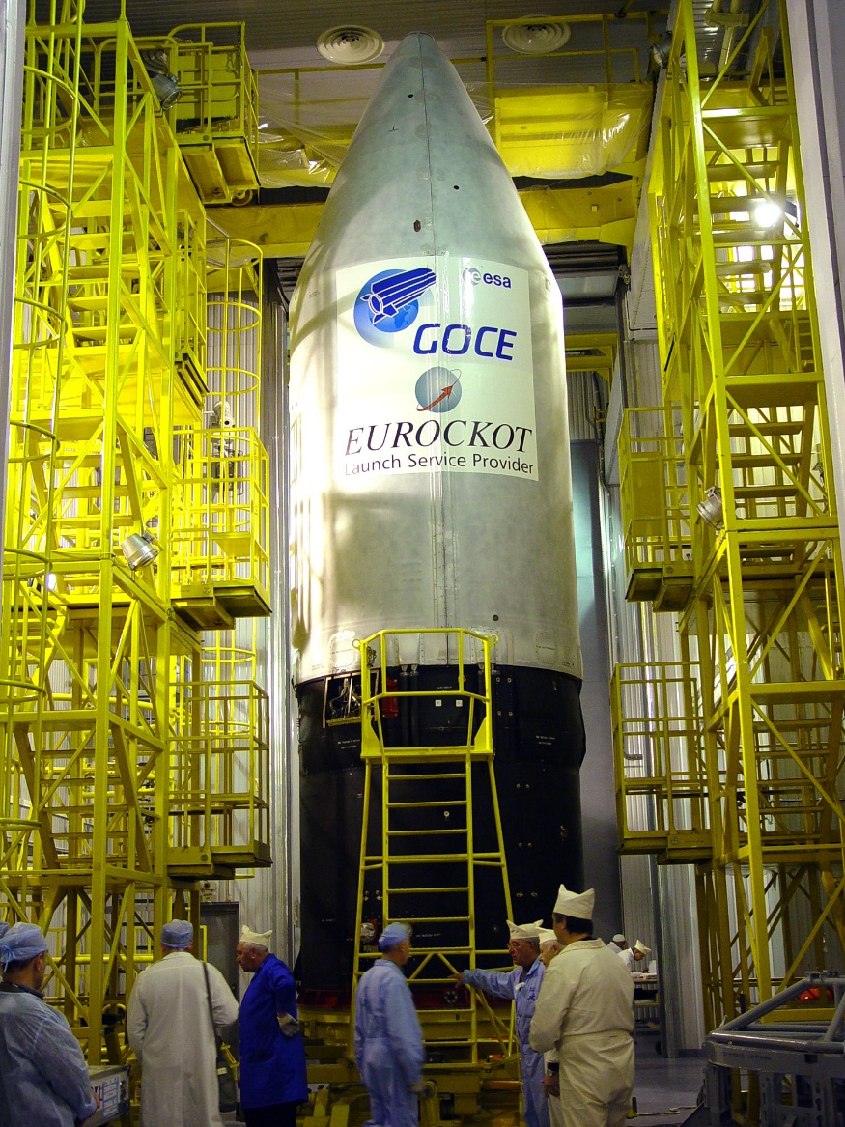
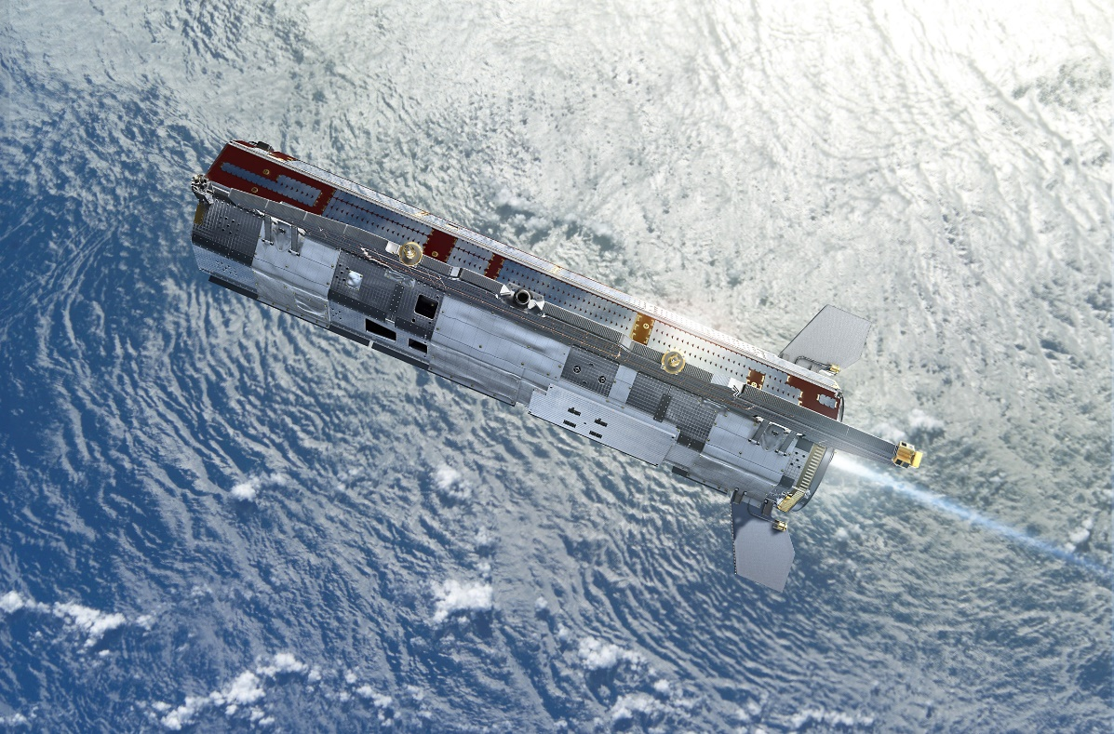
GOCE 2009-2013
(Gravity field and steady-state Ocean Circulation Explorer, ESA)
1mGal = 10⁻⁵ ms⁻², 1E = 1 Eötvös = 10⁻⁹ s⁻²
1 mGal = 10⁻⁵ ms⁻², 1 E = 1 Eötvös = 10⁻⁹ s⁻²
1 mE = 10⁻¹² s⁻²

Slide 5
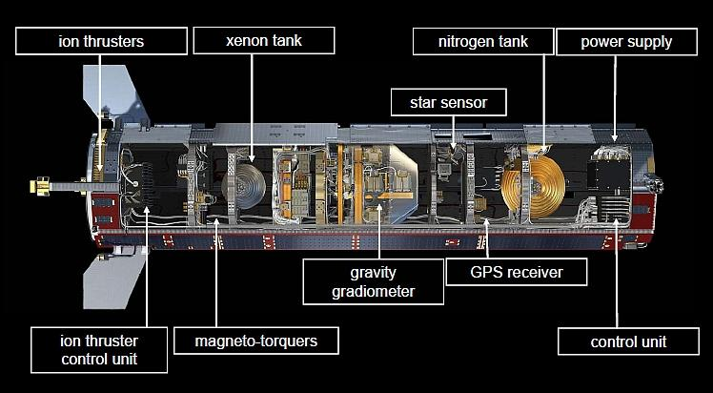

Slide 6
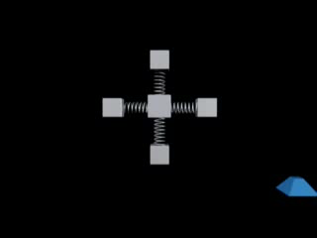

Slide 7

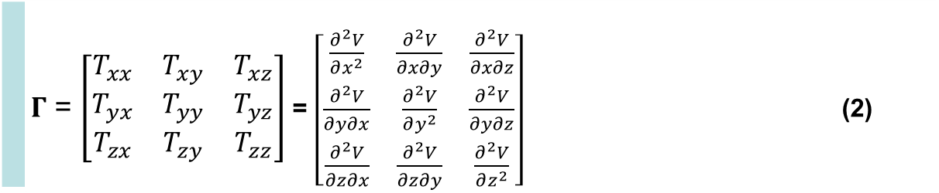
Disturbing static gravitational potential outside the Earth masses in spherical harmonic expansion
 | $$T\left(r,φ,λ\right)=\frac{GM}{r}\sum_{l=2}^{∞}{\sum_{m=0}^{l}{{\left(\frac{R}{r}\right)}^{l}\left({C^{′}}_{l,m}cos mλ+S_{l,m}sin mλ \right)}} P_{l,m}\left(sin φ\right)$$
where GM is a product of the universal gravitational constant and the mass of the Earth (also known as
the geocentric gravitational constant), r is the radial distance of an external point where T is computed,
R is the radius of the Earth (which can be approximated by the semi-major axis of a reference ellipsoid),
P_{l,m} (sin φ) are the Legendre associated functions, l and m are the degree and order of the harmonic expansion,
(φ, λ) are the geocentric latitude and longitude, C’_{l,m} and S_{l,m} are the harmonic geopotential coefficients
(Stokes parameters), fully normalized, C’_{l,m} = C_{l,m} – C^{el}_{l,m}, where C^{el}_{l,m} belongs to the reference ellipsoid.
The spherical approximation of the gravity anomaly Δg is computed
$∆g=−\frac{∂T}{∂r}−2\frac{T}{r}$
or one can use the gravity disturbance (it is the same but without the second term).
Gravity gradient tensor Γ (the Marussi tensor) is a tensor of the second derivatives of
the disturbing potential T:
 | $Γ$ = $\left[\begin{matrix}T_{xx} & T_{xy} & T_{xz} \\ T_{yx} & T_{yy} & T_{yz} \\ T_{zx} & T_{zy} & T_{zz}\end{matrix}\right]$ = $\left[\begin{matrix}\frac{∂^{2}V}{∂x^{2}} & \frac{∂^{2}V}{∂x∂y} & \frac{∂^{2}V}{∂x∂z} \\ \frac{∂^{2}V}{∂y∂x} & \frac{∂^{2}V}{∂y^{2}} & \frac{∂^{2}V}{∂y∂z} \\ \frac{∂^{2}V}{∂z∂x} & \frac{∂^{2}V}{∂z∂y} & \frac{∂^{2}V}{∂z^{2}}\end{matrix}\right]$ (2)
Notes:
Legendre associated functions,… free-air gravity anomaly, gravity disturbance

Slide 8
A.H.Saad, The Leading Edge, 942-950, Aug. 2006

Slide 9
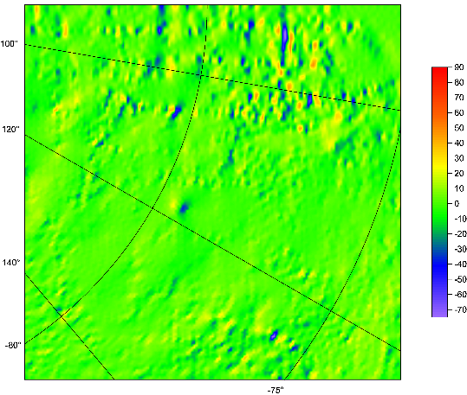
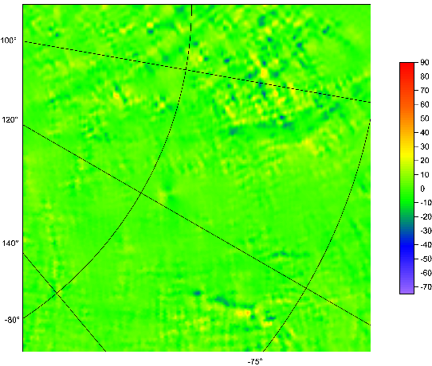
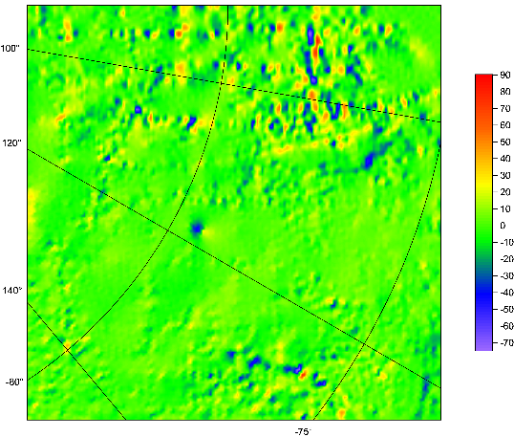
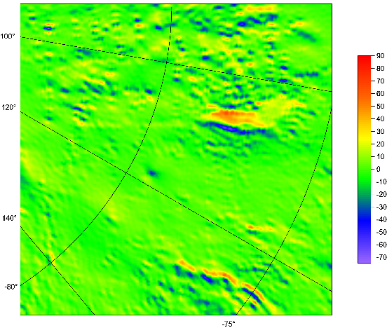
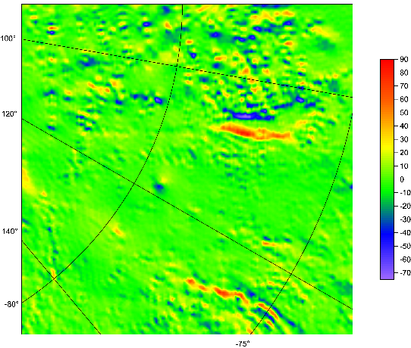
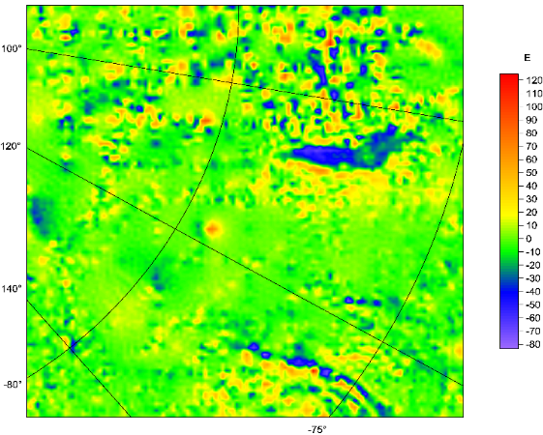
Marussi tensor
of the second derivatives T_{ij}
organized as follows:
T_{xx} T_{xy} T_{xz}
T_{yy} T_{yz}
T_{zz}

Slide 10


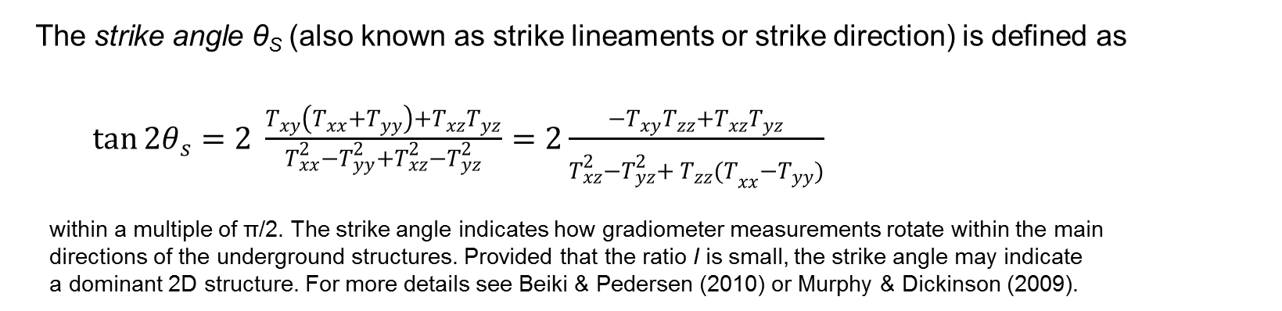
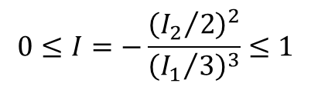
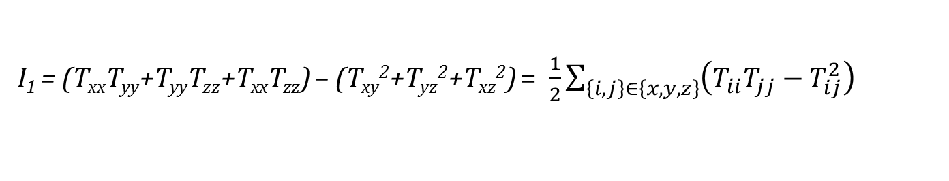
Under any coordinate transformation, Γ preserves
just 3 INVARIANTs
$I_{0}=trace \left(Γ\right)=T_{xx}+T_{yy}+T_{zz}=$ 0
I₁ = (T_{xx}T_{yy}+T_{yy}T_{zz}+T_{xx}T_{zz}) – (T_{xy}²+T_{yz}²+T_{xz}²) = $\frac{1}{2}\sum_{\left\{i,j\right\}∈\left\{x,y,z\right\}}{{\left(T_{ii}T_{jj}−T_{ij}^{2}\right)}_{}}$
I₂ = det (Г) = (T_{xx}(T_{yy}T_{zz}-T_{yz}²) + T_{xy}(T_{yz}T_{xz} – T_{xy}T_{zz}) + T_{xz} (T_{xy}T_{yz}-T_{xz}T_{yy}).
Pedersen & Rasmussen (1990) showed that the ratio I of I₁ and I₂ defined as
$$0≤I=−\frac{{\left({I_{2}}/2\right)}^{2}}{{\left({I_{1}}/3\right)}^{3}}≤1$$
lies between zero and unity for any potential field. If the causative body is strictly 2D, then I =0.
The strike angle θ_{S} (also known as strike lineaments or strike direction) is defined as
$\tan{2θ_{s}}=2 \frac{T_{xy}\left(T_{xx}+T_{yy}\right)+T_{xz}T_{yz}}{T_{xx}^{2}−T_{yy}^{2}+T_{xz}^{2}−T_{yz}^{2}}=2\frac{{−T}_{xy}T_{zz}+T_{xz}T_{yz}}{T_{xz}^{2}−T_{yz}^{2}+{{ T}_{zz}^{}(T}_{xx}^{}−T_{yy}^{})}$
within a multiple of π/2. The strike angle indicates how gradiometer measurements rotate within the main
directions of the underground structures. Provided that the ratio I is small, the strike angle may indicate
a dominant 2D structure. For more details see Beiki & Pedersen (2010) or Murphy & Dickinson (2009).

Slide 11
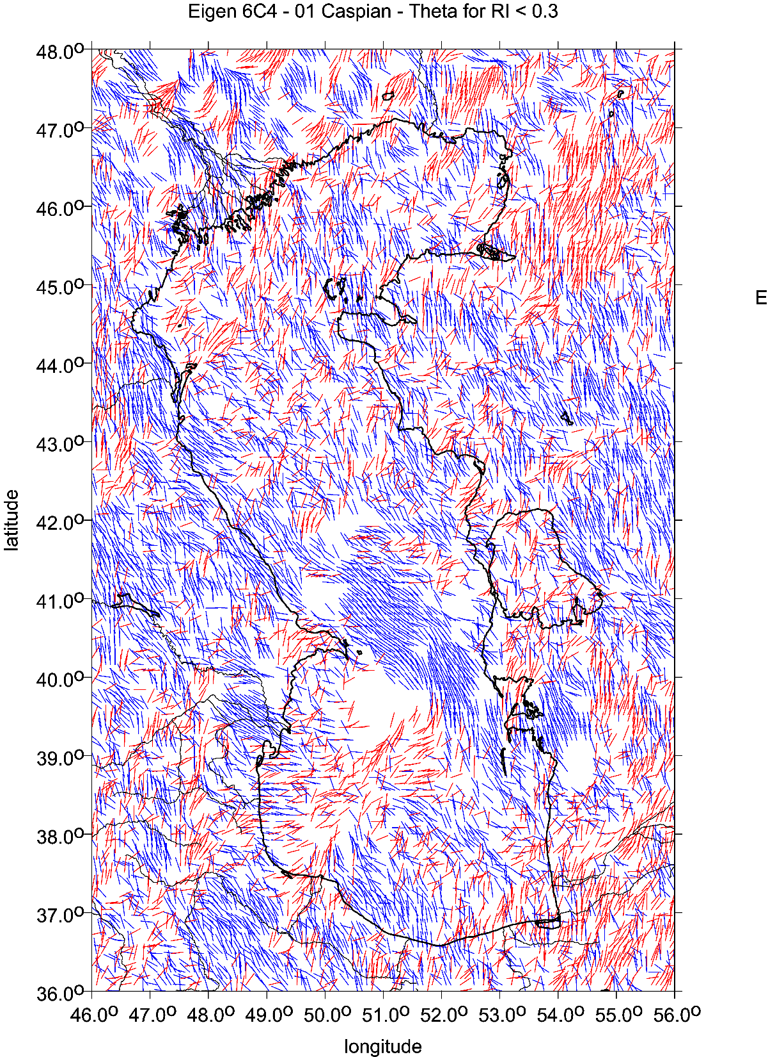

Slide 12
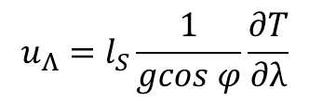



Virtual deformations (Kalvoda et al. 2012, Klokočník et al. 2013)
Virtuální deformace ukazují, jak by se příslušný materiál roztekl, kdyby byl dokonale tekutý
directions of such a deformation due to “erosion” brought about solely by “gravity origin”.
If there would be a tidal potential T, then the horizontal shifts (deformations) would exist due to it
and they could be expressed
in north-south direction (latitude direction) … [left] and in east-west direction (longitudinal direction) … [right]
where g is the gravity acceleration 9.81 m⋅s⁻²,
l_{S} is the elastic coefficient (Shida number) expressing the elastic properties of the Earth as a planet (l_{S} = 0.08),
φ and λ are the geocentric coordinates (latitude and longitude) of a point P where we measure T
The apparatus of mechanics of continuum to derive the main directions of the tension is applied (see, e.g., Brdička et al. 2000).
The tensor of (small) deformation E is defined as a gradient of shift. It holds that
The tensor E can be separated into two parts:
where e is the symmetrical tensor and Ω the anti-symmetrical tensor of deformation, respectively. The symmetrical tensor is
and the parameters of deformation are:
Δ = e₁₁ + e₂₂ total dilatation a = ½ (Δ + γ) major semi-axis of ellipse of deformation
γ₁ = e₁₁ - e₂₂ pure cut b = ½ (Δ – γ) minor semi-axis of ellipse of deformation
γ₂ = 2e₁₂ technical cut α = ½ atan(γ₂ / γ₁) direction of main axis of deformation
γ = (γ₁² + γ₂²)^{1/2} total cut
.
$$u_{Φ}=l_{S}\frac{1}{g}\frac{∂T}{∂φ}$$
$$u_{Λ}=l_{S}\frac{1}{gcos φ}\frac{∂T}{∂λ}$$
$$E=\left(\begin{matrix}ε_{11} & ε_{12} \\ ε_{21} & ε_{22}\end{matrix}\right)=\left(\begin{matrix}\frac{∂u_{x}}{∂x} & \frac{∂u_{x}}{∂y} \\ \frac{∂u_{y}}{∂x} & \frac{∂u_{y}}{∂y}\end{matrix}\right)$$
$$E=e+Ω= \left(e_{ij}\right)+\left(Ω_{ij}\right)$$
$e=\left(\begin{matrix}e_{11} & e_{12} \\ e_{21} & e_{22}\end{matrix}\right)=\left(\begin{matrix}ε_{11} & {(ε}_{12}+ε_{21})/2 \\ {(ε}_{12}+ε_{21})/2 & ε_{22}\end{matrix}\right)$

Slide 13
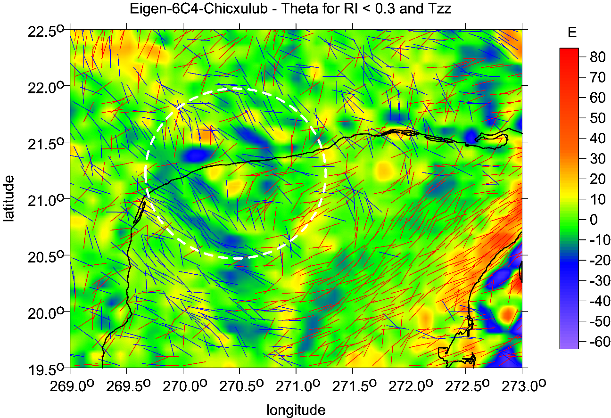
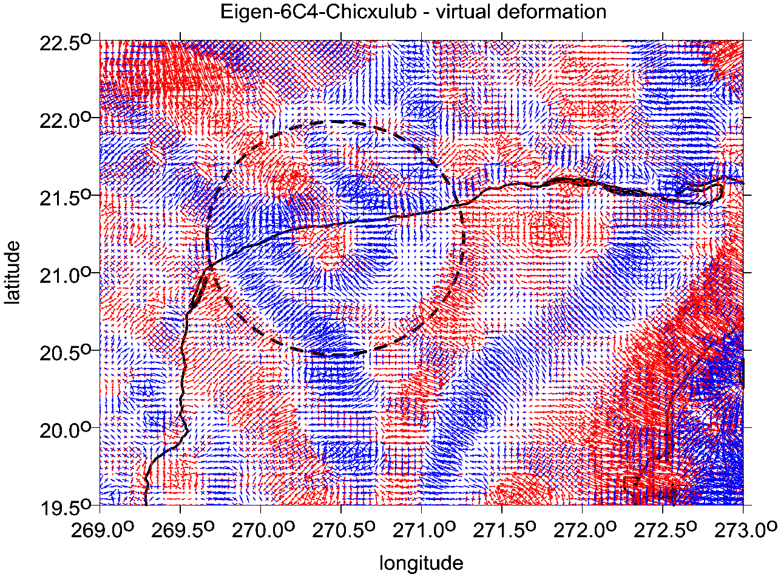
Chicxulub
Yucatan

Slide 14
Plotting
Plotting is important for visualizing our results; we make use of strongly non-linear scales to emphasize various features which otherwise might remain hidden.
A note about the units of plotted aspects:
mGal (miligals) for the gravity anomalies and/or disturbances,
E … Eötvös for the second order potential derivatives,
components of Marussi tensor.
The invariants I1 and I2 have units [s⁻⁴] and [s⁻⁶] and their ratio I is dimensionless.
The strike angle θ is expressed in degrees and its demonstration in red means its direction to the East and in blue to the West of the local meridian.
The virtual deformations (vd) are dimensionless and express a direction of dilatation (red) or compression (blue). These units are used in all figures presented below.
1mGal = 10⁻⁵ ms⁻², 1E = 1 Eötvös = 10⁻⁹ s⁻²

Slide 15
The Gravity Field Model EIGEN-6C4
EIGEN-6C4 (European Improved Gravity model of the Earth by New techniques) is a high resolution static global combined gravity field model up to degree and order 2190. It has been elaborated jointly by GFZ Potsdam and GRGS Toulouse (Foerste et al. 2014) and contains the following satellite and ground data:
LAGEOS (for degrees of harmonics from 2 to 30)
high orbiting geodynamic satellite: 1985 – 2010
Previous gravity model GRACE RL03 GRGS (deg. 2-130): ten years 2003 – 2012
GOCE-SGG data, processed by the direct approach incl. the gravity gradient components T_{xx}, T_{yy}, T_{zz} and T_{xz} throughout whole life of the GOCE satellite. The GOCE polar gaps were stabilized…
- Terrestrial data (max degree 370): DTU12 ocean geoid data and an EGM2008 geoid height grid for the continents.
BEDMAP 2 bedrock topography
Fretwell P, Pritchard H, Vaughan D, Bamber J, et al. 2013. Bedmap2: improved ice bed, surface and thickness datasets for Antarctica. The Cryosphere, 7, 375–393, 2013,
doi: 10.5194/tc-7-375-2013; https://secure.antarctica.ac.uk/data/-bedmap2/
SatGrav RET 2014, HIRT Ch. et al 2016, J Geod 90: 105-127:
A new degree-2190 (10 km resolution) gravity field model for Antarctica developed from GRACE, GOCE and Bedmap 2 data

Slide 16
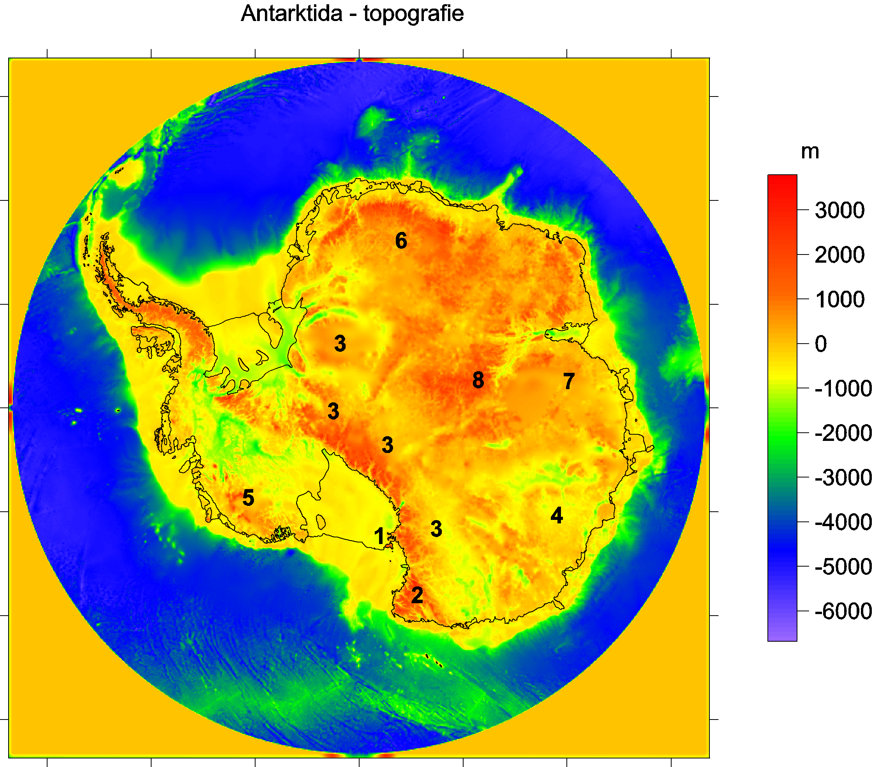
Bedmap2 bedrock topography
Ross shelf glacier
and Ross Island,
2 Victoria Land
3 Transantarctic Mountains
4 Wilkes Land
5 Marie Byrd Land
Queen (Dronning)
Maud Land
7 Princess Elizabeth Land
Gamburtsev Mountains
(under the ice).
Lake Vostok
9

Slide 17
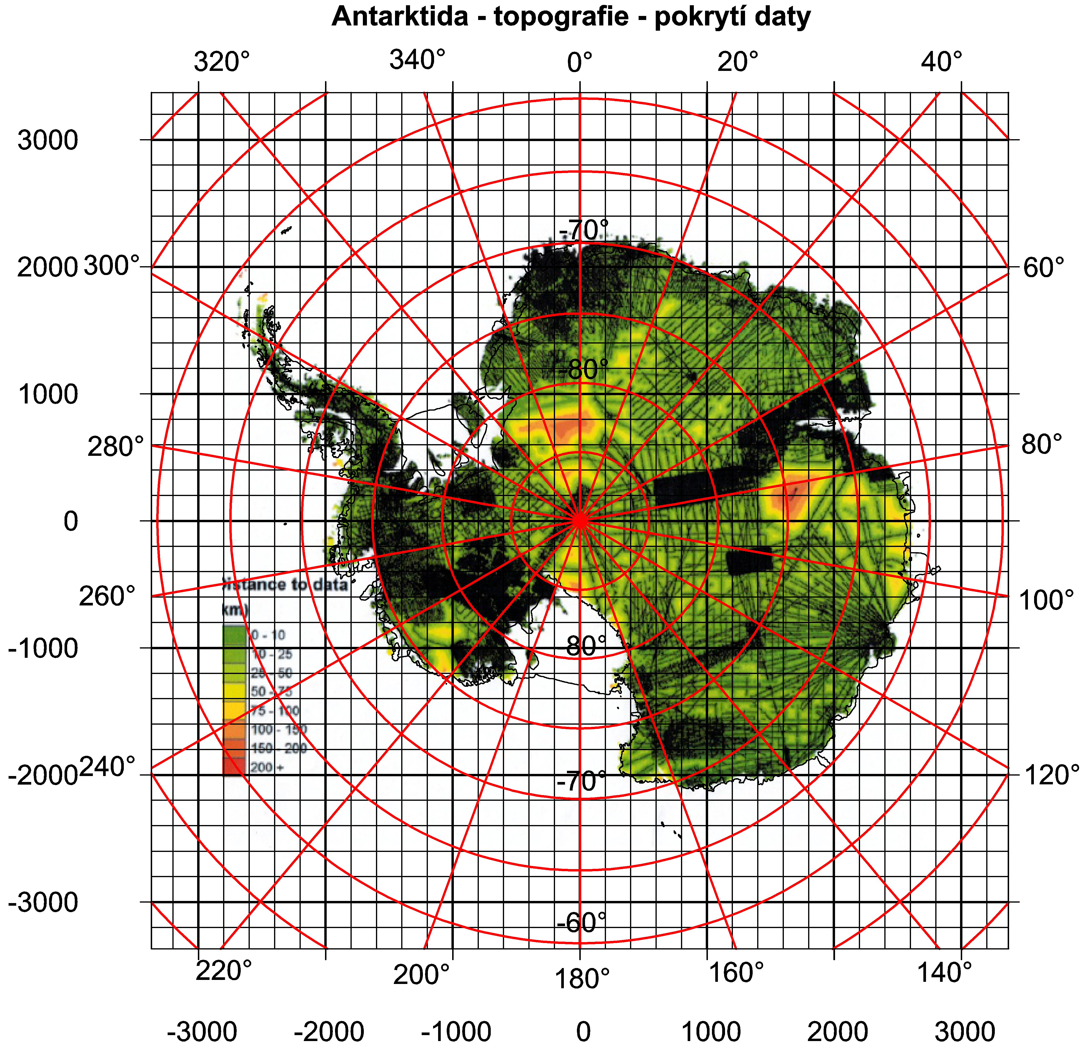
Kritická obhlídka dat

Slide 18
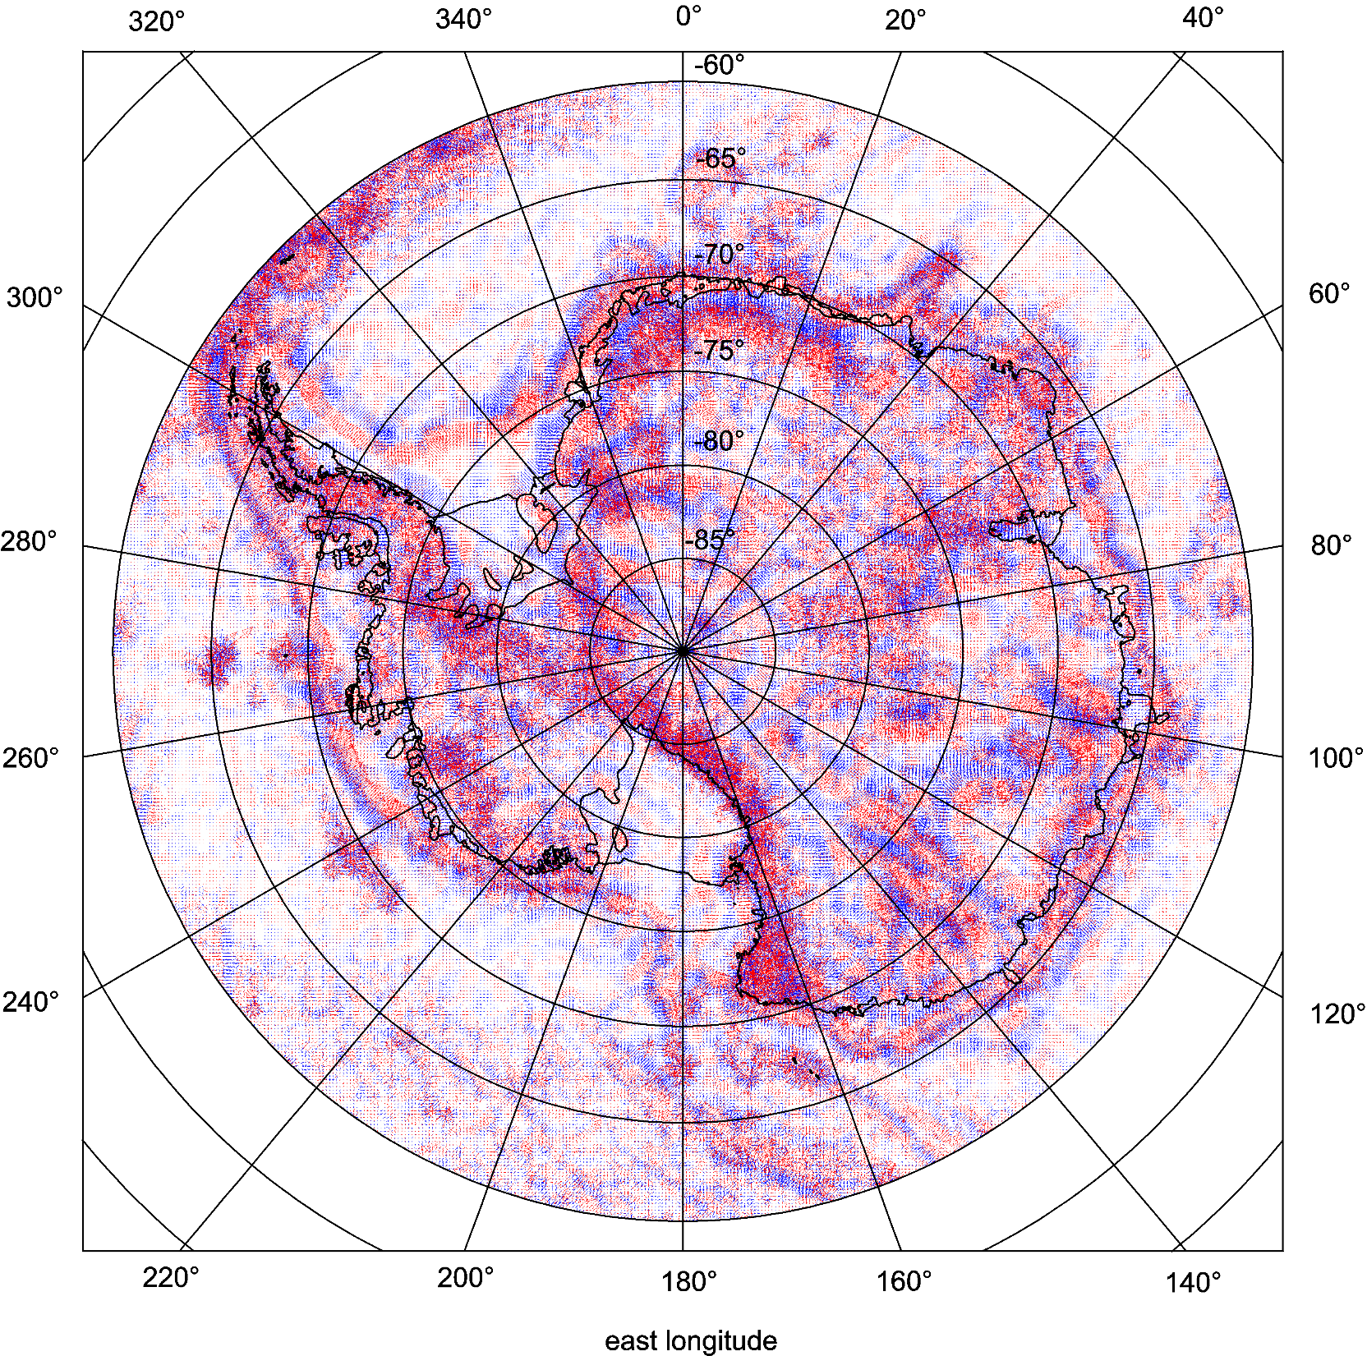

Slide 19
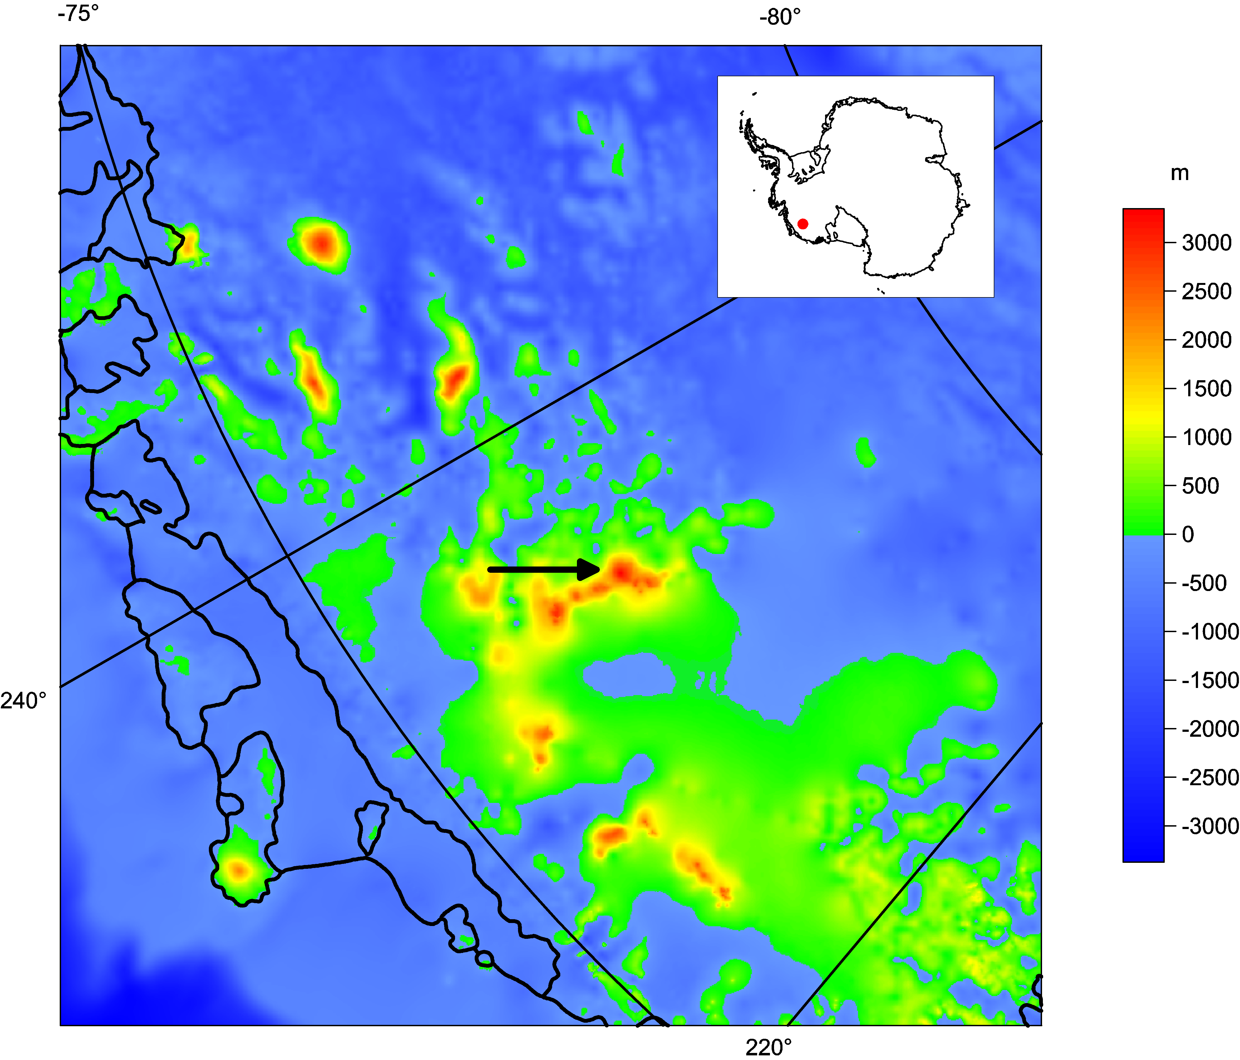

Slide 20
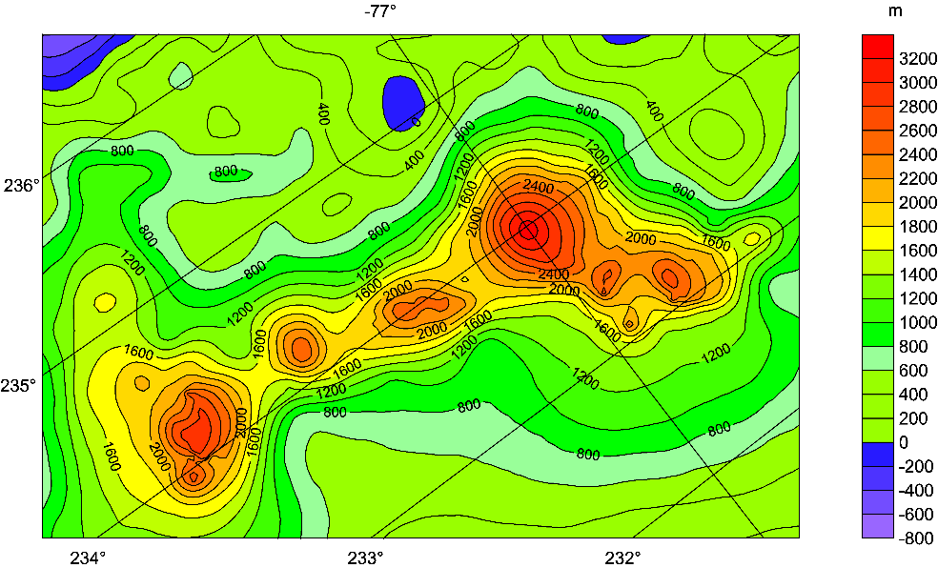
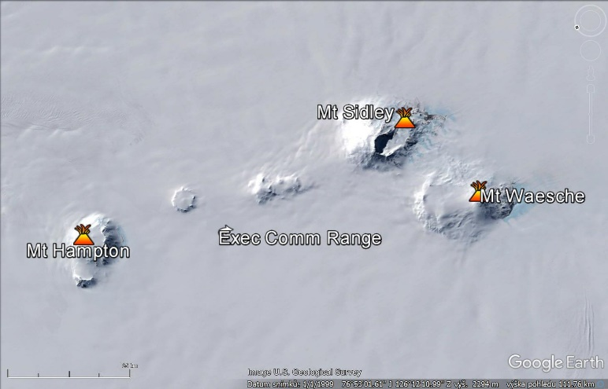
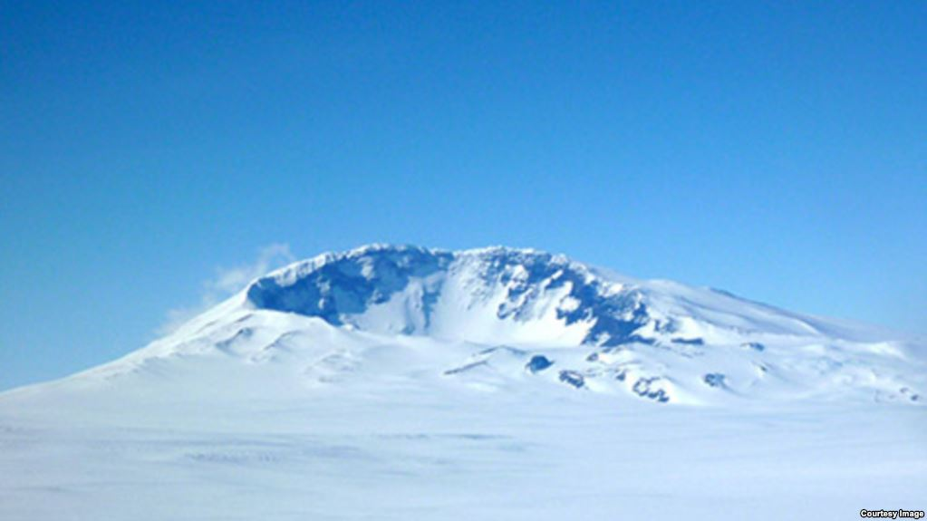
Bedmap 2 for the Executive Comm. Range with Mt Sidley [m asl].
Mount Sidley, in Marie Byrd Land, is the largest volcano that rises above the surface of the ice. Seismologists has detected new volcanic activity under the ice about 60 km away. (Washington University)

Slide 21
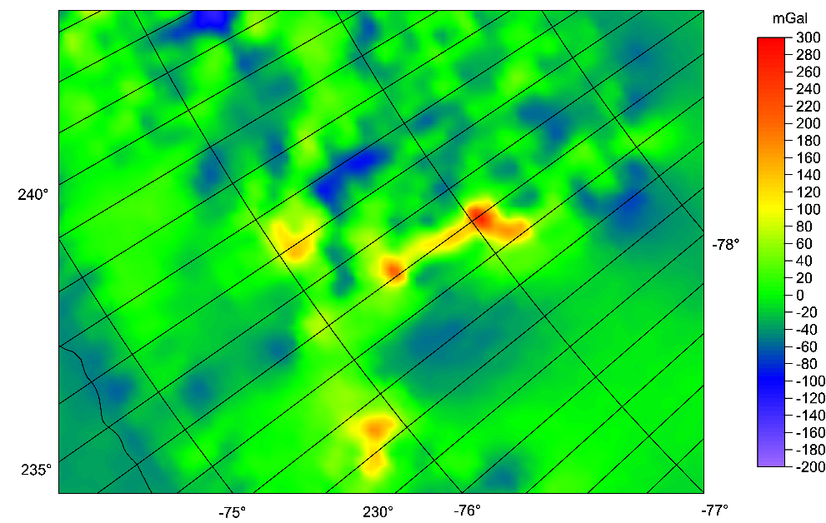
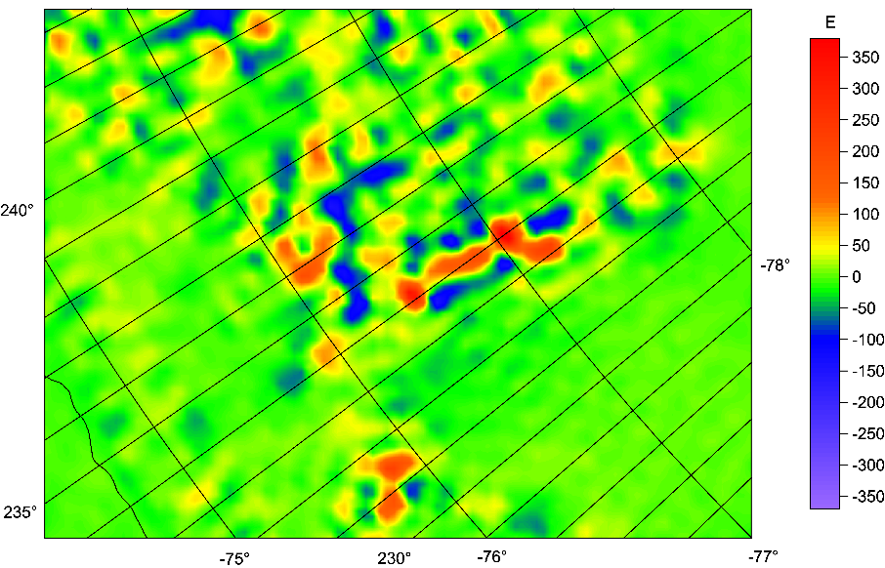

Slide 22
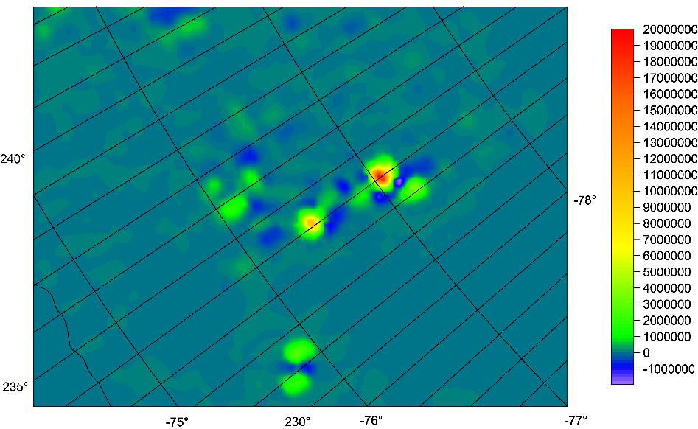
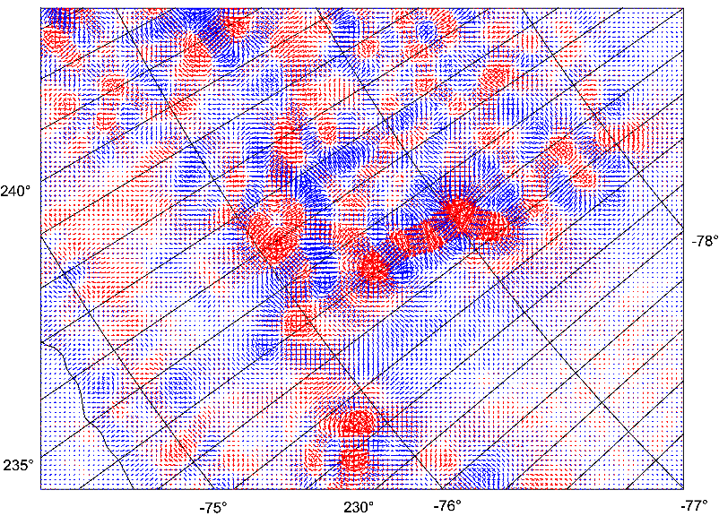

Slide 23
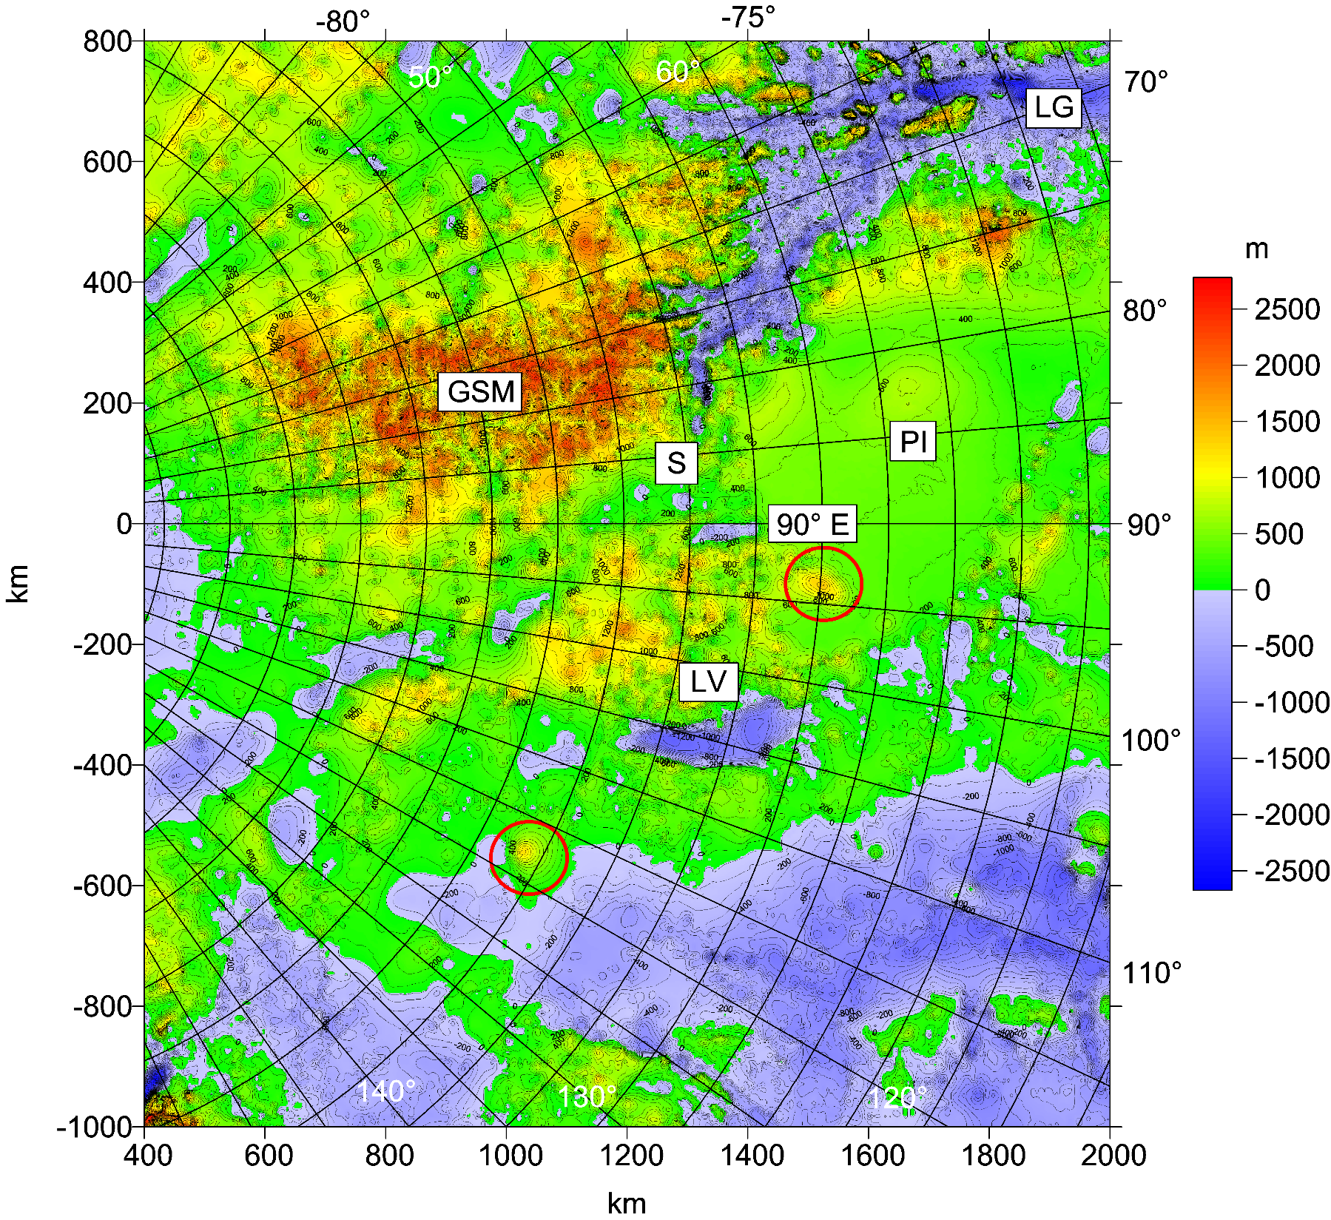
WL

Slide 24
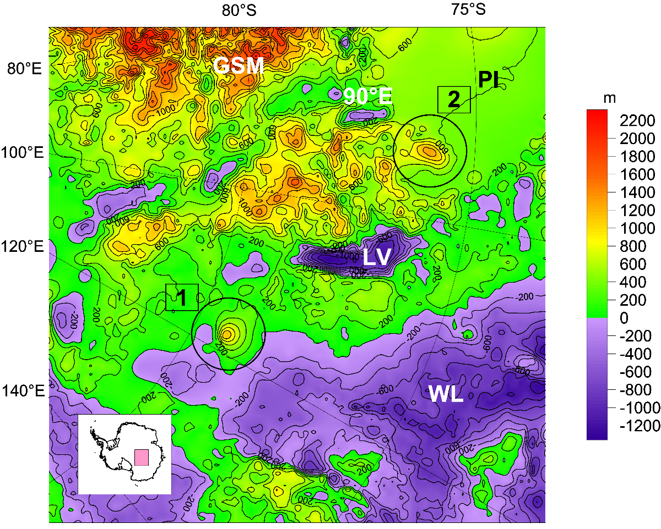
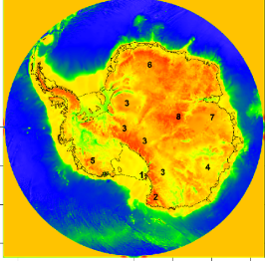
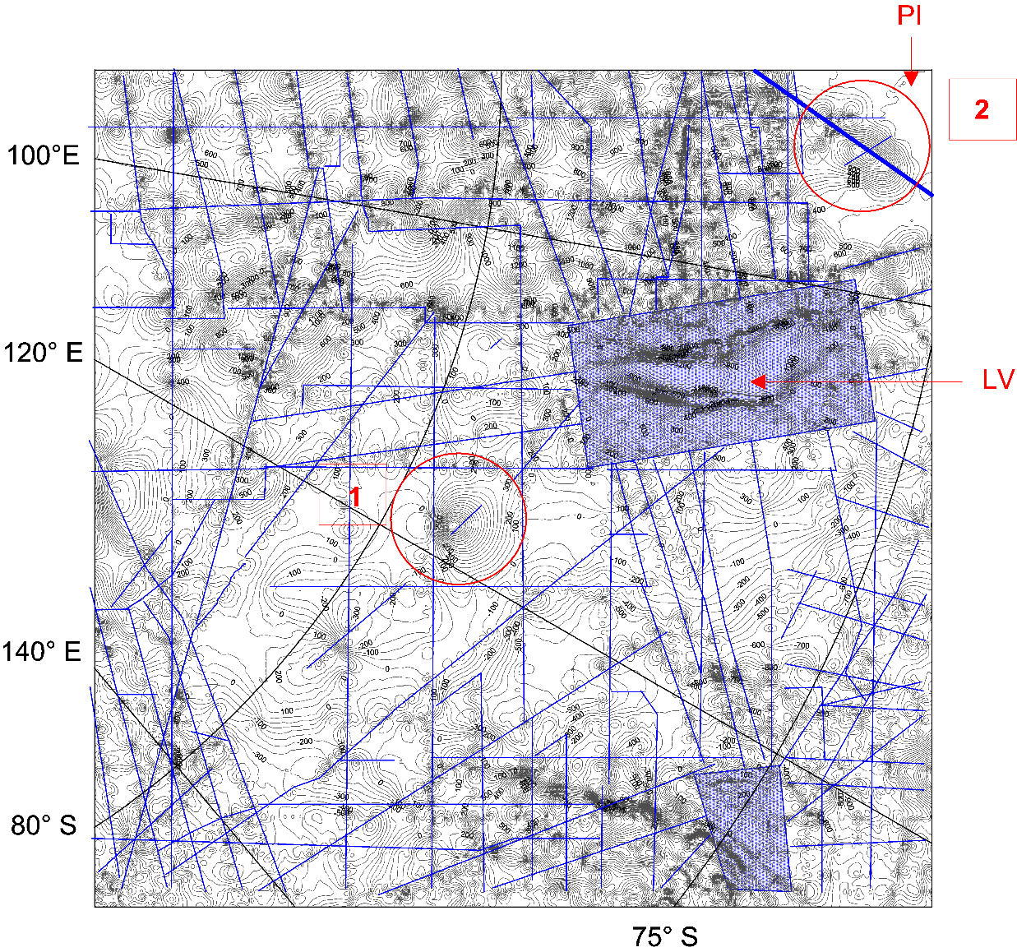
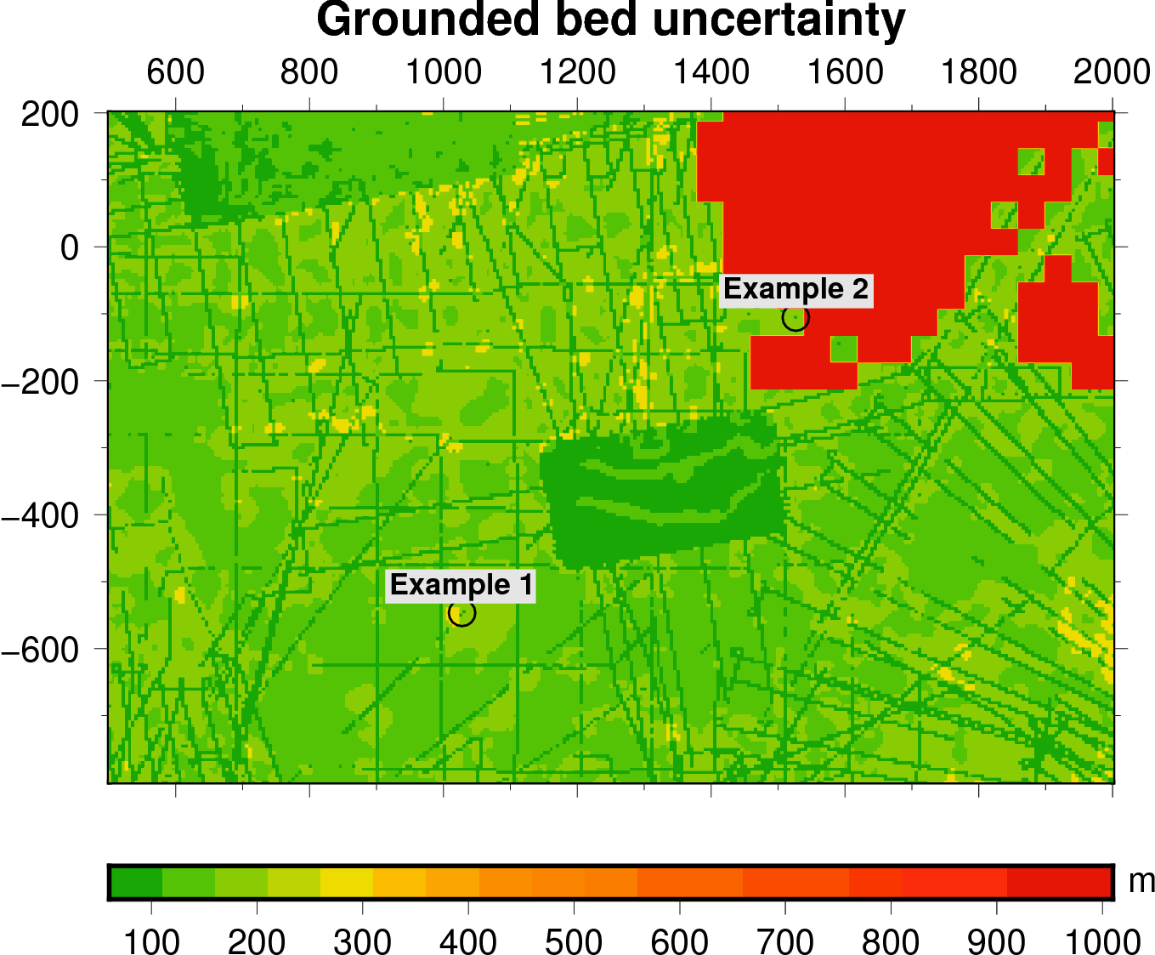
Subglacial volcanoes
Podledovcové sopky
Volcanoes in Antarctica
known and suspected

Slide 25
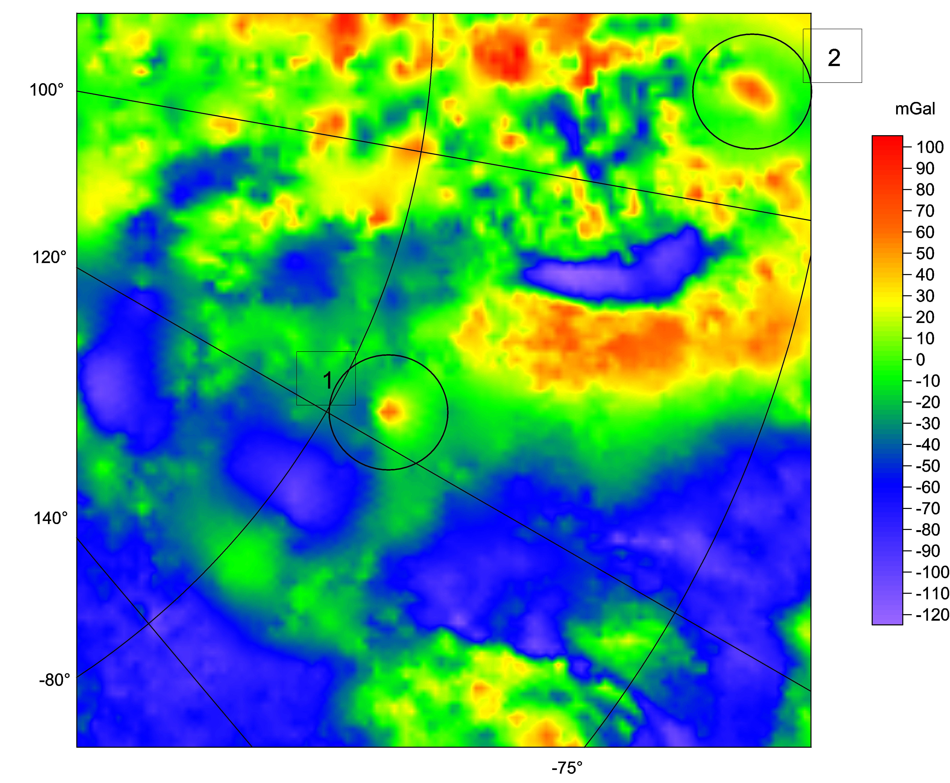

Slide 26


Slide 27
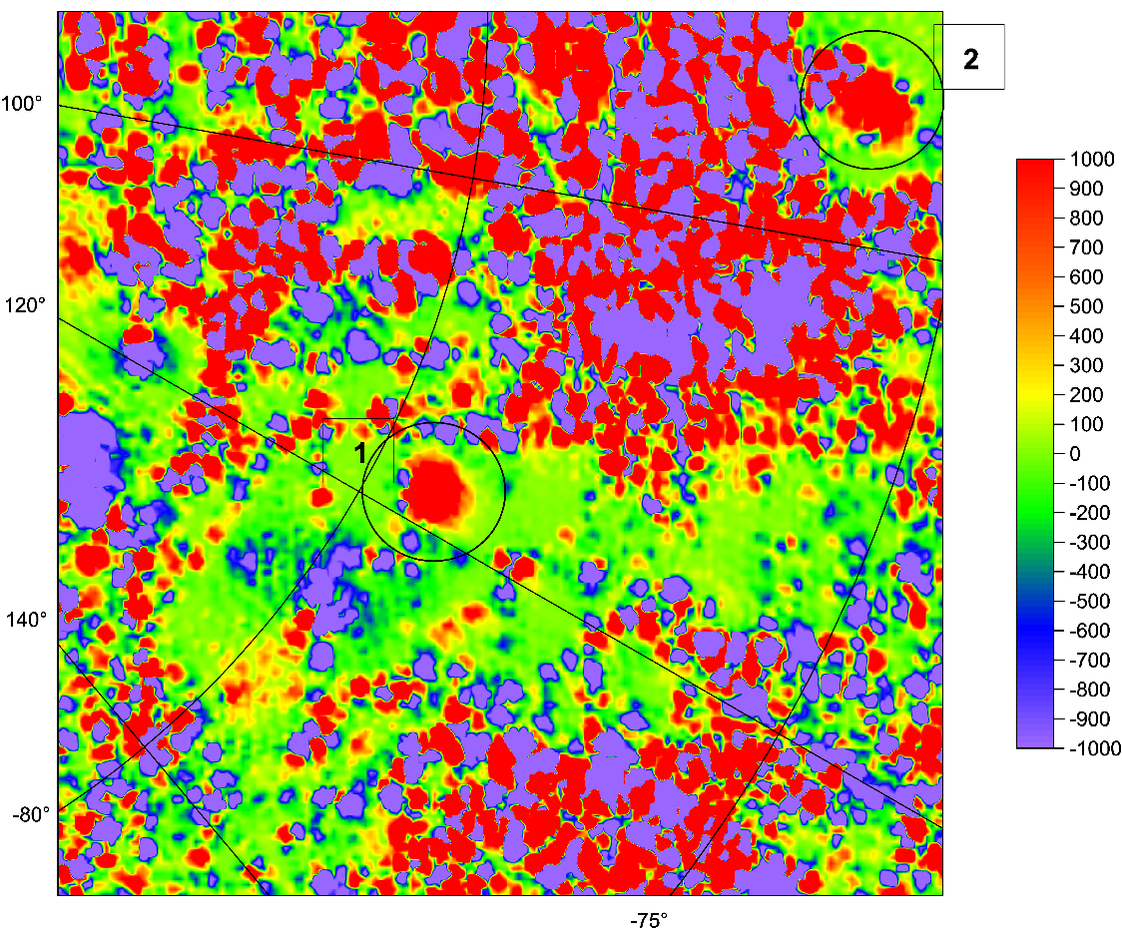
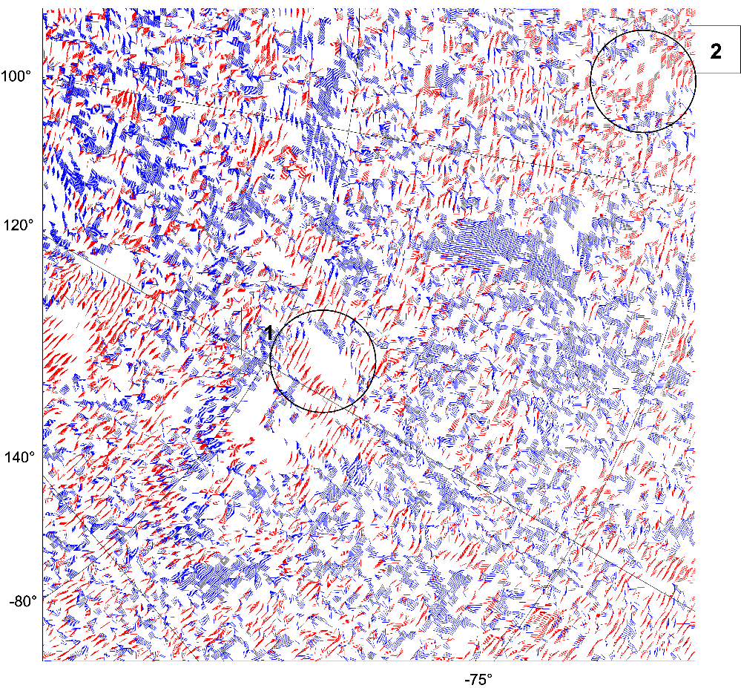

Slide 28
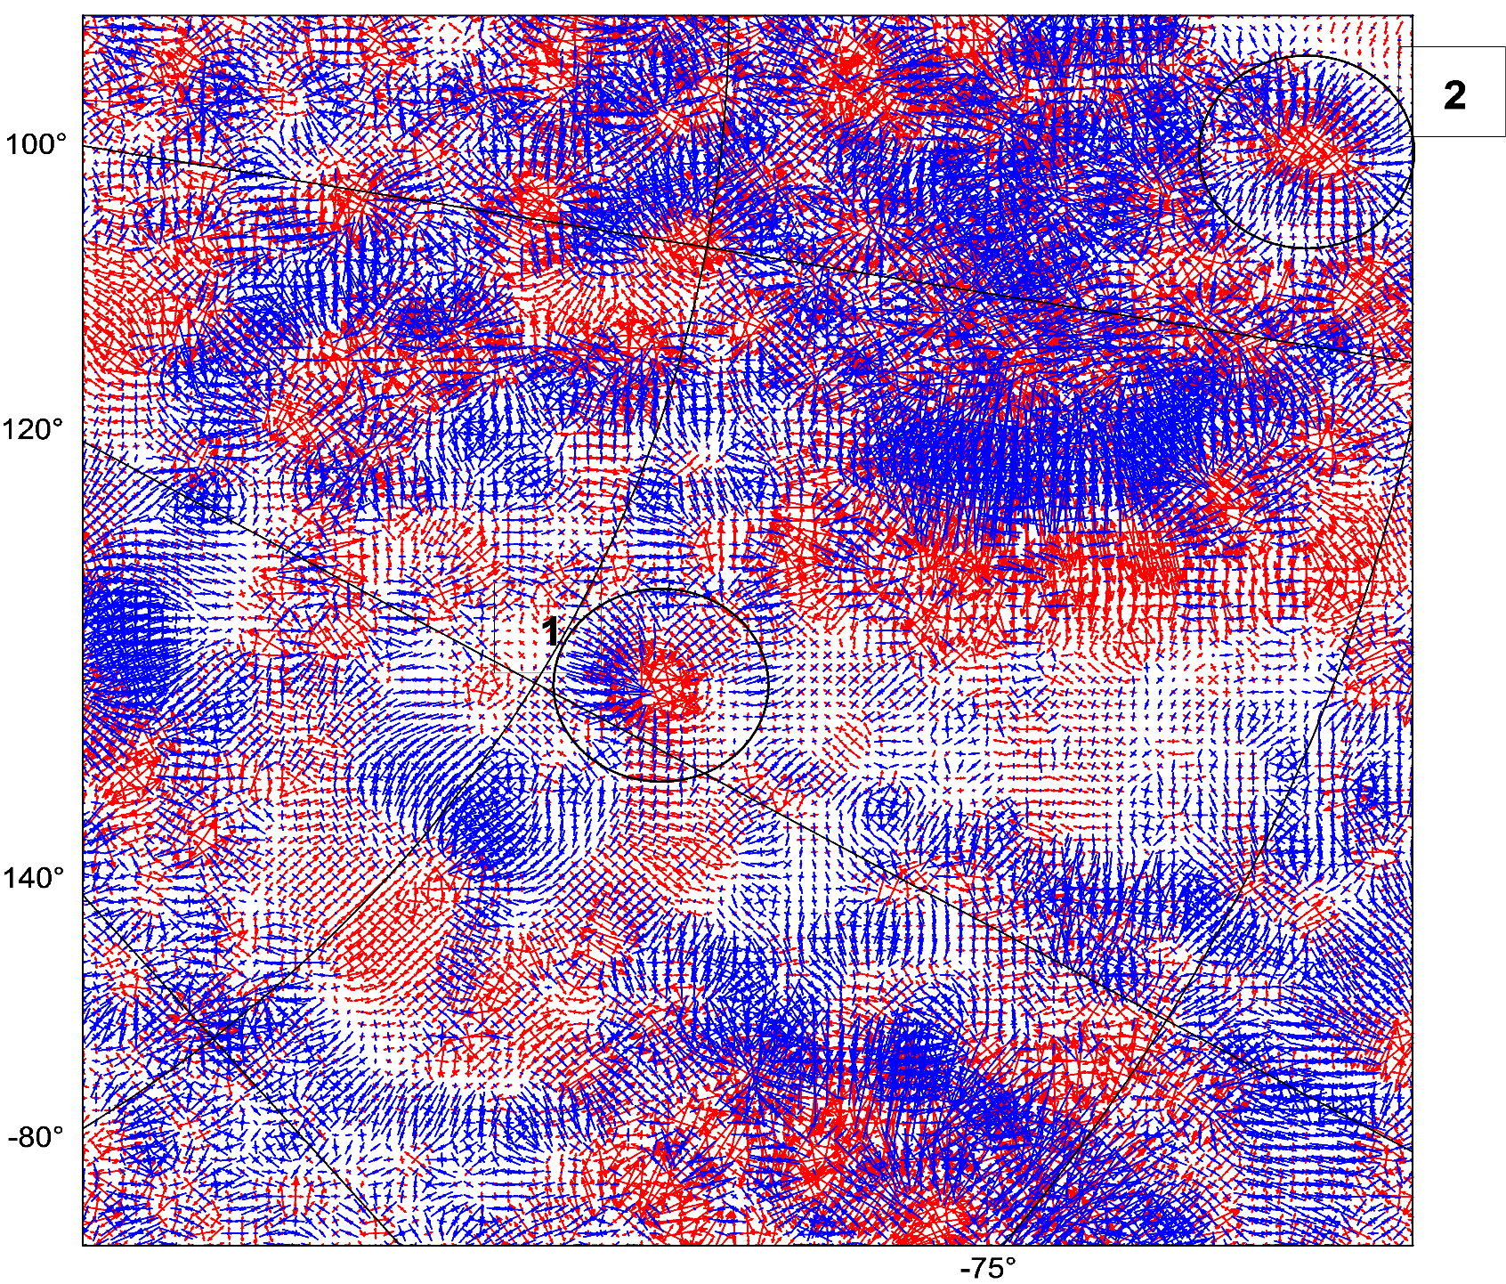

Slide 29
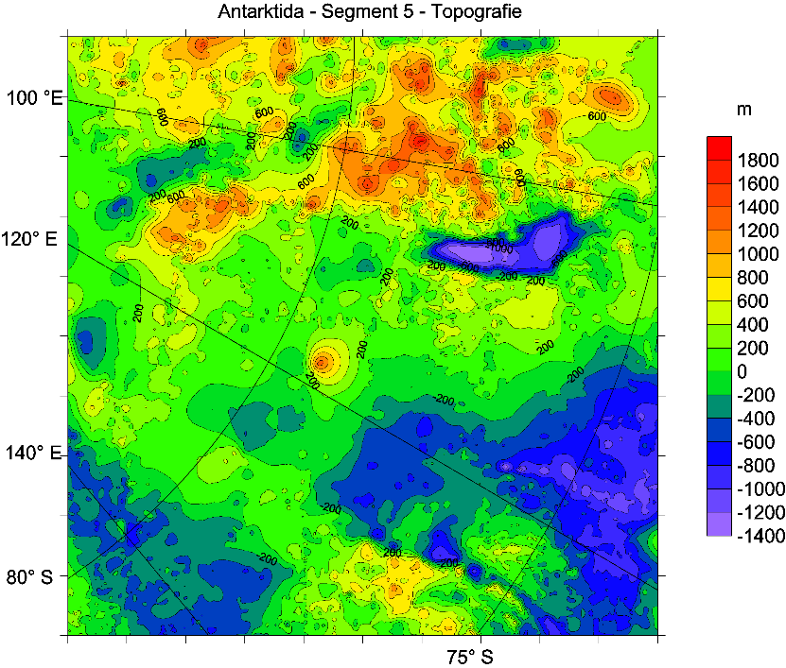
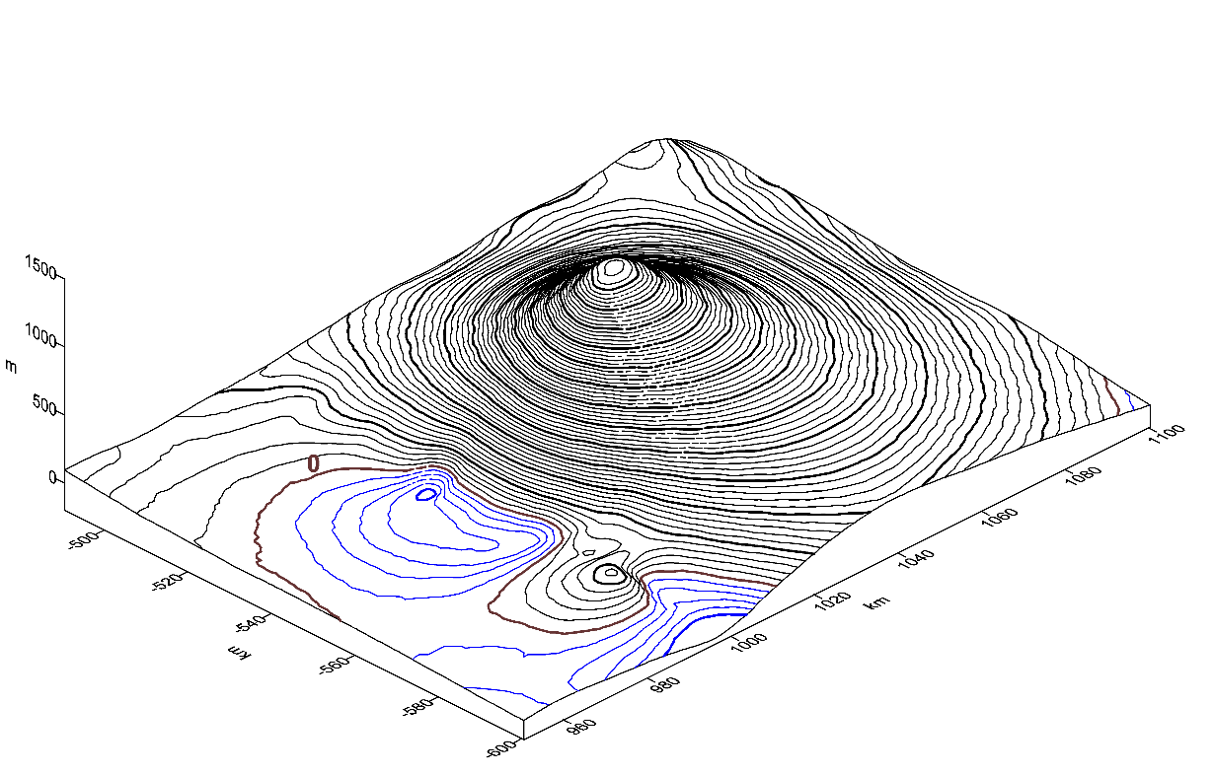
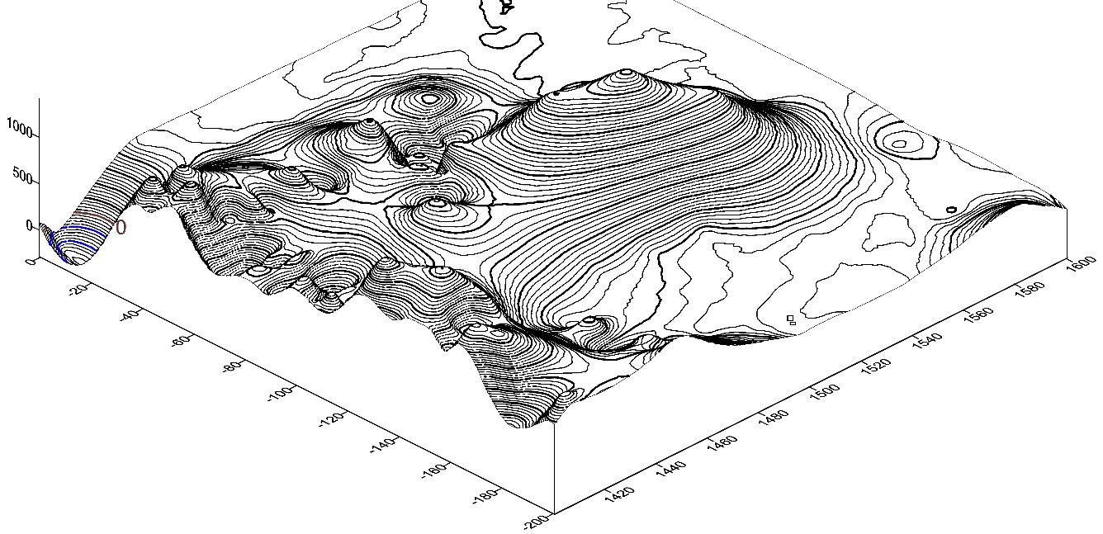
Example 1
Geographic coordinates: φ = 79⁰ 19‘ S, λ = 118⁰ 00‘ E, h = 2.3 km
Name of candidate: Dana.
Example 2
Geographic coordinates: φ = 75⁰ 59‘ S, λ = 93⁰ 57‘ E, h = 2.5 km
Name of candidate: Zuzana.

Slide 30
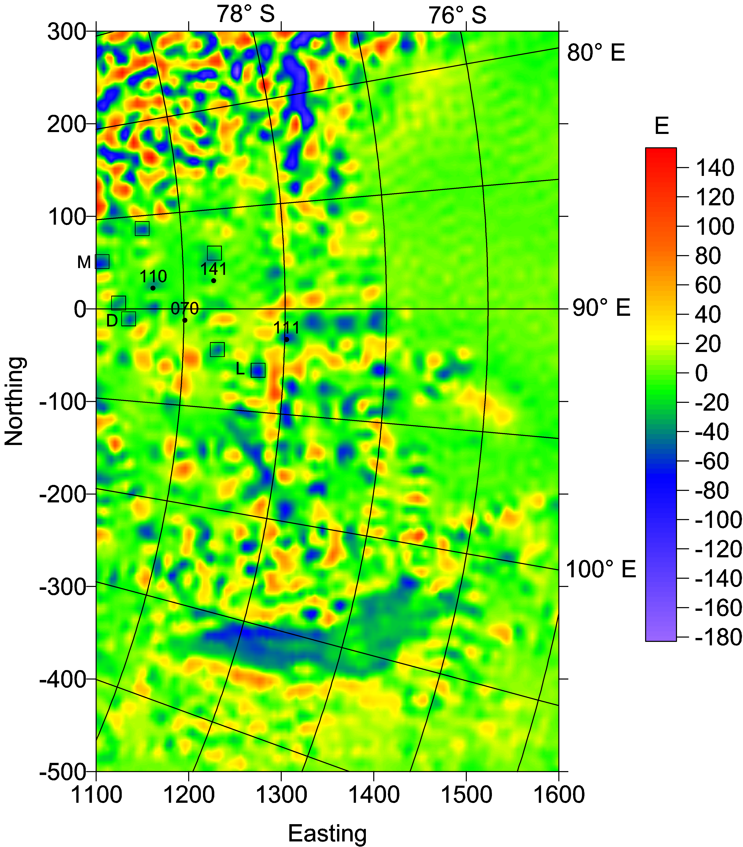
T_{zz}. Numbers show lakes from the inventory of Wright & Siegert (2012), rectangles potential new lakes nearby, M is Magda, D Denisa, and L Lucie.

Slide 31
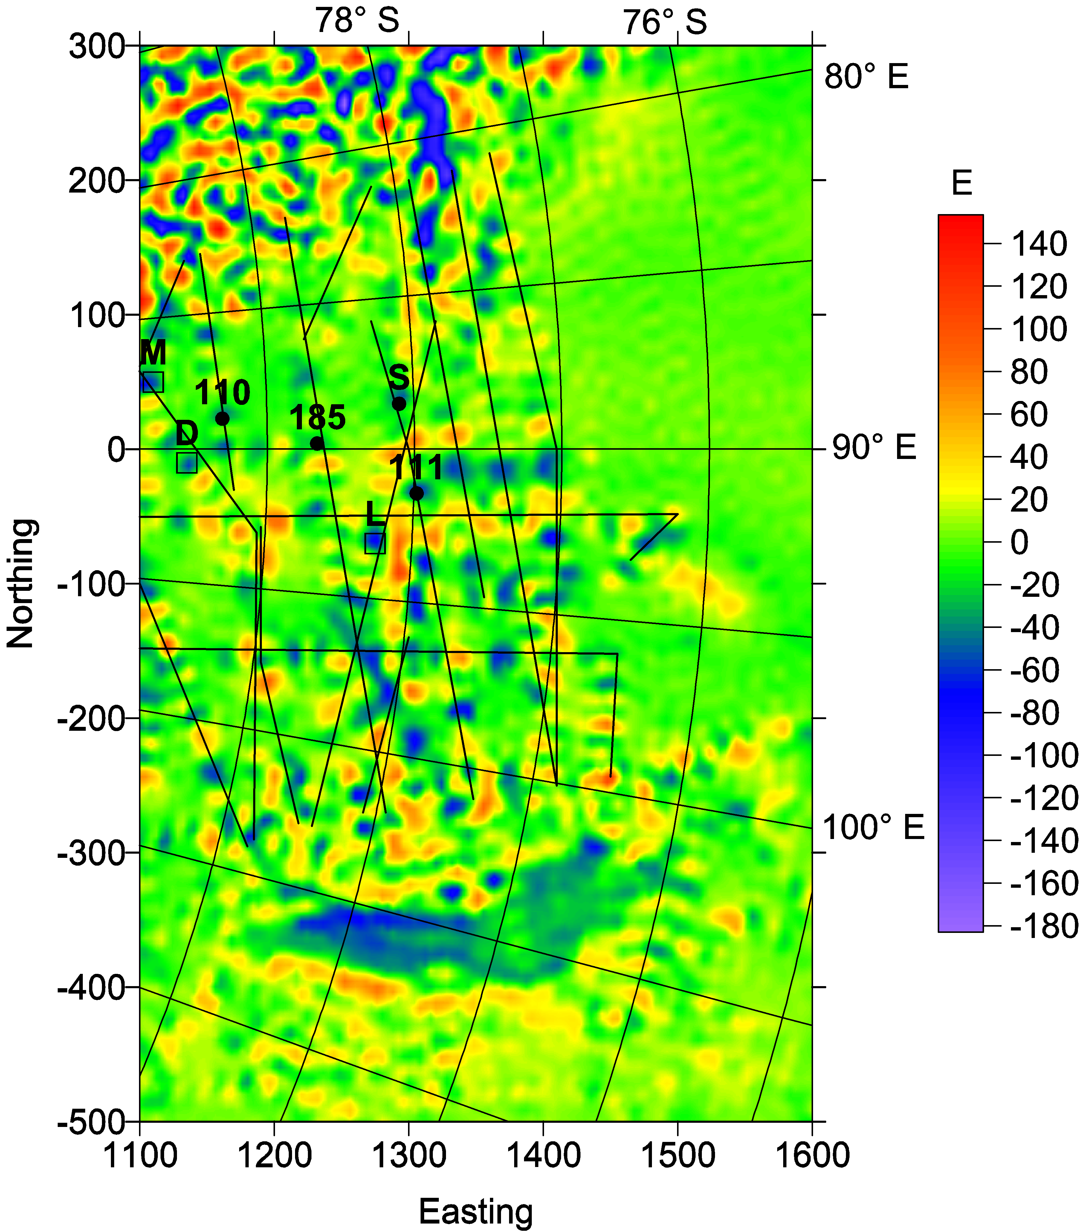

Slide 32
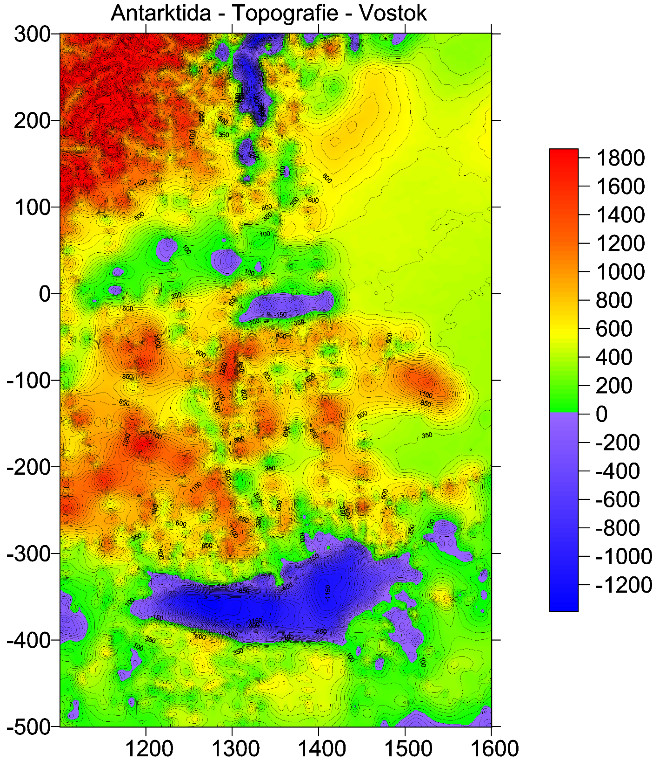
Mezi LV a GSM
90 E Basin

Slide 33
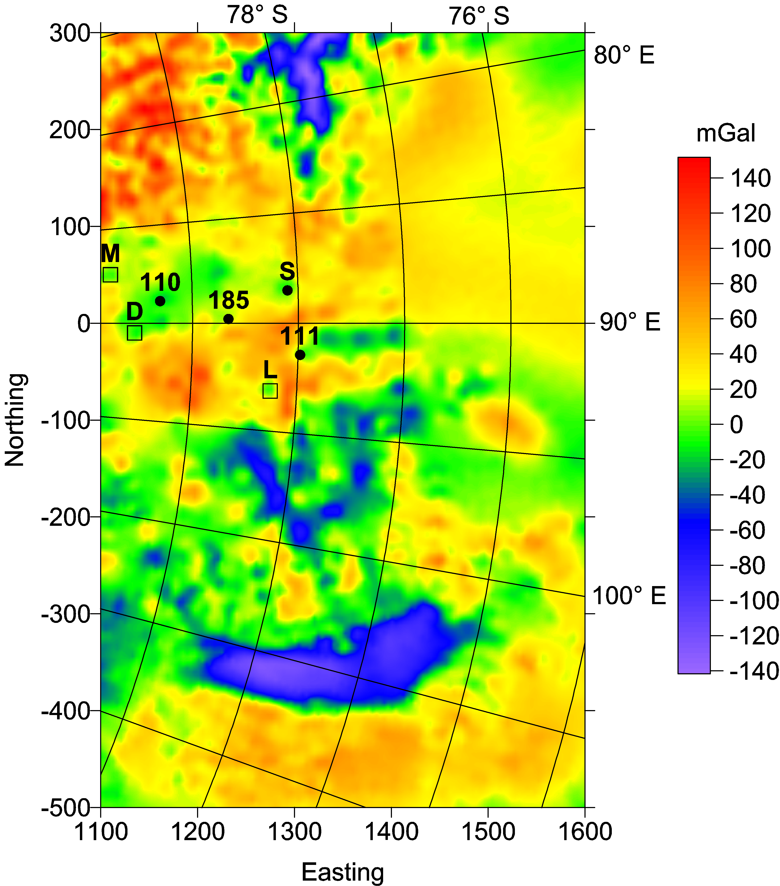


Slide 34


Reproduced from Studinger et al. (2004), fig.1c
Klokocnik et al 2018

Slide 35


Impact
crater/mascon
in Wilkes Land

Slide 36


Slide 37


∆g [mGal]
Tzz [E]

Slide 38

vd [-]

Slide 39



Slide 40


Slide 41


Thank you GOCE
jklokocn@asu.cas.cz
www.asu.cas.cz/~jklokocn
To download this lecture: www.asu.cas.cz/~jklokocn/REVIEW-SG2018

