Slide 1
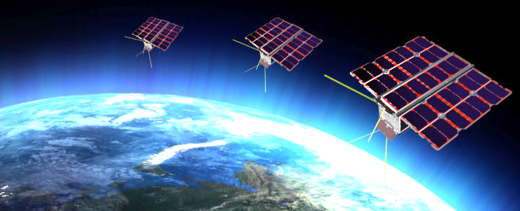
Future mission CAMELOT for Localisation of Gamma-Ray Transients by Fleet of Cubesats
Jakub Řípa
Charles University, Astronomical Institute MTA-Eötvos Loránd University
Norbert Werner, Andras Pál, Norbert Tarcai, Gábor Galgóczi, Zsolt Várhegyi, Zsolt Frei, László Kiss
Masanori Ohno, Yasushi Fukazawa, Tsunefumi Mizuno, Hiromitsu Takahashi, Koji Tanaka, Nagomi Uchida, Kento Torigoe, Kazuhiro Nakazawa, Teruaki Enoto, Hirokazu Odaka, Yuto Ichinohe

Slide 2
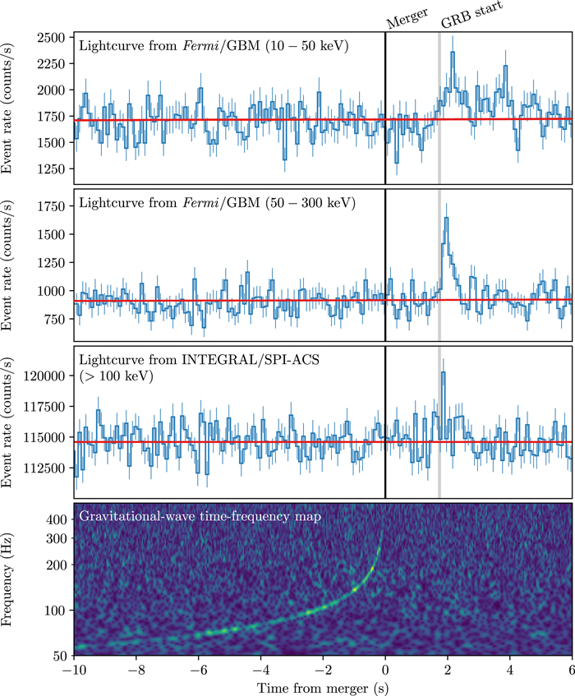
17. 08. 2017
beginning of multi-messenger astrophysics OF GRBs
5 gravitational wave detections from BH-BH merger
EM counterpart from NS-NS merger event GW170817/GRB170817A
Large campaign of follow-up observations identified a kilonova
The gamma-ray counterpart is unusual
Regular detections/follow-up observations are needed to make progress

Slide 3
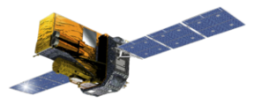
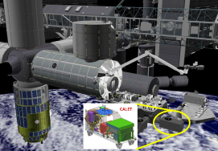
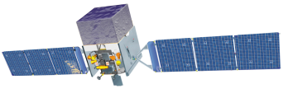
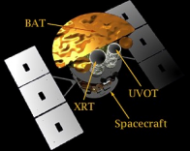
An empty region in parameter space
Field of view (str)
INTEGRAL-SPI-ACS
INTEGRAL-SPI-ACS
(w/ IPN)
No instruments with
Larger FoV (>2π str)
+
Good Loc. Acc. (arcmin)
Discovery space
4π ー
CALET-CGBM
All-sky coverage
But lower loc. acc.
Fermi-GBM
2π ー
AGILE
Fermi-LAT
CALET
X-ray mirror, coded mask
High loc. acc., but narrow FoV
MAXI
Swift-BAT
Swift-XRT
|
No localization
|
degree
|
arcmin
|
arcsec
Localization accuracy

Slide 4
CAMELOT: Cubesats Applied for MEasuring
and LOcalising Transients
Each satellite will use a standard 3U cubesat platform developed by C3S LLC for the ESA sponsored RadCube mission. The cubsesats will be equipped with a GPS receiver for precise time synchronisation and inter-satellite (Iridium NEXT) communication equipment for rapid data download
A constellation of at least 9 satellites can provide:
all sky coverage with a large effective area
Better than 0.1 millisecond timing accuracy
~10 arcmin localisation accuracy using triangulation

Slide 5
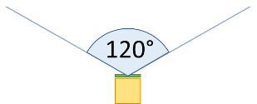
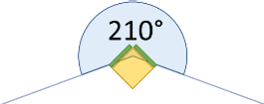
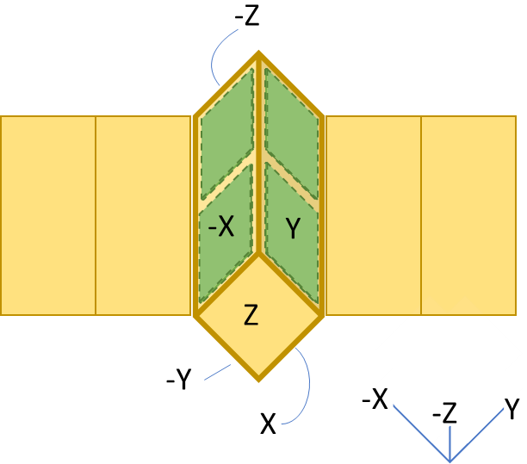
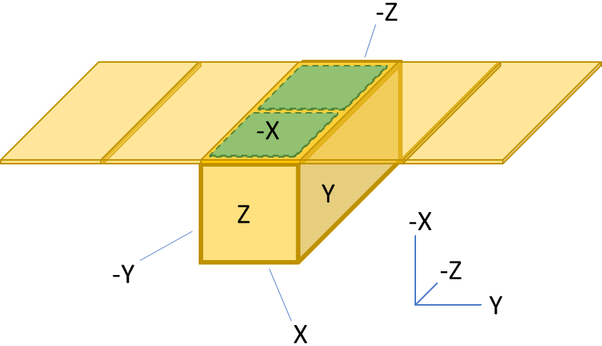
Two possible detector
configurations

Slide 6
The detector design
To maximise the effective area, the detectors based on CsI scintillators and Multi-Pixel Photon Counters (MPPC) will occupy two lateral extensions
(8.3 cm x 15 cm x 0.9 cm x 4)
The large and thin detectors with small readout area are challenging
The read out of the CsI detectors with MPPC is currently being evaluated in the lab as part of our feasibility study. The system provides a large light yield, compact readout area and relatively low operational voltage.

Slide 7
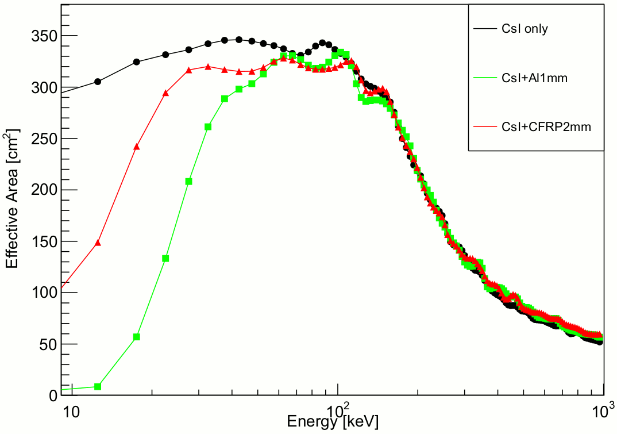
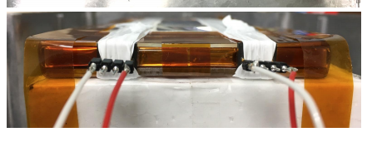
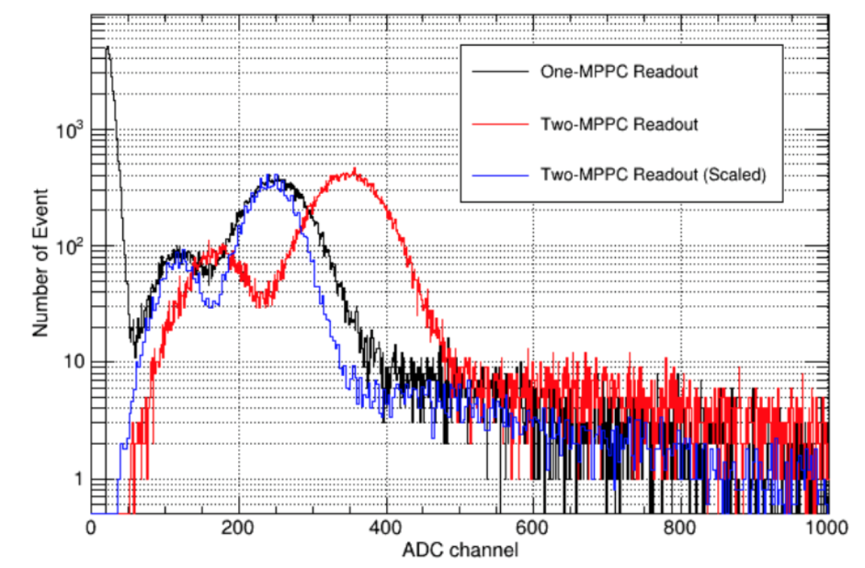
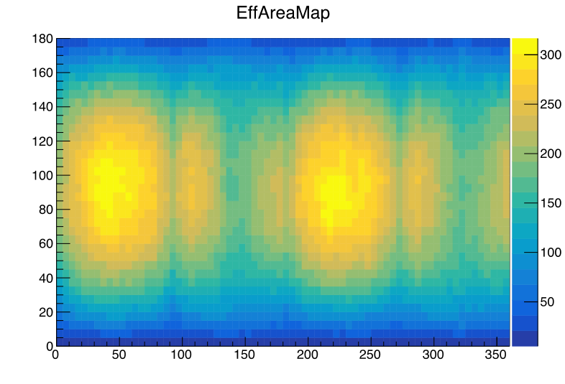
Spectral feasibility
CsI only
CsI + Al 1mm
CsI + CFRP 2mm
Preliminary!
Effective Area (cm²)
Preliminary!
Torigoe+ 2018
Single channel readout
Coincidence sum
Coincidence sum (scaled)
Energy (keV)
100
Ohno+ 2018
1000
GRB incident zenith angle (deg)
241Am
59.5 keV
Energy threshold of ~10 keV is achieved for both single/multi channel readout
Energy range: 10-1000 keV (TBD)
GRB incident horizontal angle (deg)
Effective area for best incident angle is estimated by the Monte-Carlo simulation, ~300 cm² (@100 keV)
Effective area of one satellite is comparable to two Fermi-GBM detector modules

Slide 8
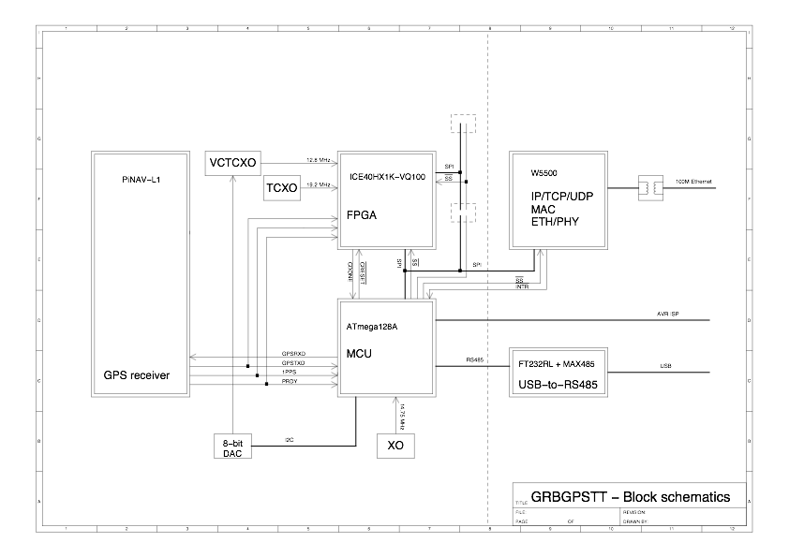
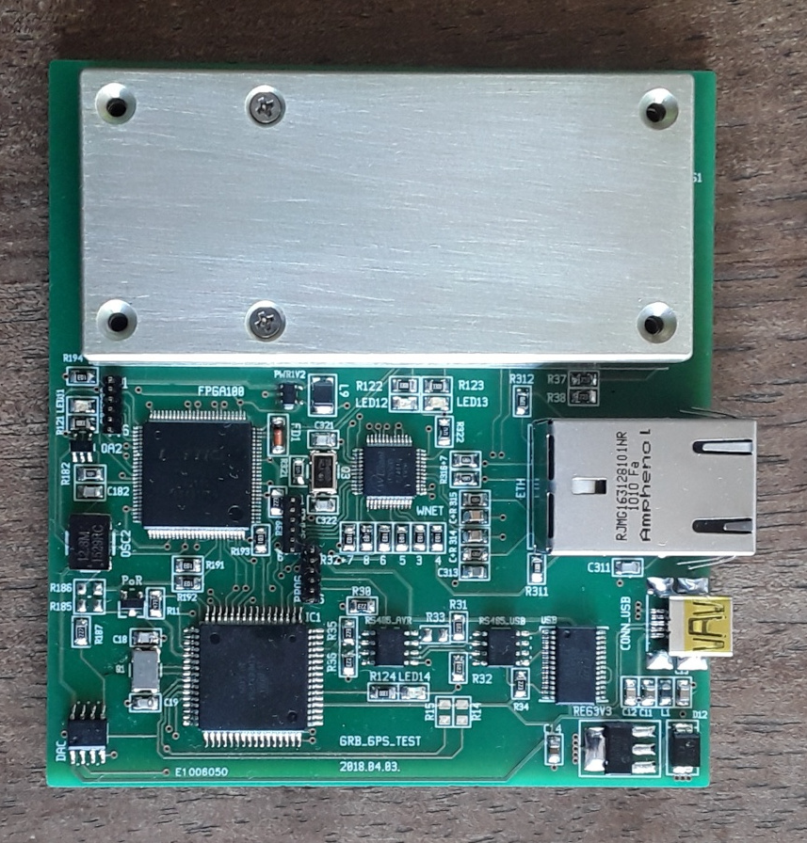
CAMELOT GPS time-stamping test board
Pál et al. 2018

Slide 9
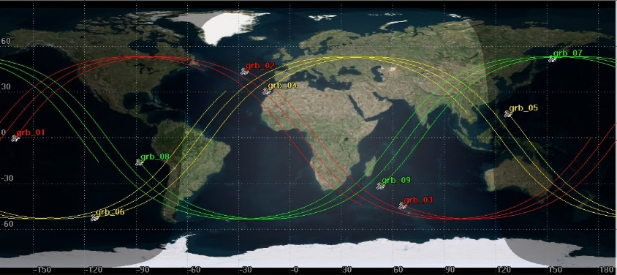
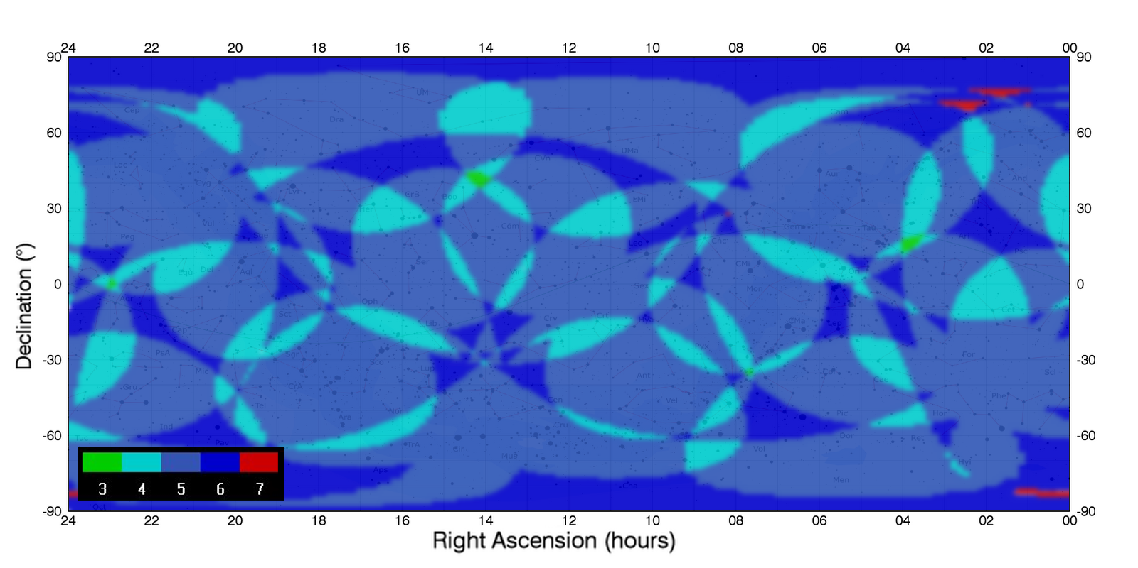
Sky visibility on 53 deg Walker Orbits
95% of the sky will be simultaneously covered by at least 5 satellites.

Slide 10
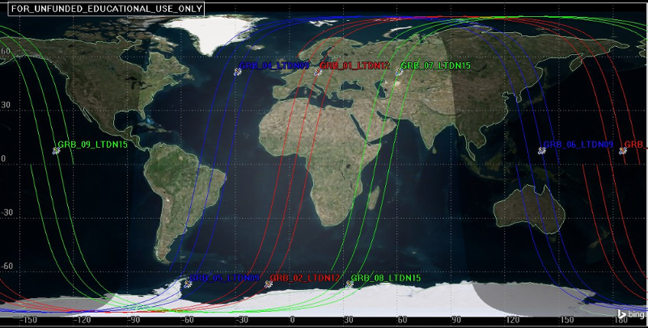
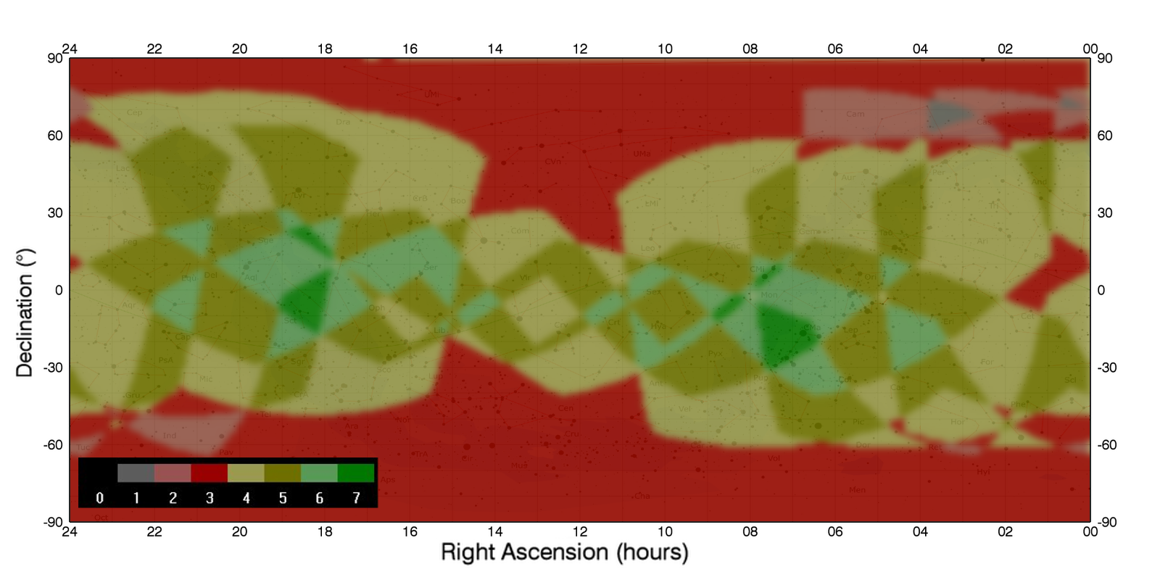
Sky visibility on sun-synchronous polar orbits

Slide 11
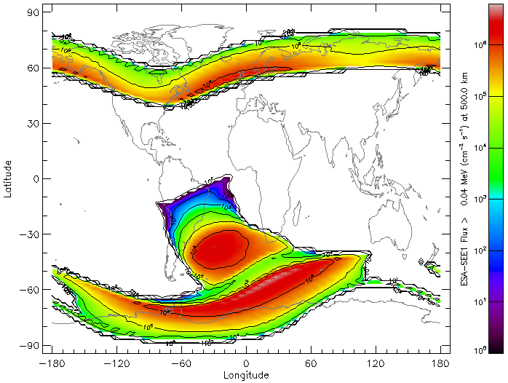
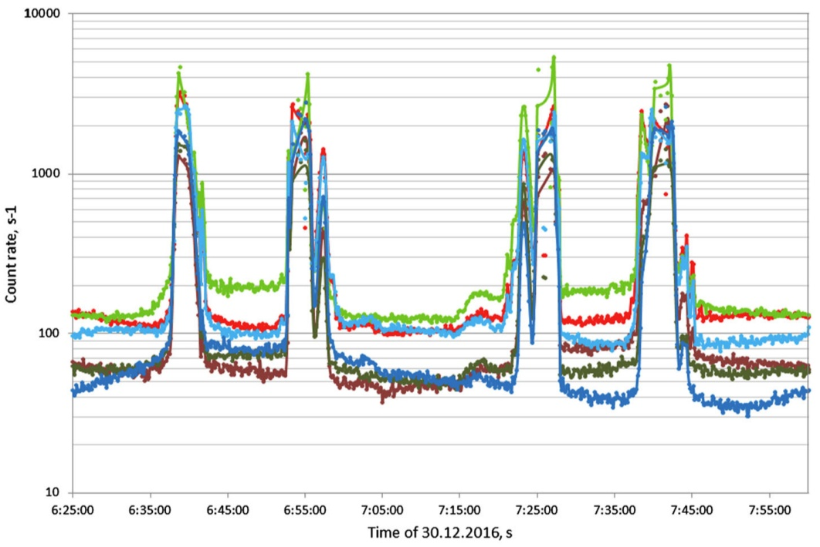
High background on polar orbits
Lomonosov / BDRG count rate in scintillator-based
GRB detector on polar orbit (~500 km).
Electron flux by ESA-SEE1 model at 500 km
Svertilov+ 2018
On polar orbit, each satellite will loose ~30-40% of observing time.
On 53° inclination orbit, each satellite will loose ~20% of observing time.

Slide 12
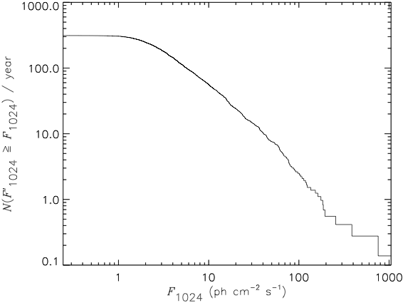
What do we expect to see?
Over 300 GRBs detected per year
Many terrestrial gamma ray flashes, solar flares, soft gamma ray repeaters, X-ray binaries, etc.

Slide 13
Timing based localisation
IPN deals with:
Different clock accuracy from one
spacecraft to another
- Various time resolutions
- Uncertainty in s/c positions
for far-Earth s/c
Different energy responses of
various detectors
Hurley+13
localisation by photon arrival time
High timing synchronization by GPS + 10μ-sec absolute
timing accuracy results several arcmin localisation accuracy ?

Slide 14
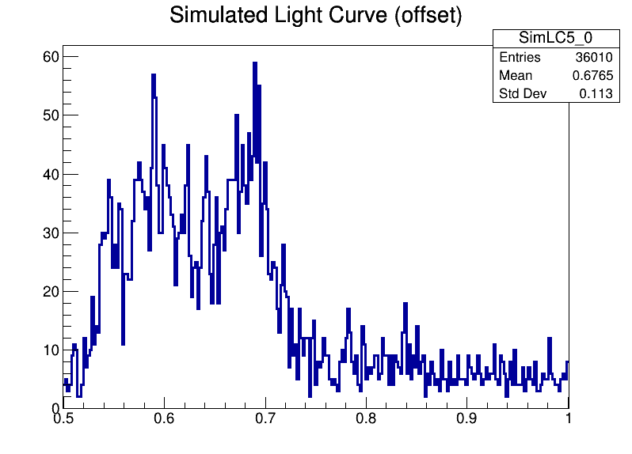
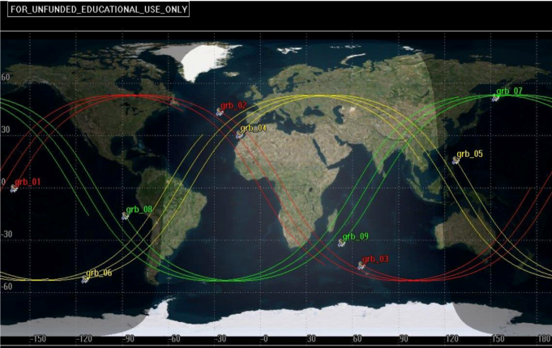
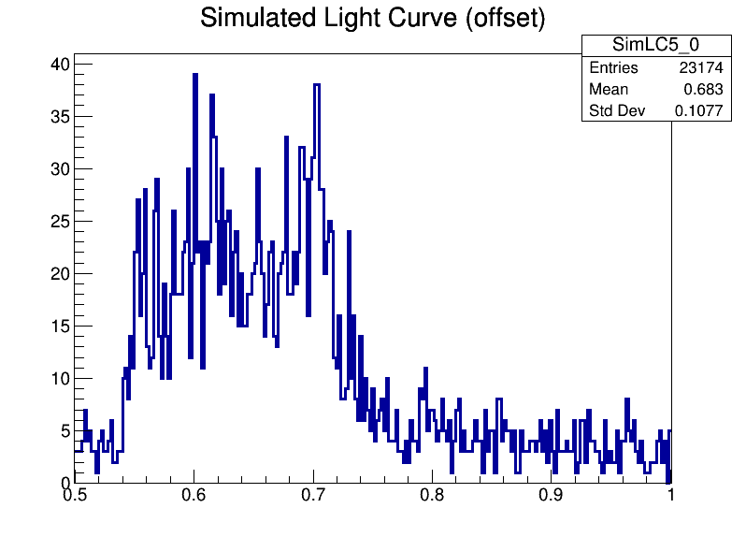
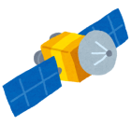
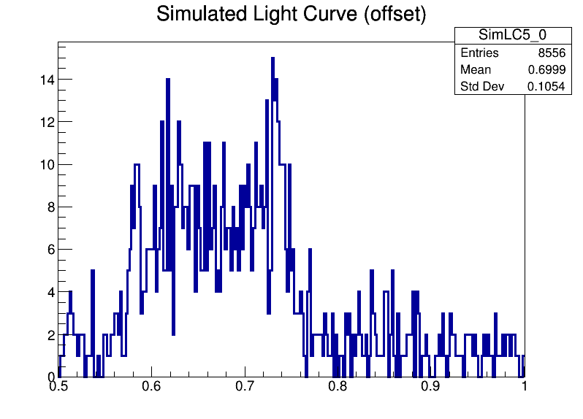
Localisation feasibility
10-1000 keV
9 satellite constellation
Semi-major axis: 6878.14 km
Inclination: 53 deg
RAAN: 0, 120, 240
True Anomaly: 0~320
(40 deg step)
sat0 – sat1
Preliminary!
sat0 - sat2
GRB!
sat2
sat0
sat3
sat0 – sat3
sat1
0.5
Time since trigger (s)
1.0
Satellite attitude, GRB position, predicted photon count/arrival time estimated using orbit and detector simulations.
Simulated photon arrival time is estimated by the cross correlation analysis ➔ triangulation annulus
Ohno et al. 2018

Slide 15
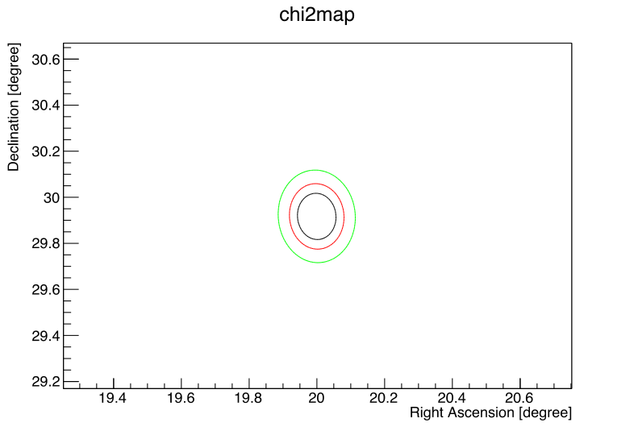
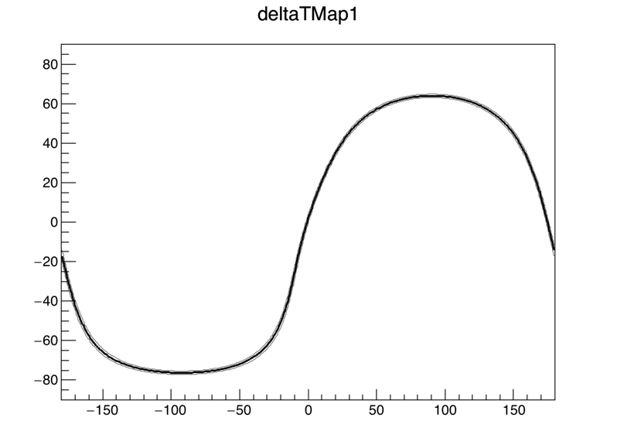
Localisation algorithm
Intersection of annuli
➔ GRB position!
*: input position
1, 2, 3 σ region
Preliminary!
*
How can we estimate the most probable position and error ?
GRB position and error is estimated by simple χ² minimization (Tanaka+ 17)
~0.1 deg_{1σ} (~6 arcmin) accuracy is achievable for bright/high-visibility case
Best fit position
R.A. = 20.0 (+/- 0.06) deg
Dec. = 29.9 (+/-0.10) deg
Ohno et al. 2018

Slide 16
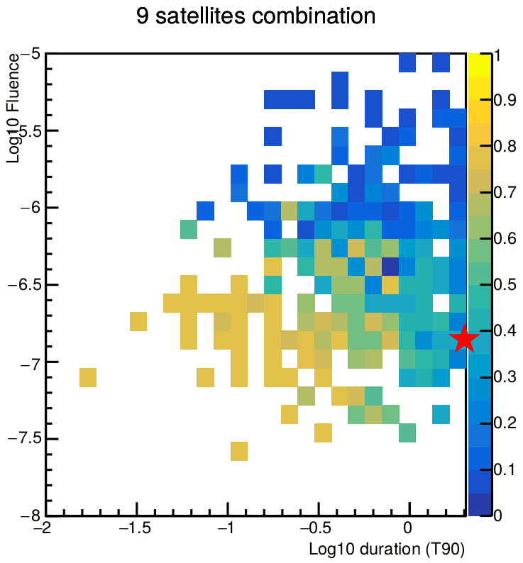
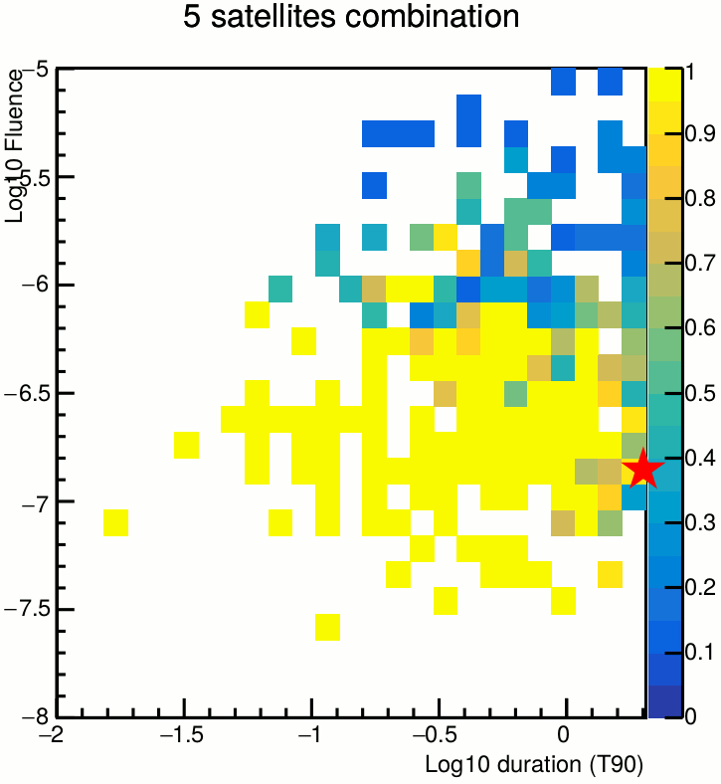
Localisation accuracy
-5
-5
GRB brightness (log Fluence)
GRB brightness (log Fluence)
Loc. Accur. (deg)
Loc. Accur. (deg)
NS-NS merger
GRB170817A
GRB duration (log T₉₀)
GRB duration (log T₉₀)
Localization accuracy of our concept is examined for all short GRBs listed in Fermi 3rd GRB Catalog (Bhar+16 T₉₀<2s: 326 events)
High localisation accuracy for good photon statistics (brighter/longer)
5-10 arcmin accuracy in the best case
Ten short GRBs per year localised to within 20 arcmin
Ohno et al. 2018

Slide 17
Summary
We are proposing the CAMELOT mission, a constellation of nine 3U cubesats in three orbital planes on low Earth orbit, to provide an all-sky coverage and ~10 arcmin localisation accuracy
Each nanosatellite shall be equipped with four thin, 9 mm, and relatively large, 8.3 × 15 cm, CsI(Tl) based detectors as lateral extensions on its surface read out by MPPCs. The large thin detectors provide high sensitivity (comparable with Fermi-GBM), while leaving enough room for electronics.
Timing based localisation demands precise time synchronization between the satellites and accurate time stamping of detected photons. This will be achieved by using GPS receivers.
Rapid localisation by gamma-ray observations is critical for the study of GW sources
Rapid follow up observations at other wavelengths require the capability for fast simultaneous downlink of data for the triggered events from all satellites in the fleet. This can be achieved using satellite-to-satellite communication networks such as Iridium NEXT.
CAMELOT will also provide important secondary science, such as monitoring of outbursts of soft gamma-ray repeaters, gamma-ray flares on the Sun, terrestrial gamma-ray flashes (produced in thunderstorms), and space weather phenomena.
CAMELOT provides ample potential for international cooperation. Because the proposed fleet is scalable and extendable, we envision collaboration with future partners using different satellite designs, extending the capabilities of the constellation.
Werner et al. arXiv: 180603681
Ohno et al. arXiv: 180603686
Pal et al. arXiv: 180603685
Torigoe et al. 2018, NIMPA, in press

